Slide 1

World Summit on the Information Society (WSIS) Forum 2013
WSIS Forum 2013:
Open Consultation Process
Final Briefing
16 APRIL 2013
www.wsis.org/forum
ROOM H, ITU, Geneva, Switzerland

Slide 2




WSIS Forum 2013
13-17 May 2013, Geneva
Unique multistakeholder global platform to discuss, coordinate and facilitate implementation of WSIS
WSIS Forum 2013 will attract more than 2,000 delegates, including more than 50 ministers and several senior representatives from private sector and civil society
Outcome Document published on the last day of the WSIS Forum provides strategic guidance and will identify Emerging Trends in the 11 WSIS Action Lines

Slide 3

WSIS Forum 2013: 13-17 May, Geneva
Open Consultation Process
8 October 2012: Opening of the Open Consultations:
  Online Dialogues on the WSIS Knowledge Communities
  Official submissions at www.wsis.org/forum
16 November 2012: First Physical Meeting
21 January 2013: Deadline for Submission of the Official Contributions and binding Requests for Workshops
15 February 2013: Final Review Meeting
16 April 2013: Final Brief on the WSIS Forum 2013
13–17 May 2013
GENEVA

Slide 4
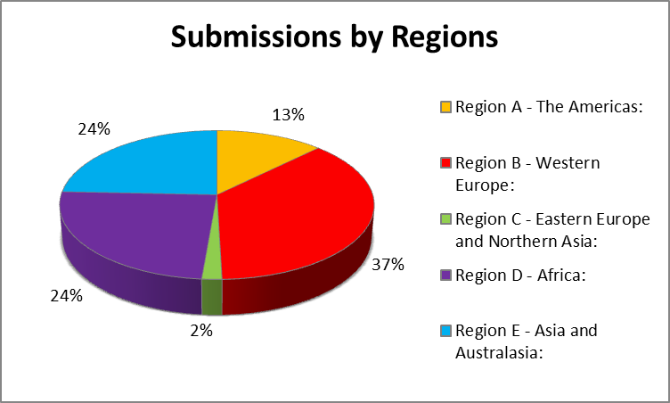
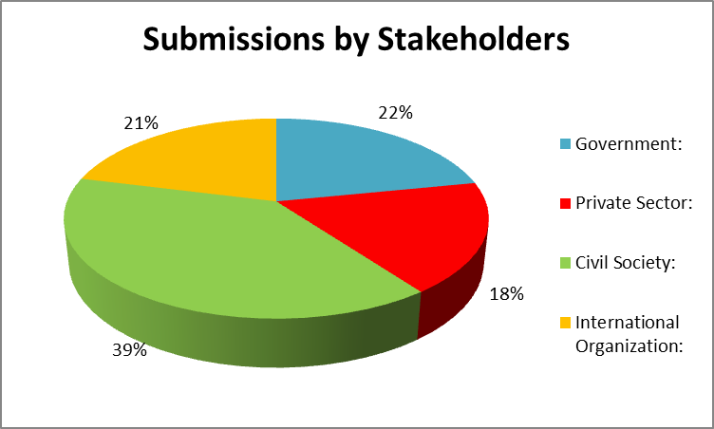
WSIS Forum 2013:Open Consultation Process
Official Submissions received : 170

Slide 5
WSIS Forum 2013: Agenda
 | 13 May | 14 May | 15 May | 16 May | 17 May
AM | Opening Ceremony | AL/CW/TW | WSIS+10 Plenary | AL/CW/TW | WTISD
AM | HL Opening Segment | AL/CW/TW Partnership | AL/CW/TW | AL/CW/TW | ALF Meeting
AM | HL UNGIS / Press Conference | WL-UNGIS | WSIS+10 Visioning Challenge | WSIS+10 Visioning Challenge | ALF Meeting
PM | Lunch / Exhibition Group Photograph | Lunch / Publication | Lunch / Publication | Lunch / Publication | Lunch
PM | AL/CW/TW | HL Dialogues / Ministerial RT | HL Dialogues | HL Substantive Sessions | WSIS+10
PM | AL/CW/TW | AL/CW/TW | AL/CW/TW | AL/CW/TW | Certificates
PM | Reception | Gala Dinner |  |  | Closing
* WTPF is co located with the WSIS Forum 2013

Slide 6
WSIS Forum 2013 and
Events in Parallel
13 May | 14 May | 15 May | 16 May | 17 May
WSIS FORUM 2013 AM: CICG PM: ITU | WSIS FORUM 2013 AM: CICG PM: ITU | WSIS FORUM 2013 AM: CICG PM: ITU | WSIS FORUM 2013 AM: CICG PM: ITU | WSIS FORUM 2013 AM: CICG PM: ITU
 |  |  |  | WTISD (ITU)
Strategic Dialogue (CICG)
 | WTPF (CICG) | WTPF (CICG) | WTPF (CICG)

Slide 7










WSIS Forum 2013: Type of Sessions
High Level Dialogues
Interactive Session
Thematic Workshop
Action Line Facilitators
Meetings
WSIS+10
Knowledge Exchange
Action Line Facilitation
Meetings
Ministerial Roundtable
Country Workshop
Exhibition

Slide 8
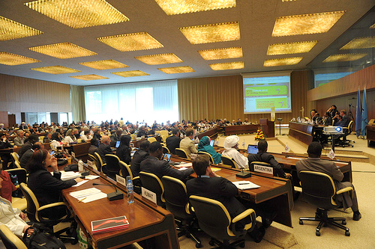
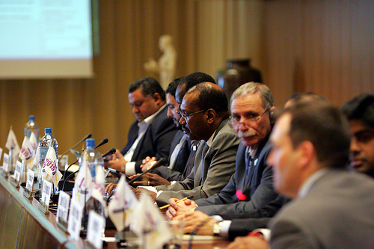
WSIS Forum 2013: 13-17 May, Geneva
High Level Dialogues and Substantive Sessions
Women's Empowerment in the
Information Society
Smart climate monitoring: Expanding access to information on weather, climate and water
ICT Innovations and Standards: Creating technology for the next three billion
Securing Cyberspace in a borderless world: Vision 2015 and Beyond
ICT in Post 2015 Goals
Youth and ICTs

Slide 9

WSIS Forum 2013: WSIS+10 Visioning Track
Opening Segment
(13 May 2013)
Ministerial round table
(14 May 2013)
Two WSIS+10 Visioning plenary sessions
(15/17 May 2013)
WSIS+10 Visioning Challenge: WSIS Beyond
2015 (15/16 May 2013)
www.wsis.org/review

Slide 10
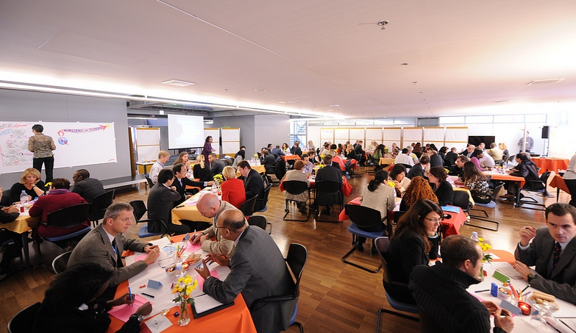
WSIS +10 Visioning Challenge
A new meeting format
’’ITU’s innovative collaborative tool’ Dr Hamadoun Touré
www.wsis.org/review

Slide 11

WSIS +10 Visioning Challenge
Meetings that create vision
Collaborative conversation as a core process
Understand complexity and test ideas together
Include the views of all stake-holders
Highly interactive
Generate many innovative ideas
Informal and all-inclusive
Facilitate connection and networking
www.wsis.org/review

Slide 12


WSIS+10 Visioning Track: Expected Outcomes
WSIS+10 Visioning Challenge: Set of recommendations developed through the multi-stakeholder and consensus based approach shaping WSIS process review requirements to be addressed during the WSIS+10 High Level Event (2014)
WSIS+10 Communique
WSIS Forum 2013 Outcome Document: Compilation of recommendations from all sessions with special focus on recommendations for WSIS+10.
Identifying Emerging Trends and a WSIS Beyond 2015
2013 Edition
www.wsis.org/review

Slide 13



WSIS Beyond 2015 and Post MDGs
High Level Substantive Session on the Post 2015 and WSIS
(16 May 2013)
Ministerial Round Table
(14 May 2013)
WSIS+10 Visioning Plenary
Sessions Two (17 May 2013)
WSIS+10 Visioning Challenges
(15/16 May 2013)
www.wsis.org/review

Slide 14
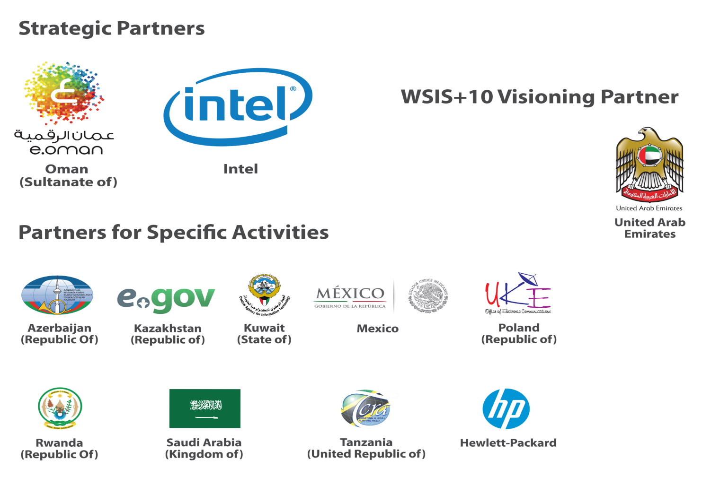
Partners of WSIS Forum 2013

Slide 15
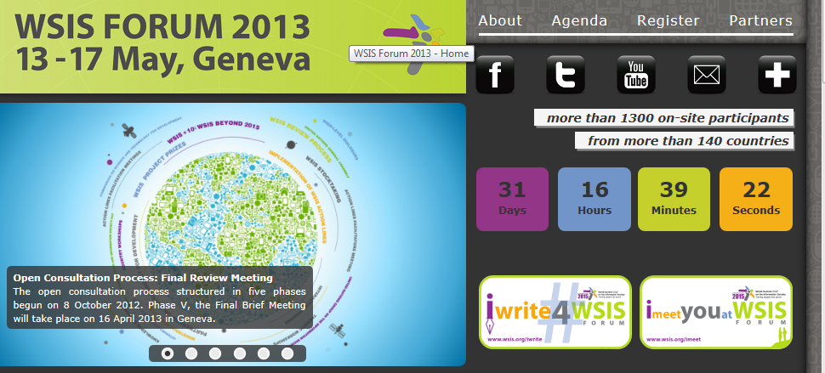
WSIS Forum 2013 Registration
Please register here
Complete your profile

Slide 16
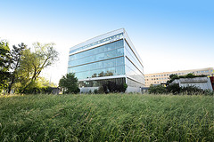
WSIS Forum 2013: Registration Venue
VENUE: ITU MONTBRILLIANT BUILDING ENTRANCE
TYPE of BADGE: with photo and RFID
IMPORTAND: Diplomatic badge will not be valid
Opening hours of badging desks:
Friday 10 May 2013: 14.00-17.00 hours
Sunday 12 May 2013: 15.00-18.00 hours
Monday 13 May 2013: 07.30-12.00 and 13.30-17.00 hours
Tuesday 14 May 2013 to
Friday 17 May 2013: 08.30-12.00 and 13.30-17.00 hours.

Slide 17


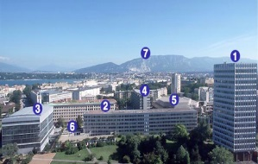
WSIS Forum 2013: Venue
Registration: ITU MONTBRILLIANT BUILDING
Opening Ceremony: CICG (13 May, AM)
NOTE: From 14 May CICG is accessible only by WTPF participants
Ministerial Round Table: CCV (14 May, AM)
All WSIS Sessions from 13 May (PM): ITU Buildings

Slide 18
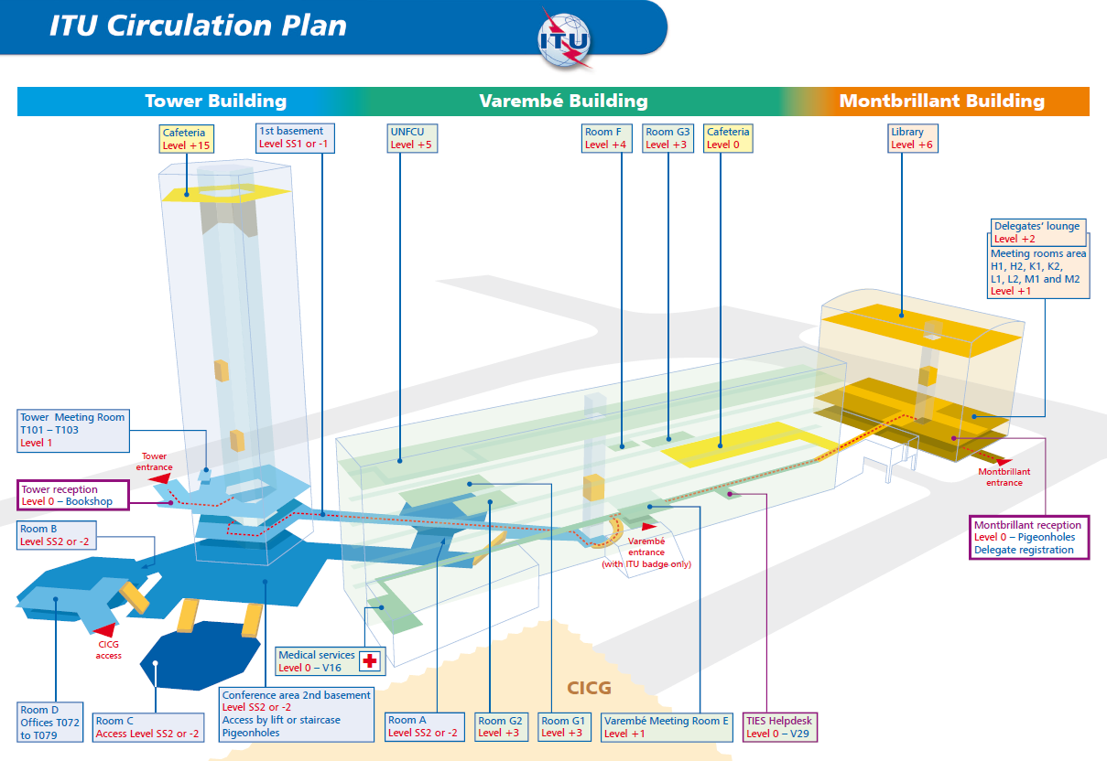
ITU Circulation Plan
An ITU Circulation plan is available on the WSIS Forum 2013 Website. This provides a detailed map of all the rooms that will be used during WSIS Forum 2013.
www.itu.int/wsis/implementation/2013/forum/ocp/finalbrief.html
>> Venue Information >> ITU circulation plan

Slide 19

WSIS Stocktaking Reporting
Reporting on latest WSIS related activities from all over the world
WSIS Stocktaking Report 2013 will be released on 14th May @WSIS Forum 2013
Session on WSIS Stocktaking @WSIS Forum-Best practices to build inclusive information Society on 13th May
www.wsis.org/stocktaking

Slide 20

WSIS Project Prizes 2013
More than 280 projects nominated
18 winners to be announced at the
Prize Ceremony on 13th May 2013
New Report on the WSIS Success Stories launched on 14th May 2013
Showcasing Theater – Four sessions at the WSIS Forum 2013
Exhibition space for winners
www.wsis.org/prizes

Slide 21

WTPF-13 and Strategic Dialogue
13-16 May 2013 , CICG
All information available: http://www.itu.int/wtpf-13
Online registration at http://www.itu.int/en/wtpf-13/Pages/participation.aspx
Registration desk will be located at ITU Montbrillant
Registration will be open on Friday 10 May from 14:00-to 18:00, on Sunday 12 May from 15:00 to 18:00 and as of Monday 13 May 2013: 07.30-12.00 and 13.30-17.00 hours. Tuesday 14 May 2013 to Friday 17 May 2013: 08.30-12.00 and 13.30-17.00 hours.
Registration is via Focal Point
Permanent mission badges will not be valid to enter CICG.

Slide 22
WTPF-13: Important Information
WTFP will be conducted in a paper less manner. Requests to receive documentation should be submitted to sg-registration@itu.int by 29/04.
Comments by the membership on the Secretary-General’s Report: in order to ensure the timely translation and thorough consideration by delegations, written contributions to be presented during the Forum should be sent to wtpf2013@itu.int by 29 April 2013. Contributions should not exceed three pages.
Ministers wishing to address the Forum during its first day to present their vision on any of the theme addressed in the Secretary-General’s Report should inform the ITU Secretariat at wtpf2013@itu.int of their interest to speak and the topic they would like to focus on.

Slide 23
Country Presence
Opening Segment (13th May) (Ministerial Level)
WSIS Forum 2013 Official Reception (13thMay)
Ministerial Round Table (14th May)
WSIS +10 Plenary Session (15th May)
WSIS+10 Visioning Challenge (15th and 16th May)
Country Workshops
High Level Dialogues

Slide 24
WSIS Forum 2013: Checklist
Register to the WSIS Forum 2013
Promote your activities using #WSIS
Use effectively imeetYou@WSIS and registration system for arranging bilateral meetings with onsite participants
Use remote participation component effectively (training will be provided)
Ensure that Administrations, Ministers, Stakeholders are well briefed the Forum 2013 and WSIS+10 Review Process. Please do not hesitate to ask for more information or bilateral briefing
Remind your delegation to book hotel as soon as possible

Slide 25




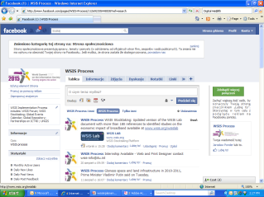
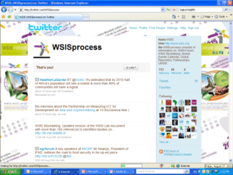
WSIS Process : Publicity and Outreach
  Customer Relationship Management System
      WSIS Flash (WSIS Implementation Process Monthly Newsletter)
  Social Networking tools
      iwrite4WSIS Forum: Twitter – @WSISProcess #WSIS
      imeetyouatWSIS Forum
      Facebook
      Linkedin

Slide 26
WSIS Secretatiat:Contact
Email : wsis-info@itu.int
WSIS Forum : www.wsis.org/forum
WSIS Review: www.wsis.org/review
WSIS Stocktaking: www.wsis.org/stocktaking
ITU-WSIS: www.itu.int/itu-wsis

