Slide 1


Mrs Susan Schorr,
Head, Special Initiatives Division
BDT / IEE / SIS

Slide 2

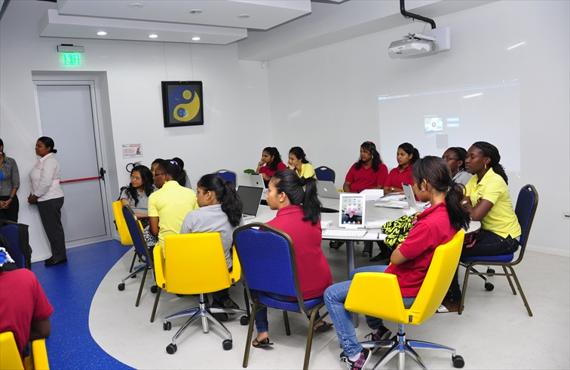
Plenipotentiary Resolution 70
4th Thursday of April
Create a global environment that empowers and encourages girls and young women to consider careers ICTs.
Notes:
International Girls in ICT Day, celebrated on the fourth Thursday of April every year, is an initiative backed by ITU Member States in Plenipotentiary Resolution 70 (Guadalajara, 2010) to create a global environment that empowers and encourages girls and young women to consider careers in the growing field of information and communication technologies (ICTs).

Slide 3
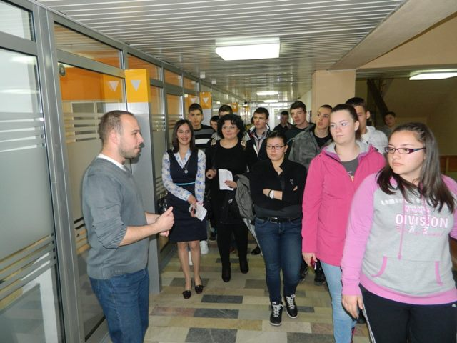

The ITU BDT has developed the Girls in ICT Portal at www.girlsinict.org which houses practical information for girls and young women considering a career in ICTs
Notes:
In 2011 ITU launched the multilingual Girls in ICT Portal focused to support girls and women to prepare for careers in the fast-growing information and communication (ICT) sector.
The Girls in ICT Portal houses some 500 programmes, including over 100 scholarship programmes and some 70 contests and awards, more than 100 training and internship opportunities, over 100 online networks offering career support and mentoring, as well as tech camps and other activities.

Slide 4
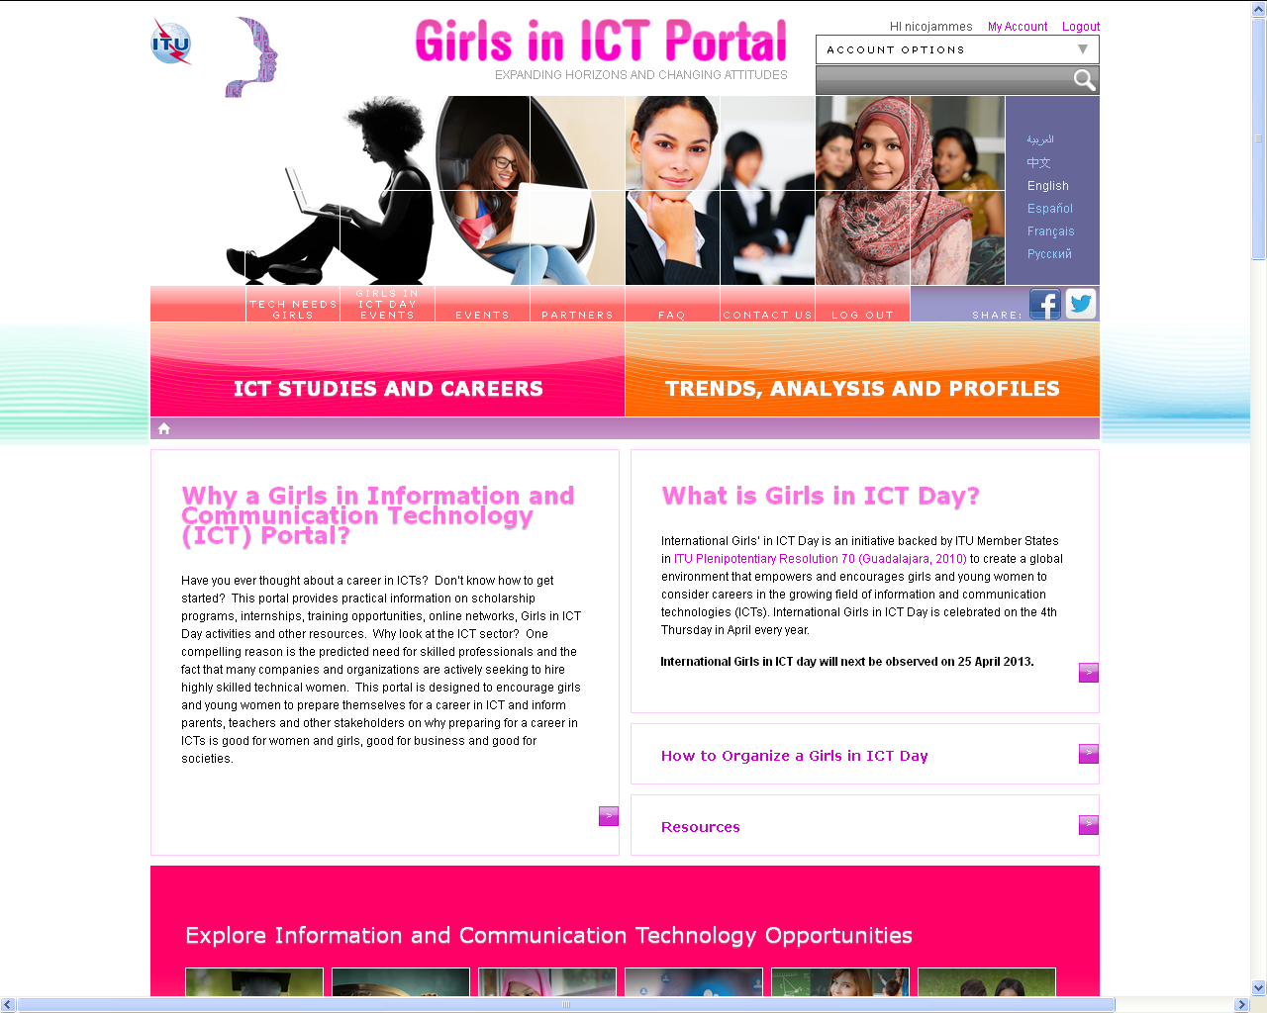
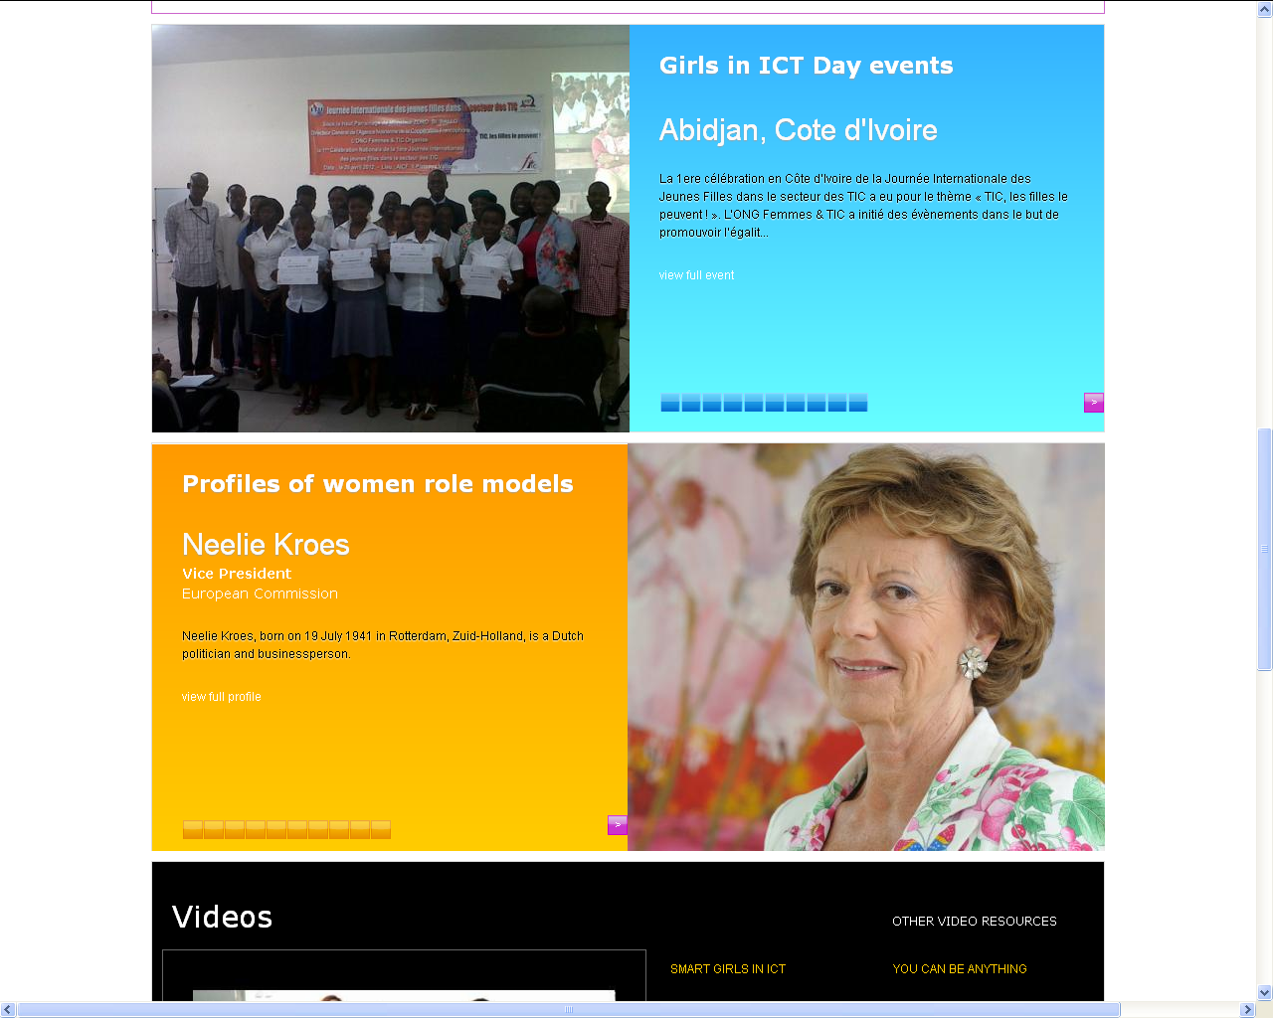
Notes:
The Girls in ICT Portal contains many different pieces of information on the ICT sector and ways to attract girls and young women to the sector.
As you can see on the picture, information is available on how to organise Girls in ICT Day events and also resources and promotional materials available for download. There also profiles of women role models in ICT, a showcase of Girls in ICT Day events held in 2012, reports and white papers as well as links to partners organisations.

Slide 5
A Bright Future in ICTs Opportunities for a new generation of women
This report:
  surveys global trends in women’s professional development and employment in ICT sector
  Explains why we need to engage more women, and
  Identifies national policies and private sector initiatives to attract, retain and promote women in ICT careers
Notes:
This report surveys the global trends in women’s professional development and employment in the information and communication technology (ICT) sector, and offers a sample of the range of national policies, training programs and initiatives targeting girls and women as potential students and professionals. The key points arising from this research are divided into:
key findings – status report
expanding horizons with government support
the future of jobs in the ICT sector.

Slide 6
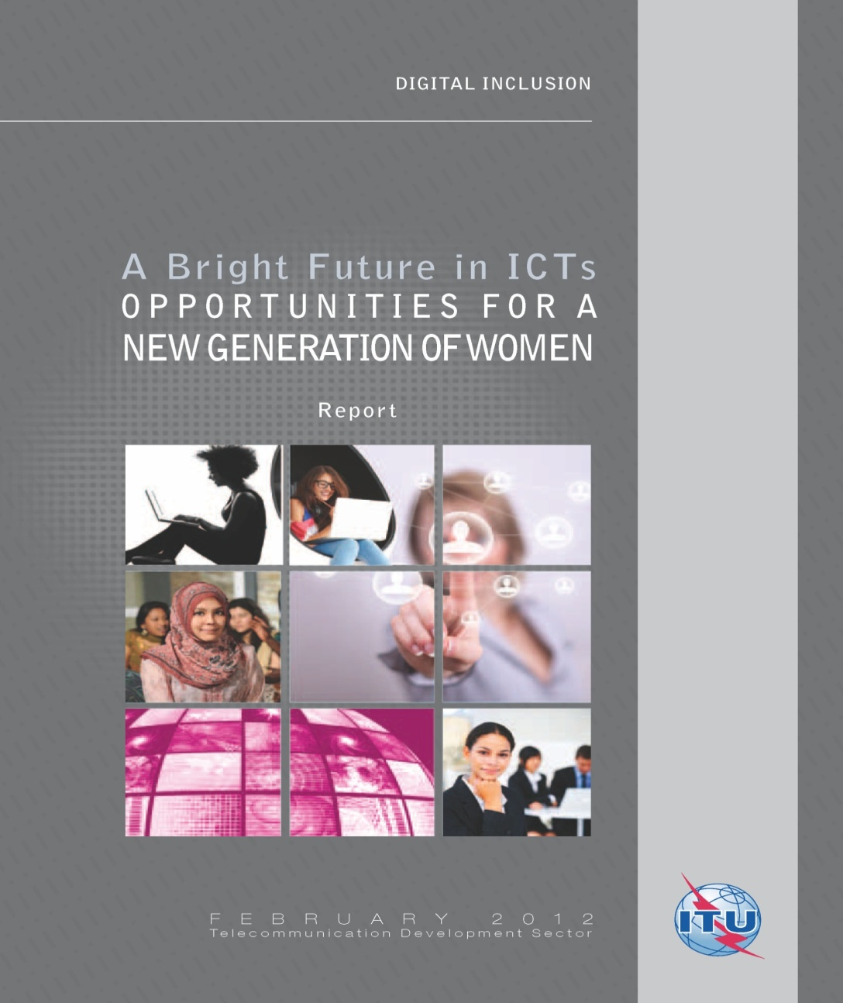
Notes:
This report can be downloaded directly from the Girls in ICT Portal, in the 6 UN languages

Slide 7
What is a Girls in ICT Day event?
An event where teenage girls and university students are invited to spend the day at the office of ICT companies, government agencies and academic institutions
or to invite women who have a successful career in the ICT sector to share their experiences, or offer practical experiences.

Slide 8

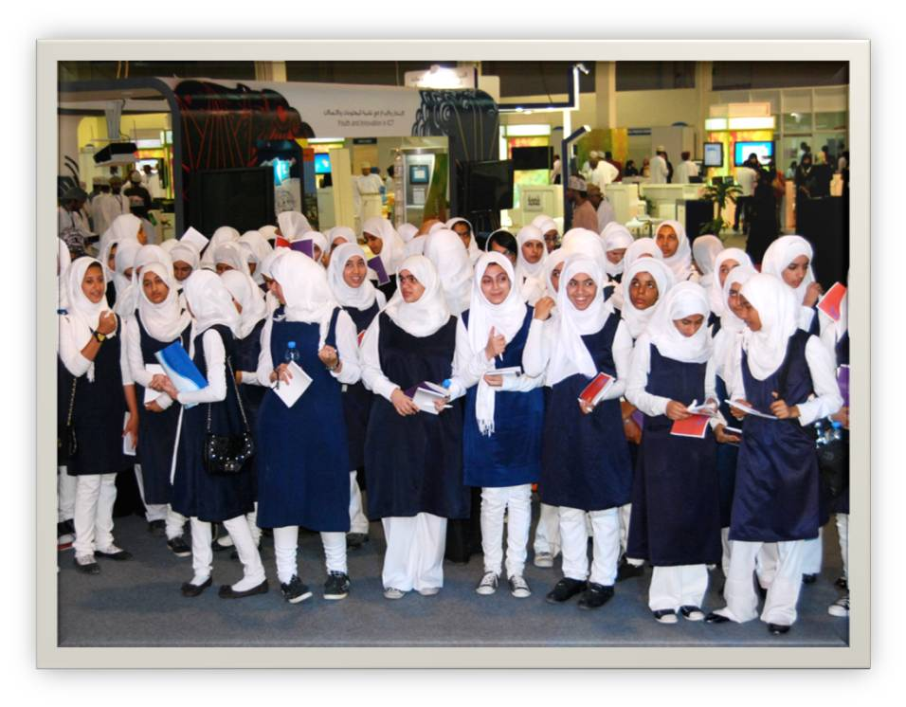
Girls in ICT Day 2012
Almost 90 countries involved
More than 30,000 girls directly empowered
Some 1,320 events organized worldwide
Notes:
In 2012, on or around 26 April 2012, International Girls in ICT Day saw 1,320 events organized worldwide in nearly 90 countries, with over 30,000 girls being directly empowered with a better understanding of the exciting opportunities a career in ICTs holds for them.

Slide 9
Women in ICT Careers Strategy
Increase demand among girls and women for ICT careers through Girls in ICT Day and using media
Increase the number of girls and women who receive STEM education, ensure supply,
Encourage ICT businesses to attract, recruit, retain and promote women, achieve long-term sustainability.
Notes:
As part of this strategy, ITU will continue to encourage its members to organize international Girls in ICT days. These events are essential to raise visibility and build widespread national support for women in ICT careers. Moving to the next level, the strategy will leverage the power of media to create unprecedented, game-changing, demand for ICT careers by producing films and TV programs that feature women characters with successful ICT careers, girls who use ICTs for their empowerment as well as video games that build in such characters. Of course, increasing demand alone is not enough. Stakeholders need to ensure that educators are teaching STEM to women and girls and that ICT businesses commit to attract, recruit, retain and promote women.

Slide 10
Women in ICT Careers Strategy
The ITU Women in ICT Careers Strategy includes the following elements:
Promotion of International Girls in ICT Day on the ^{4th} Thursday of every April
European Parliamentary Hearing in Brussels on International Girls in ICT Day 2013
Enhancement of the Girls in ICT Day Portal (www.girlsinict.org)
Notes:
Promotion of International Girls in ICT Day on the ^{4th} Thursday of every April
This year the European Commission, European Parliament and the International Telecommunication Union are joining forces to ensure maximum visibility for the Day. We warmly encourage all stakeholders to organise activities around Girls in ICT Day. This is a way to raise visibility and build widespread support for women in ICT careers, on a local, national, regional and global scale. And if you are doing something worthy at your level, we would like to know! As part of the event, the European Parliament will organise a hearing on Women in ICT that will be streamed live online.
2. Enhancement of the Girls in ICT Day Portal, (www.girlsinict.org) as a resource-based tool that includes programmes to support women and girls in ICT careers as well as profiles of women role models, partner organizations, videos and information about Girls in ICT Day events held worldwide and other related events, including those organized by stakeholders;

Slide 11
Women in ICT Careers Strategy
ICTs can be used in a myriad of ways to empower women and girls.
ITU and its partner Telecentre.org Foundation launched the Women’s Digital Literacy Campaign to train 1 million poor women to become digitally literate.
Notes:
Promoting women in ICTs is not the end of the story. ICTs can be used in a myriad of ways to empower women and girls. ITU and its partner Telecentre.org Foundation launched the Women’s Digital Literacy Campaign to train 1 million poor women to become digitally literate. The success of this campaign has unleashed demand by the newly-digital literate women for additional tools to enable them to use ICTs for their empowerment, in the form of employment, entrepreneurship, addressing climate change, providing health services and more. In addition, a growing number of women continue to seek digitally literacy training and need your help.

Slide 12
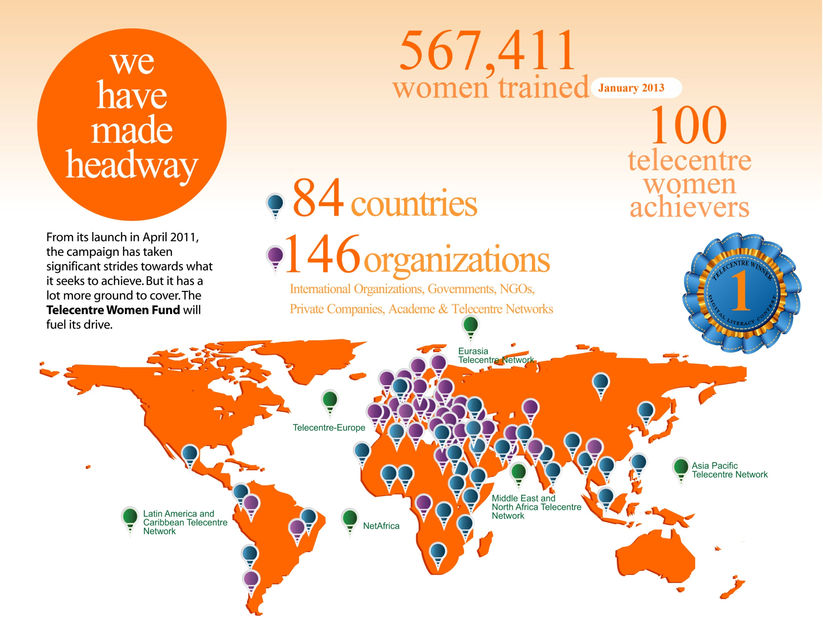
Notes:
From its launch in April 2011, the ITU – Telecentre.org campaign has taken significant strides towards what it seeks to achieve, but it has a lot more ground to cover.By January 2013, the number of women trained globally has reached 567,411.

Slide 13
Women in ICT Careers Strategy
ITU invites all stakeholders to join forces to respond to the growing demand for empowering women and girls through ICTs.
If you are running programmes designed to empower girls and young women through ICTs, please let us know and be part of the Girls in ICT network!
Raise awareness around you!
Contact us at girlsinict@itu.int
Notes:
ITU invites all stakeholders to join forces to respond to the growing demand for empowering women and girls through ICTs. Please contact us at girlsinict@itu.int to see how your current efforts could be featured on the TNG website and to expand our on-going efforts throughout ITU and to encourage women and girls to gain access to ICT tools for their empowerment and design and develop ICTs to create their own brighter future.

Slide 14
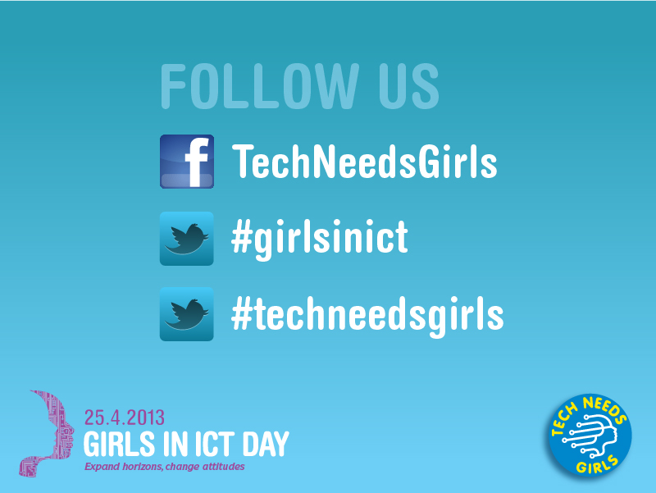
More information
Please contact us at girlsinict@itu.int
The Girls in ICT Portal, a one-stop shop for girls and women looking for information www.girlsinict.org
On Twitter: #GirlsinICT or #TechNeedsGirls
On Facebook: www.facebook.com/TechNeedsGirls

