Slide 1

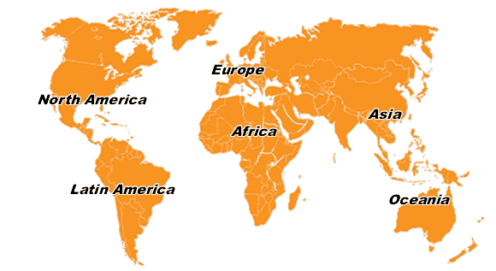
ECO council
(Funding)
ECO
Java programmer
WGSE
Issue contract
Chairmanship
Planning
Maintenance
Product distribution
Implementation
Term of reference
Feedback
Enhancement
STG
Technical expertise, testing, etc...
Priority settings
Promotion
Reporting
New features
Feedback
ECC PT’s
Feedback
Testing
Enhancement
SEAMCAT users

