Slide 1
Overview of CDMA – OFDMA
European Communications Office
Jean-Philippe Kermoal - SEAMCAT Manager (ECO)
27 November 2012
(Jean-Philippe.Kermoal@eco.cept.org)
EUROPEAN COMMUNICATIONS OFFICE | Nansensgade 19 DK-1366 Copenhagen Denmark | Telephone: + 45 33 89 63 00 Telefax: + 45 33 89 63 30 | E-mail: eco@eco.cpet.org Web Site: http://www.cept.org/eco

Slide 2
Outline
Commonalities
Conclusion
Exercise #1 - CDMA
Exercise #2 - OFDMA
CDMA System
OFDMA System

Slide 3
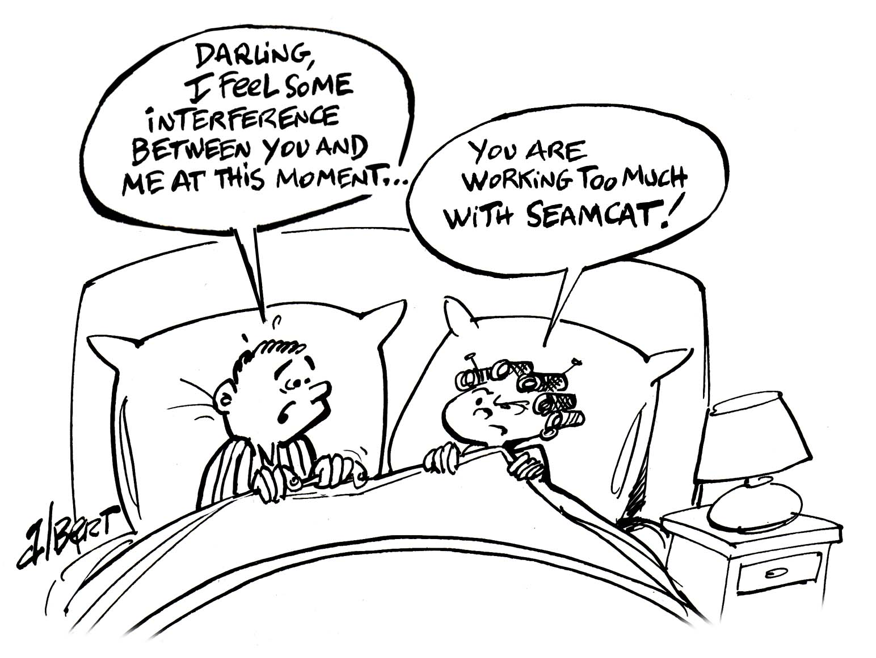
Commonalities
CDMA/OFDMA GUI overview
Cellular topology
Pathloss / Effective Pathloss
Reference cell

Slide 4
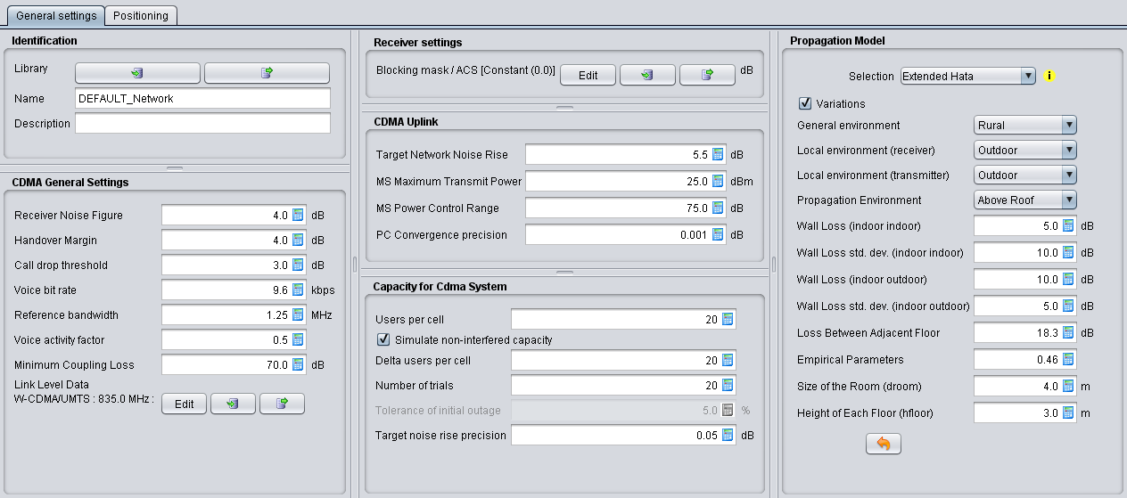
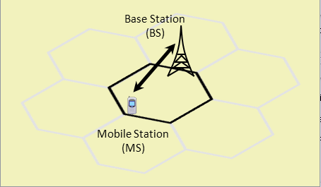
CDMA/OFDMA GUI (1/2)
2 tabs: General settings and Positioning

Slide 5
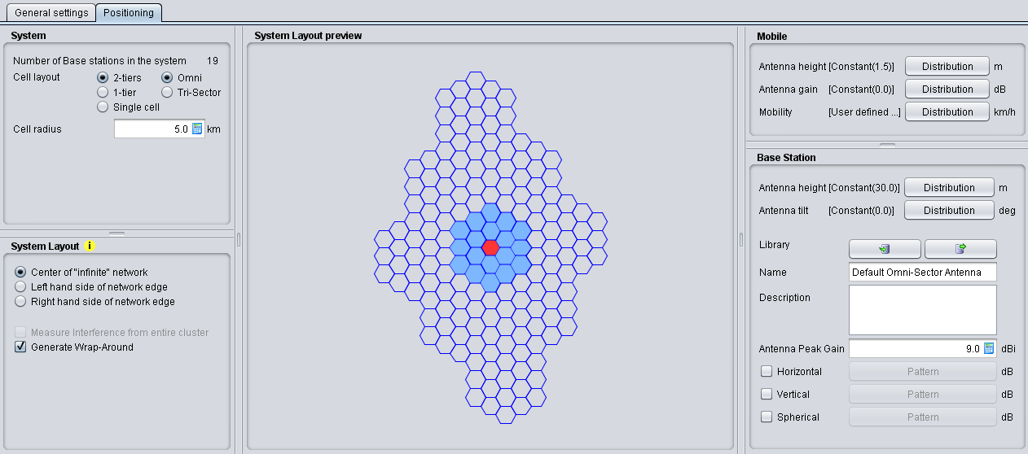
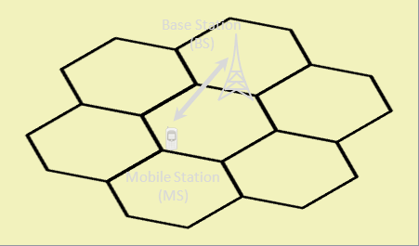
CDMA/OFDMA GUI (2/2)
Common interface for both CDMA and OFDMA

Slide 6
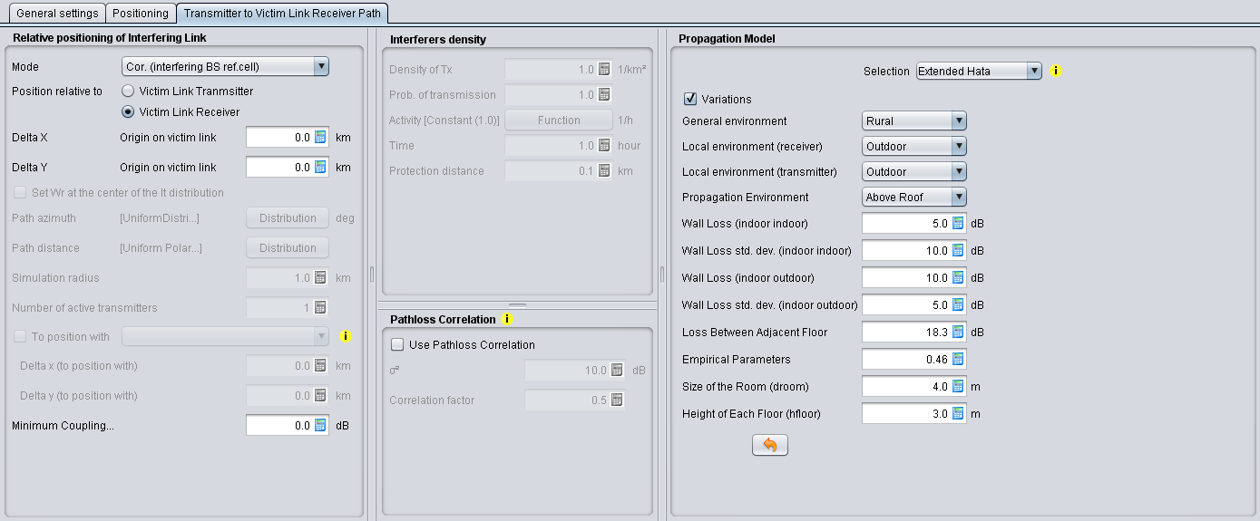
3rd tab when interferer

Slide 7
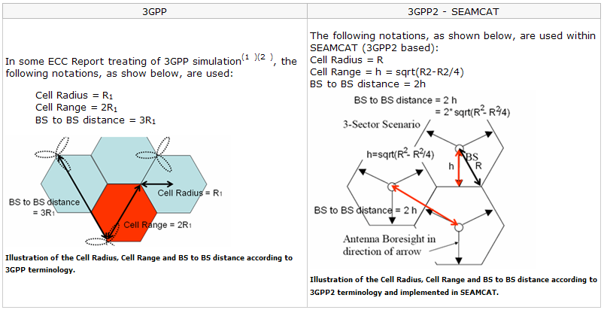
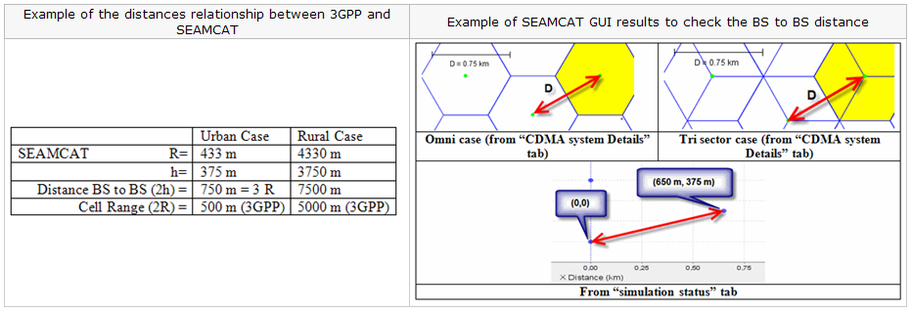
SEAMCAT cellular topology

Slide 8
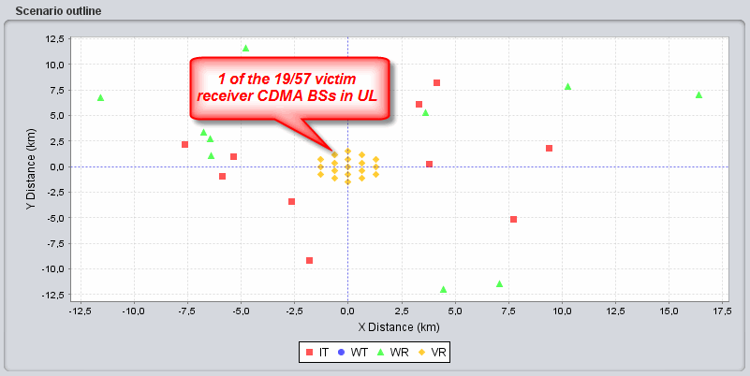
Modelled cellular system
Interferer-Victim distance
Other radio system, counter-part in interference simulation
Modelled cellular system (i.e. CDMA or OFDMA)
Two auto-generated tiers of auxiliary CDMA cells

Slide 9
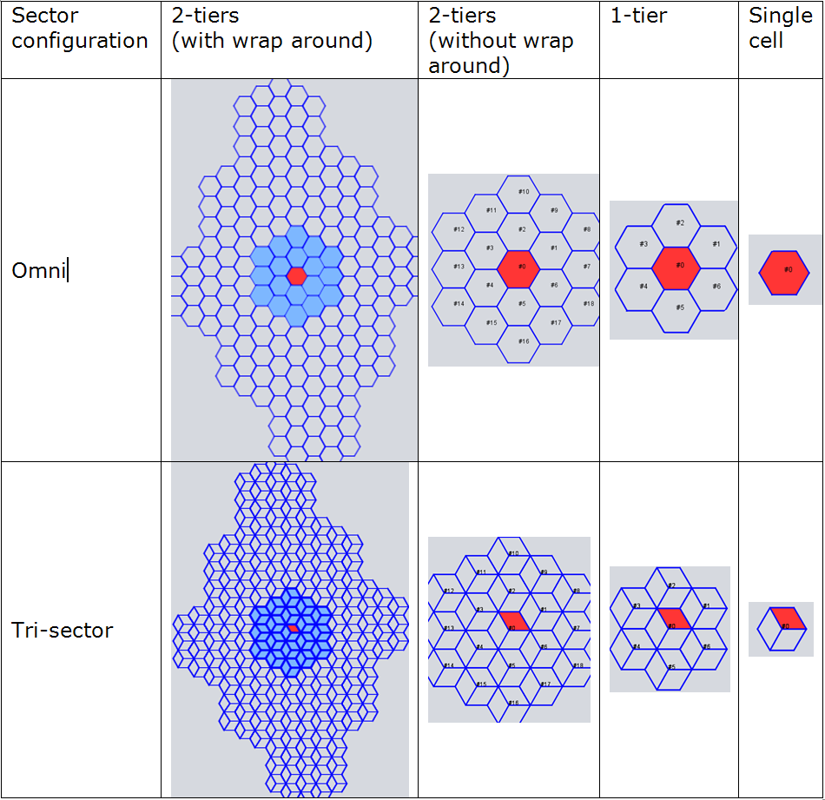
Several options
Application of Wrap-Around technique for calculation of distance to closest BS produces effect of “endless” uniform network
Only available in 2-tiers option

Slide 10
Pathloss/Effective Pathloss
Distinction between the raw pathloss and the effective pathloss.
The MCL is the parameter describing the minimum loss in signal between BS and UE or UE and UE in the worst case and is defined as the minimum distance loss including antenna gains measured between antenna connectors.
Typical values of MCL can be found in 3GPP documents.

Slide 11
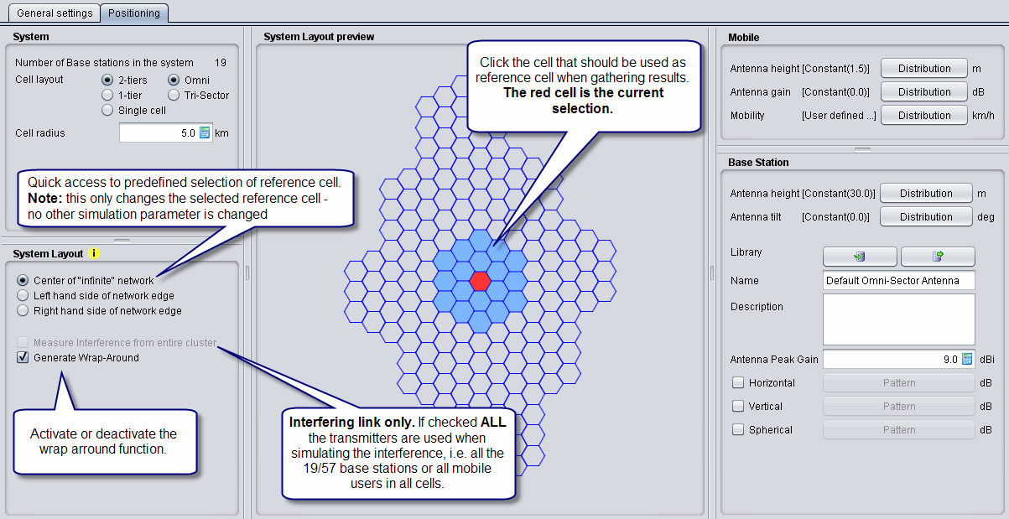
Reference Cell
The ref.cell is used to measure results
All none reference cells are used to provide a proper interference background to the ref.cell.

Slide 12
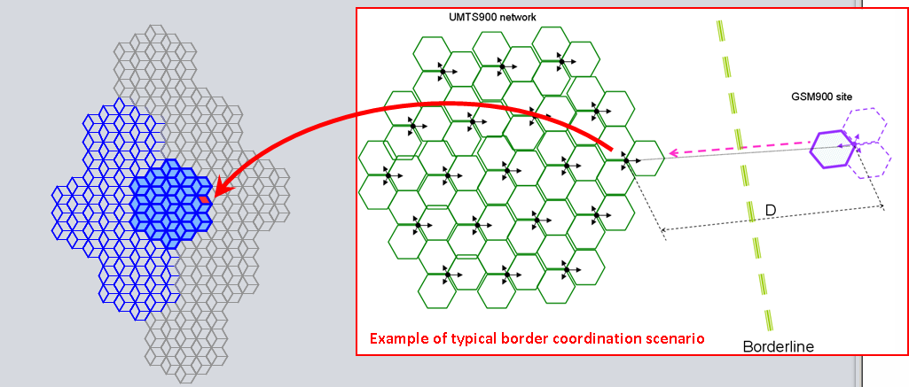
Network-edge case
Instead of centre cell, takes the cell at the edge cluster as a reference cell
Wrap-around formulas adjusted as if no other cells are located beyond that cell
cross-border or similar interference scenarios

Slide 13
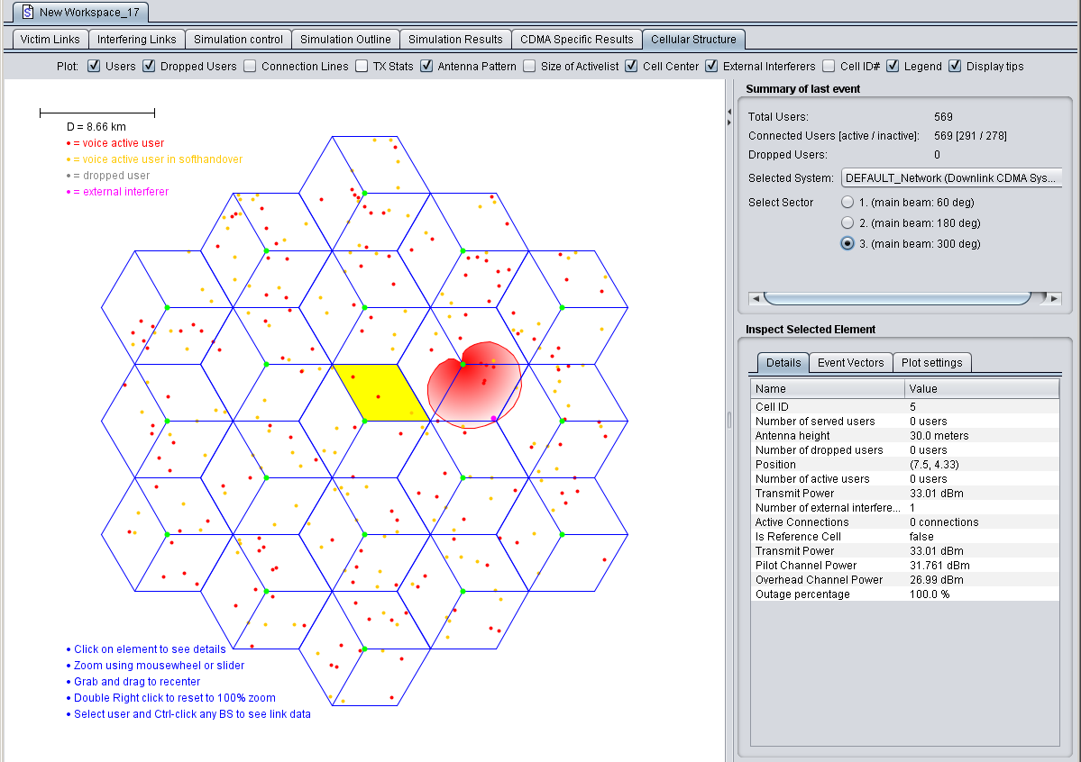
Cellular system last event
legend
BS antenna
legend
BS or MS info display
Detailed insight into simulated data for modelled CDMA/OFDAM system
General system info:
Cell specific info
Connected - voice active user
Active link
Inactive link
Dropped user
CDMA interferer

Slide 14
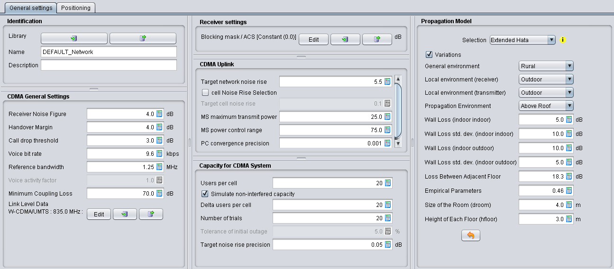
CDMA – GUI

Slide 15
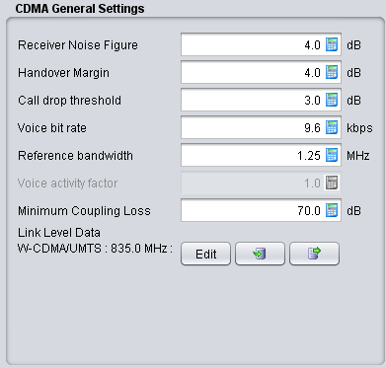
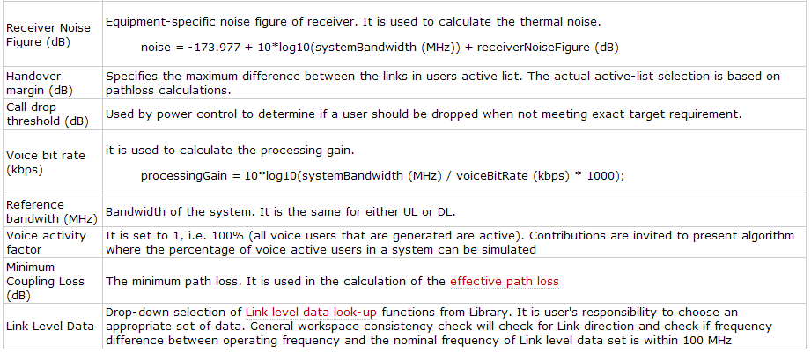
CDMA - General Settings

Slide 16
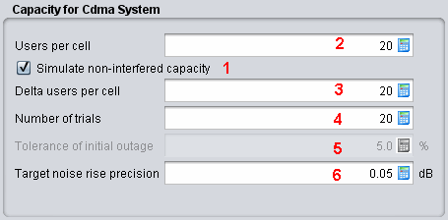
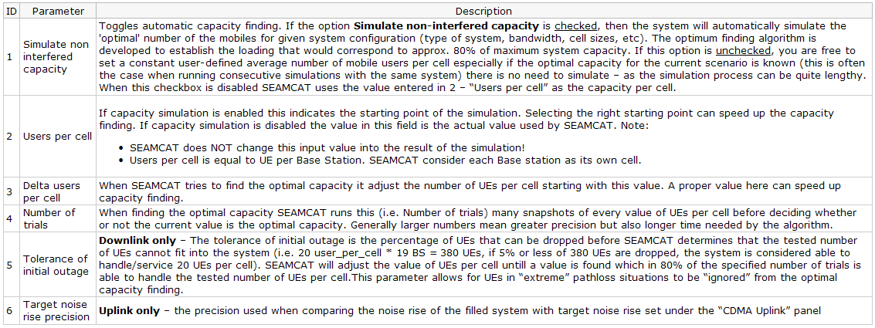
CDMA capacity finding

Slide 17
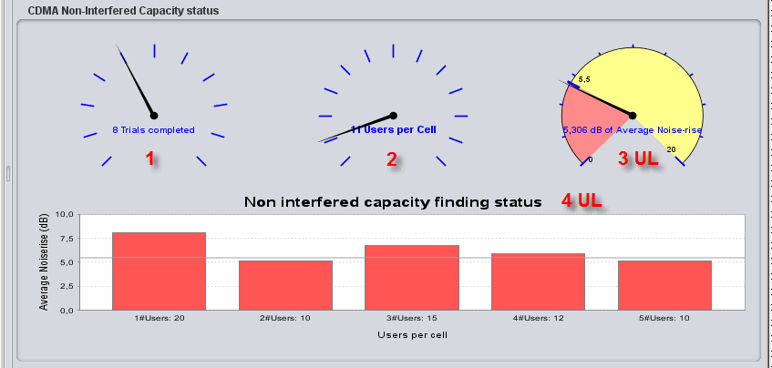
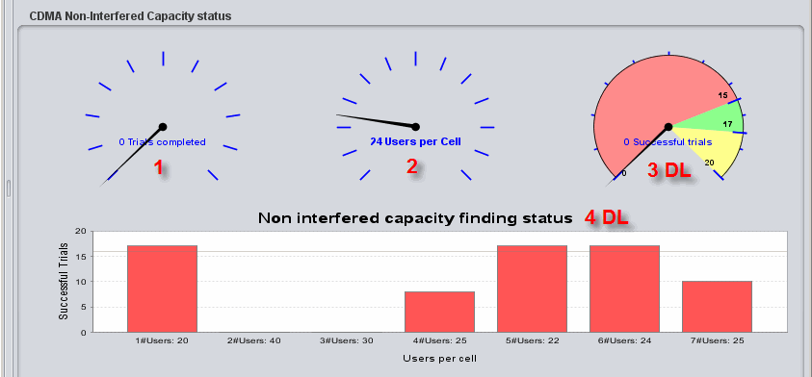
CDMA UL and DL as victim
CDMA UL
CDMA DL
Noise rise is measured as the linear average of dB values – across all 19/57 base-stations
Number of users that can fit into the system in 80% of the trials.
Red: <80% has been reached (i.e. too many users in the system – or not all trials yet complete)
Green: =80%
Yellow: >80% of the trials are successful (too few users in the system).
SEAMCAT stops when this dial stops in the green area after all trials completed.

Slide 18
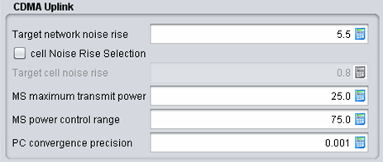
CDMA UL – network noise rise
Interferering cellular network
Measure the noise rise over the whole network
Adapted to
Remove the users with highest power over the whole network to level out the network noise rise
Victim cellular network

Slide 19
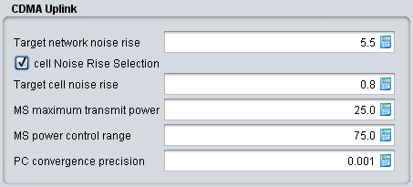
CDMA UL – cell noise rise
Single Interferering source
Measure the noise rise in each cell
Adapted to
Select cells with highest cell noise rise
Victim cellular network
Iteratively, from cell to cell, remove the users with highest power in the cell to level out the network noise rise

Slide 20
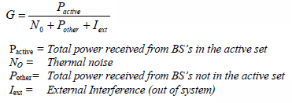
CDMA Link Level Data
Link level results are independent of most system level variations (cell sizes, amplifier ratings, antenna types, etc.) → applicable to a wide variety of network configurations.
Maps link quality to channel power.
Geometry: users in favorable locations (high geometry) may require less power than users that are in unfavorable locations (low geometry).

Slide 21
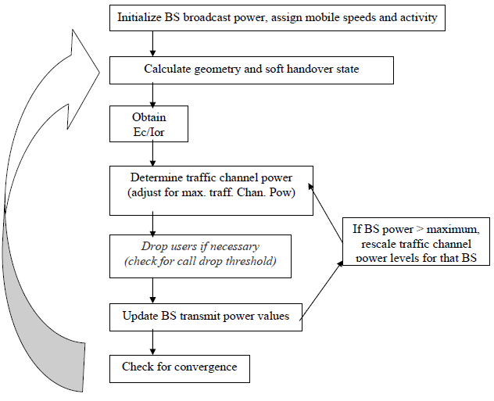
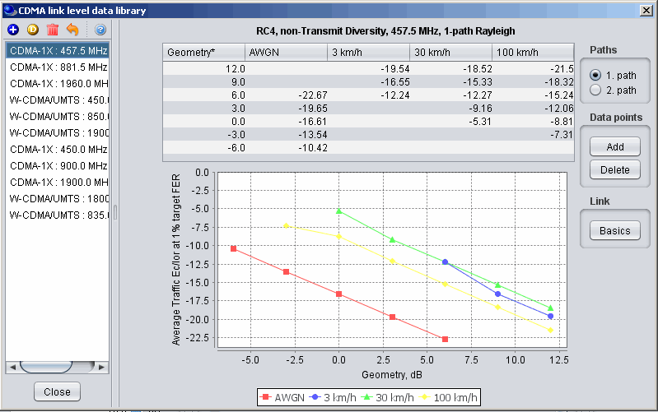
LLD - DL
Downlink → Ec / Ior requirements

Slide 22
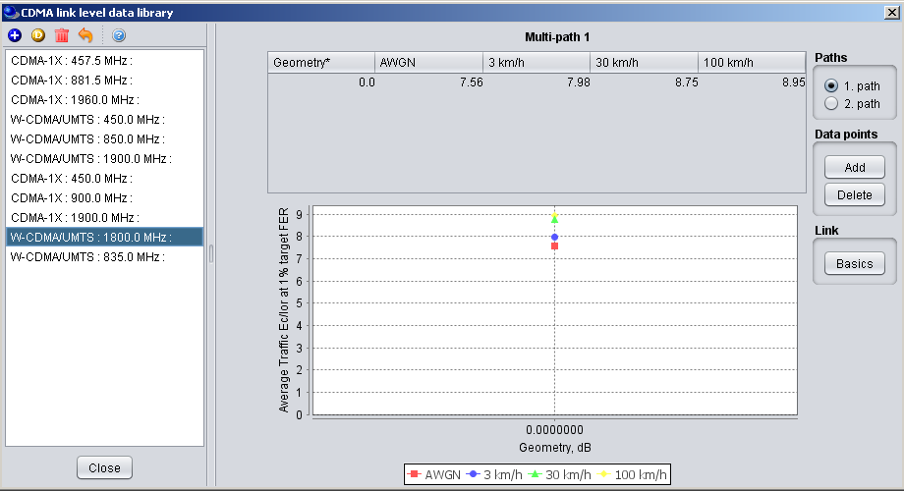
LLD - UL
Uplink → Eb / No requirements
Closed-loop fast transmit power control (TPC) is supported in uplink. The base station estimates the signal-to-interference ratio (C/I), measured in bit energy-to-noise density ratio Eb/N0, and compares it to a target value (Eb/N0_target).
If the estimated C/I is below Eb/N0_target, the base station commands the mobile station to increase the transmit power; if the measured C/I is above Eb/N0_target, it commands the mobile station to lower its power.

Slide 23
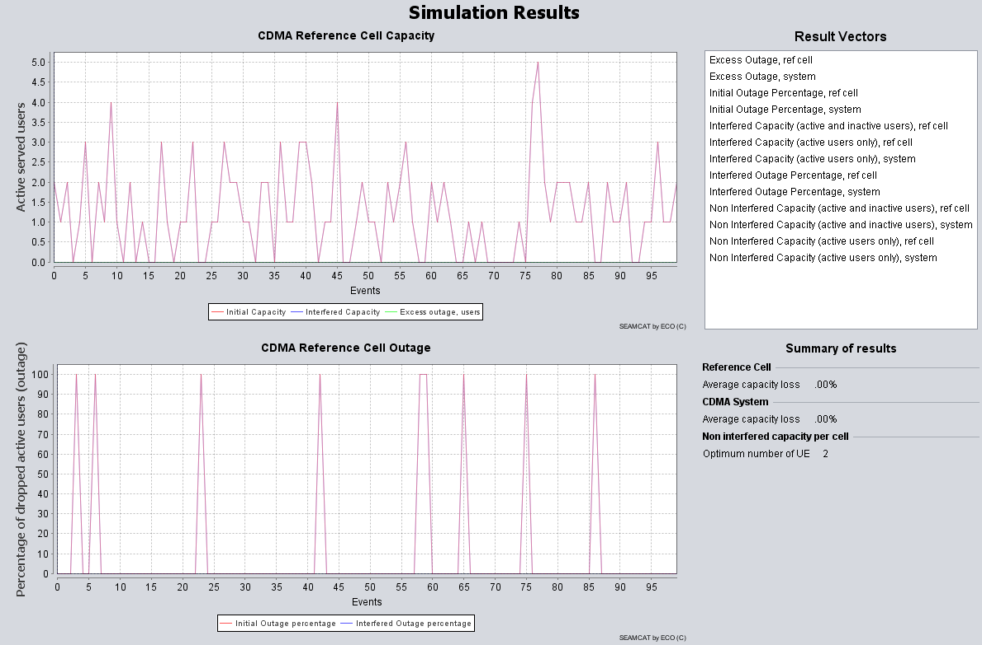
CDMA results
Initial capacity: Number of connected UEs before any external interference is considered.
Interfered capacity: Results after external interference is applied.
Excess outage, users: How many UEs were dropped due to external interference.
Outage percentage: Percentage of UEs dropped due to external interference.

Slide 24
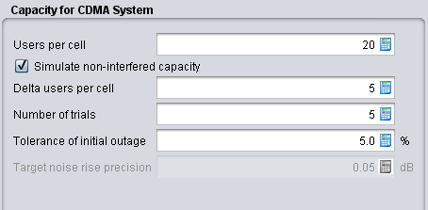
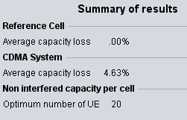
Exercise #1 - CDMA
Victim: CDMA DL – default value
Delta users per cell: 5
Number of trials: 5
Interferer: default
Simulation control: 5 events (fast)

Slide 25
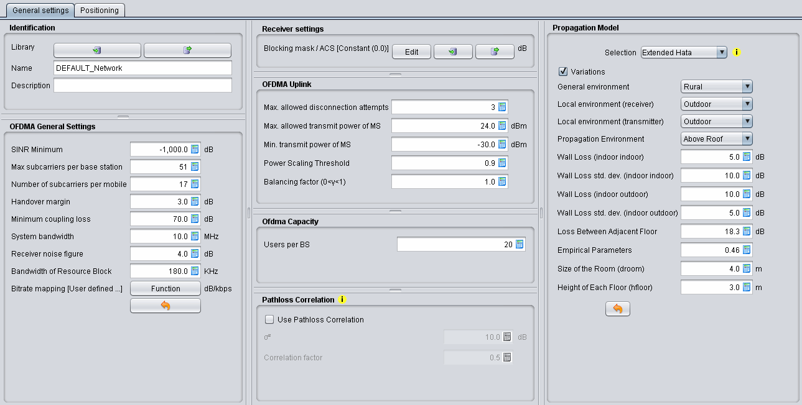
OFDMA - GUI

Slide 26
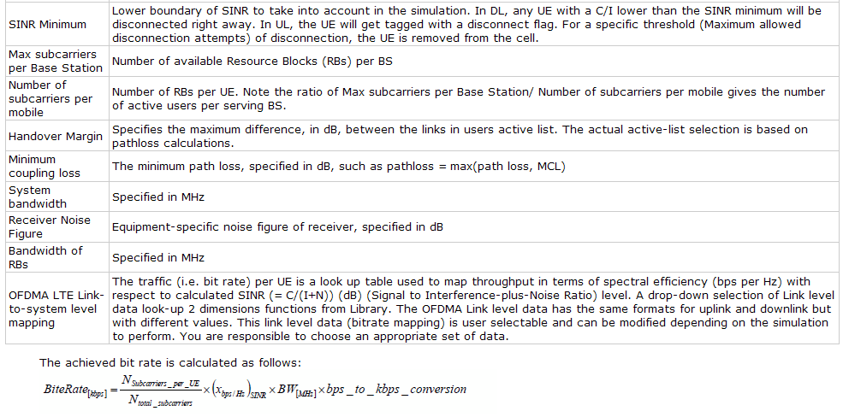
OFDMA – General settings

Slide 27
OFDMA capacity
Defines how many mobiles per cell should be generated in the system. For each BS, each UE will be added to served UE list of that BS. Depending on the propagation or handover conditions, a UE will either remain connected to the BS or will be disconnected.
THIS IS NOT the number of active users

Slide 28
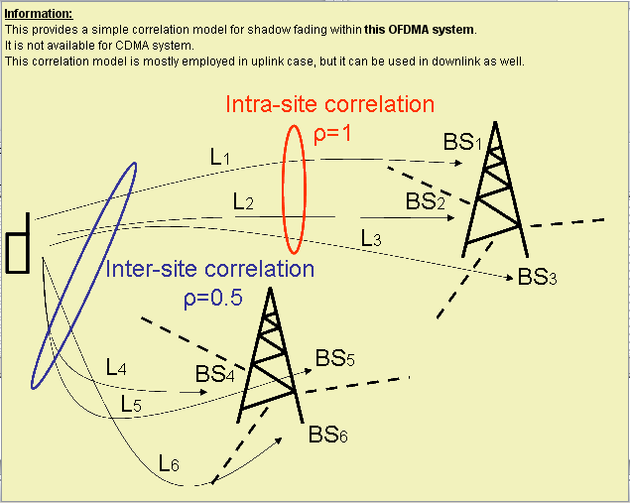
Pathloss Correlation
The concept of a simple correlation model for shadow fading has been widely adopted in LTE co-existence studies mostly employed in uplink case.

Slide 29
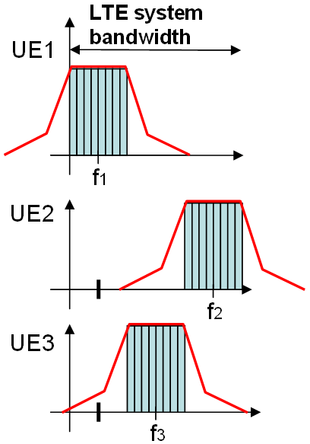
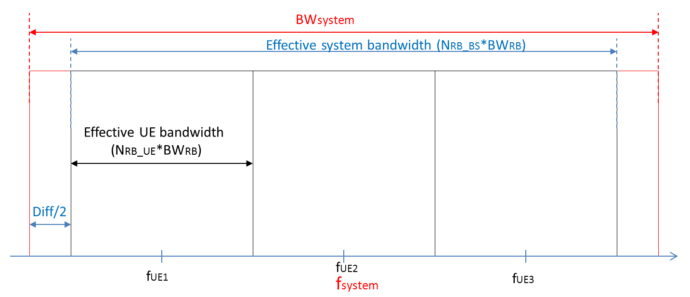
Frequency UL

Slide 30
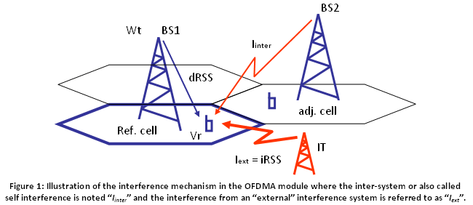
OFDMA DL SINR
Adjacent cell interference

Slide 31
OFDMA UL SINR
In UL each LTE user will be transmitting its own RB. It is assumed that each UE transmit the same amount of RBs therefore they have the same emission spectrum mask.
OFDMA UL = victim system. The interferer will impair each of the signals transmitted by the UEs serving its own BS (i.e. the victim BS). Therefore, for a specifc link (UE1 to BS1) the interference caused by an external interferer will only affect the spectrum occupied by the RBs allocated to UE1 for that link and not the whole system bandwidth at BS1.

Slide 32
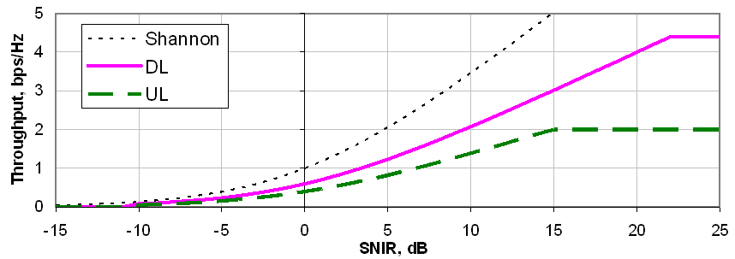
LTE Link-to-system level mapping
A look up table is used to map throughput in terms of spectral efficiency (bps per Hz) with respect to calculated SINR (= C/(I+N)) (dB) level.
This link level data (bitrate mapping) is user selectable and can be modified depending on the simulation to perform.

Slide 33
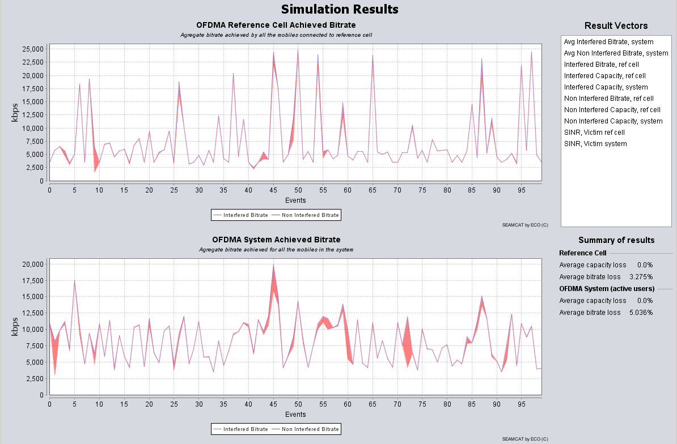
OFDMA results
Capacity results +
Non interfered bitrate: bitrate before any external interference
interfered bitrate: bitrate after external interference is applied.

Slide 34
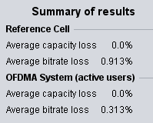
Exercise #2 - OFDMA
Victim: OFDMA DL
5 active users (with 50 subcarrier per BS)
Capacity (Initial users per BS):10
Interferer: DVB-T BS
Power = 55 dBm
SEM: DVB-T
Simulation control: 30 events (fast)

Slide 35
Conclusions
Simplified cellular layout
Versatile tool to configure victim and interferer
Parameters received from ECC PT1 (STG(10)53)
SEAMCAT returns the following results
Victim system | Intereference criteria
Classical (i.e. non CDMA/OFDMA module) | Probability of interference based on C/I, C/(I+N), (N+I)/N, I/N
CDMA | Capacity loss (i.e. number of voice users being dropped)
OFDMA | Bitrate loss (i.e. number of bit rate lossed compared to a non interfered victim network) Capacity loss (i.e. number of voice users being dropped)

Slide 36
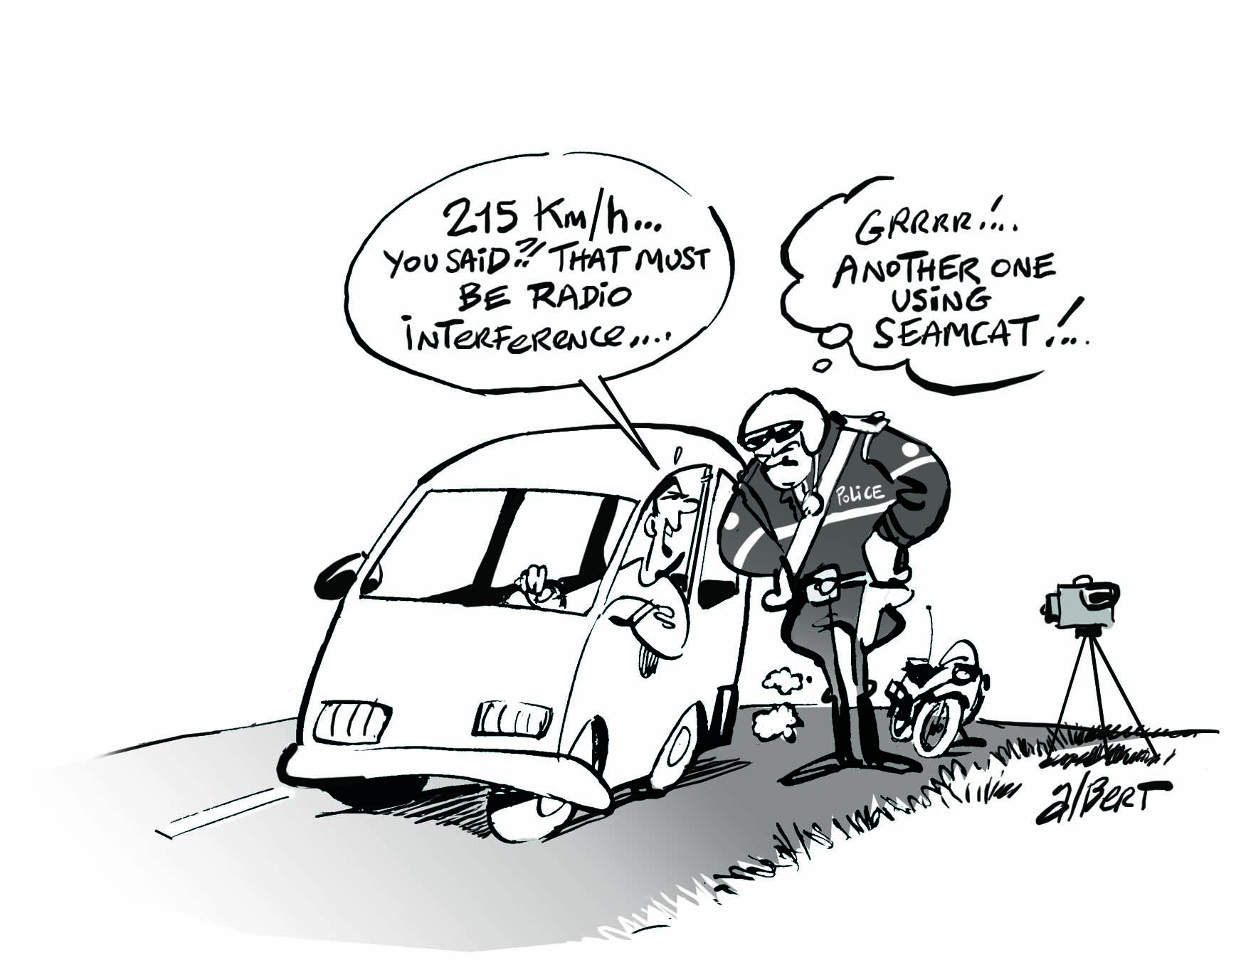
Thank you - Any questions?

