Slide 1
SEAMCAT Benchmarking and Quality control
European Communications Office
Jean-Philippe Kermoal - SEAMCAT Manager (ECO)
10 February 2014
(Jean-Philippe.Kermoal@eco.cept.org)
EUROPEAN COMMUNICATIONS OFFICE | Nansensgade 19 DK-1366 Copenhagen Denmark | Telephone: + 45 33 89 63 00 Telefax: + 45 33 89 63 30 | E-mail: eco@eco.cept.org Web Site: http://www.cept.org/eco

Slide 2
Overview
Tractool: collect any feedback from users (i.e. Possible error, verified error, enhancement, new feature, editorial, task, clarification)
Benchmarking: Ensure that the code are the same from one release to another. Any changes is detected and carefully analysis (wanted or unwanted change)
Quality control: Ensure that the implementation respect the specification defined by STG, i.e. that the algorithm is corrected, 2+2 = 4
Solution: Junit

Slide 3
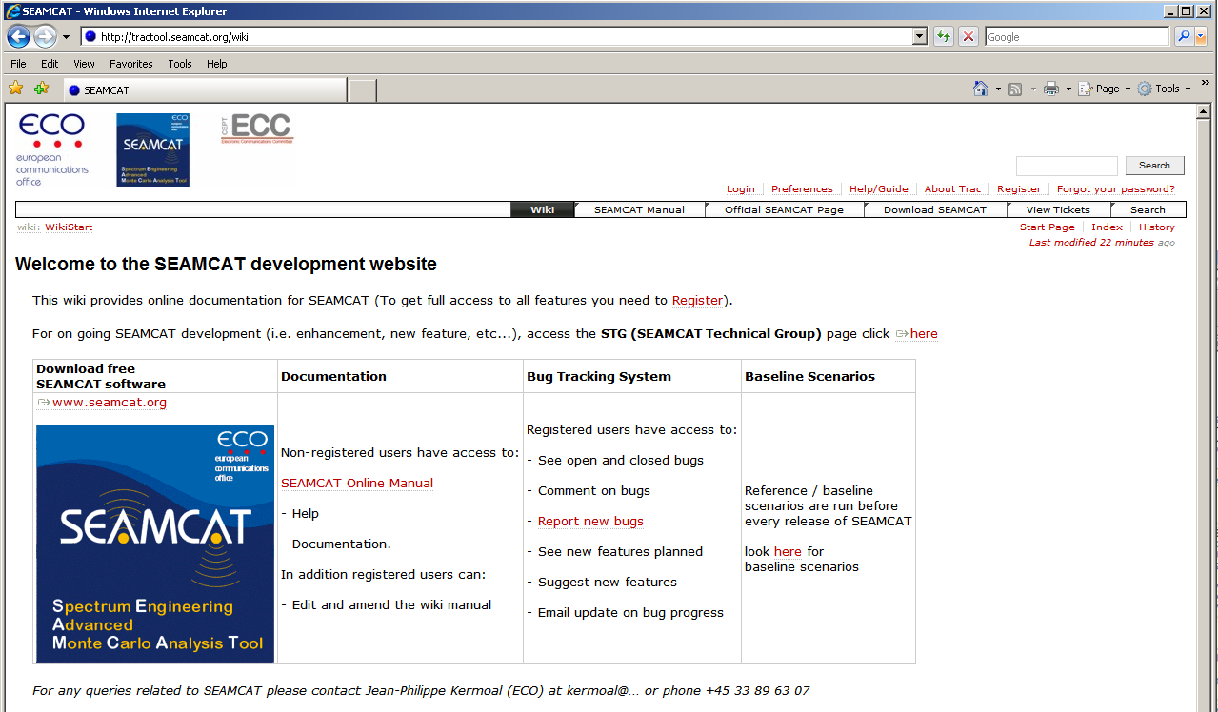
On-Line management based database

Slide 4
TracTool
Ticket based project and service desked management
Web based interface used to keep track of all technical SEAMCAT development tasks
Available for all registered users to follow at: http://tractool.seamcat.org
Report bugs and keep track of resolutions
Provides detailed information on the changes incorporated into every new release
History of changes to the code available

Slide 5
Benchmarking
Before any official release, a mandatory benchmark routine is performed.
Allow controling that no unintended changes have been made
Allow checking that changes are due to modification requested by STG
187 workspaces are being tested (Feb 2014).
Administrations are encouraged to provide, through STG, new workspaces to be added to the list.

Slide 6
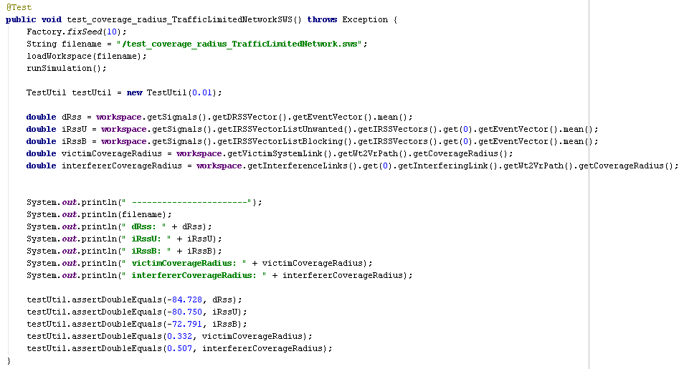
Example of a benckmark
Calling a specific workspace
Extract parameters to be compared
Print results during testing
Compare calculate values with expected results

Slide 7
Benchmarking
Passed/failed results
Sequence of 187 workspaces
Printed results
Environment: IntelliJ IDEA

Slide 8
Interim benchmarking
Early 2014, interim benchmarking will be performed automaticaly for each commit.
During any commit of a new codes, SEAMCAT will be crossed checked.
Day benchmark: specific workspaces are selected as they are more likely to be affected by the changes made (generic or CDMA/OFDMA) (about 10 min)
Night benchmarking: all the workspaces are checked (about 3 hours)
Between 2 official release, it can happen that 20 to 50 or more commits have been done.

Slide 9
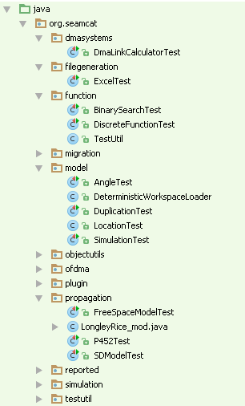
Quality control
Ensure that the implementation respect the specification defined by STG
Investigates small module of SEAMCAT
Propagation model
Angle calculation
Etc...

Slide 10
Example: ITU-R P.452
input
output

Slide 11
Conclusion
ECO has a record of changes to the tool since 2007
1151 tickets have created (10 Feb. 2014).
Transparent process
STG is responsible for benchmarking and quality control of SEAMCAT
STG reports to WGSE on work status and future planning
Benchmarking and quality control has made SEAMCAT a robust and professional interference calculation software
Strategic tool to the CEPT

