Slide 1
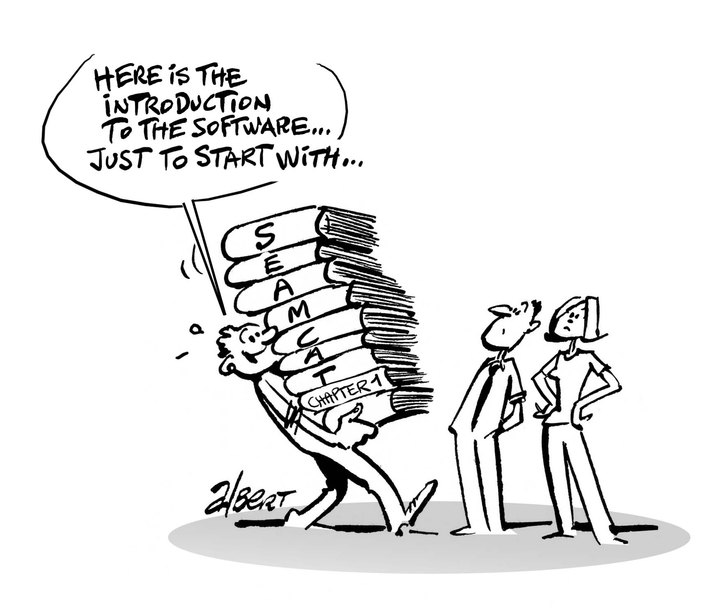
Introduction to SEAMCAT
European Communications Office
Jean-Philippe Kermoal - SEAMCAT Manager (ECO)
3 June 2014
(Jean-Philippe.Kermoal@eco.cept.org)
EUROPEAN COMMUNICATIONS OFFICE | Nansensgade 19 DK-1366 Copenhagen Denmark | Telephone: + 45 33 89 63 00 Telefax: + 45 33 89 63 30 | E-mail: eco@eco.cept.org Web Site: http://www.cept.org/eco

Slide 2
Outline
Spectrum Engineering
SEAMCAT
Conclusions

Slide 3
Spectrum engineering challenges
increasing penetration of the existing radio applications
regulatory
technological
introduction of new radio applications
economic considerations
The requirement for global compatibility amongst many radio systems within a congested radio spectrum

Slide 4
Need for spectrum sharing
There are no more “empty” spectrum
Proposed new systems have to find way of “sharing” with some of existing systems
Thus the need for spectrum engineering and optimisation:
to find which existing radio systems are easiest to share with, and then
determine the “sharing rules”

Slide 5
Sharing methods
Spacing radio systems in frequency
Using the gaps between existing channels
Spacing geographically
Using the gaps between intended deployment areas (e.g. cities vs. rural areas)
Time sharing
Exploiting different work time (day vs. night)
Working at different power levels
E.g. “underlay” spectrum use by UWB

Slide 6
Sharing implementation
Agile (cognitive) radio systems require minimum sharing rules as they could be adapting dynamically
Simple example: finding free channel in a given geographic area
Traditional rigid-design radio system will require precisely defined sharing rules
Maximum transmit power, guard-bands to existing systems, etc

Slide 7
Defining the sharing rules
Analytical analysis, usually by worst-case approach:
Minimum Coupling Loss (MCL) method, to establish rigid rules for minimum “separation”
Statistical analysis of random trials:
The Monte-Carlo method, to establish probability of interference for a given realistic deployment scenario
That is where SEAMCAT comes into picture!

Slide 8
Strategic tool for CEPT
For performing compatibility/sharing studies
Used in generating studies for ECC/CEPT Reports
As a Reference tool
Recognised at ITU (Rep. ITU-R SM.2028-1)
As an agreed work platform
Project Teams (PTs) can focus on the input parameters and not on the algorithm
Sharing simulation between proponents ease the trust in the results
For educating future generation of spectrum engineer (Administrations, Industry or University)

Slide 9
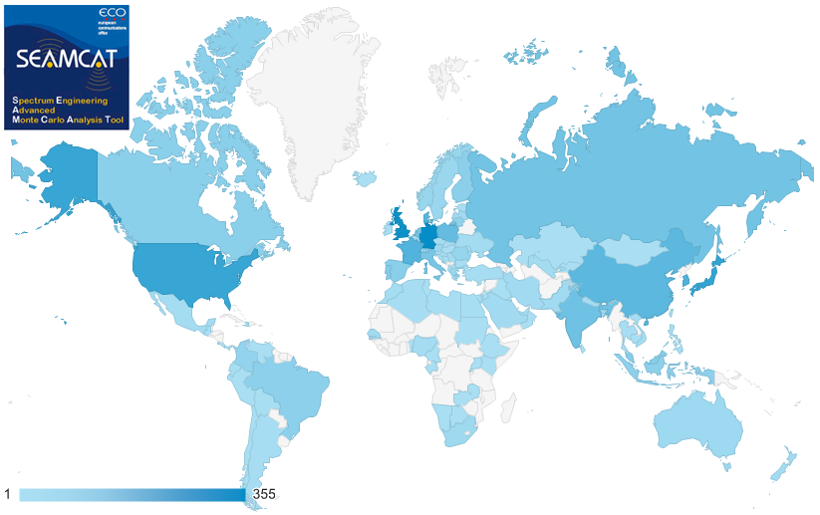
Usage in and outside CEPT
Source: google analytics on the www.seamcat.org download page in 2012.
2012 survey: about 1000 people downloaded SEAMCAT.

Slide 10
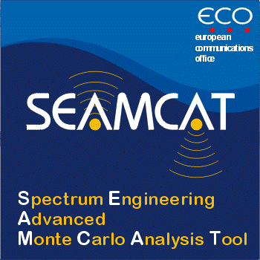
SEAMCAT-4 Software tool
SEAMCAT is not a CAT

Slide 11
History
Developed in CEPT as a co-operation between National Regulatory Administrations, ECO and industry
First released in Jan-2000, then gradually developed in several phases
Latest version 4.1.0 (October 2013)
Freely downloadable from ECO website (www.seamcat.org)

Slide 12
Purpose
SEAMCAT is designed for:
Co-existence studies between different radio systems operating in same or adjacent frequency bands
Any type of radio systems in terrestrial scenarios
Extended to cellular system like CDMA and OFDMA
Quantification of probability of interference between various radio systems
Not designed for system planning purposes
Based on Monte-Carlo generation

Slide 13
Typical examples of modelled system
Mobile:
Land Mobile Systems
Short Range Devices
Earth based components of satellite systems
Broadcasting:
terrestrial systems
DTH receivers of satellite systems
Fixed:
Point-to-Point and Point-to-Multipoint
... and more

Slide 14
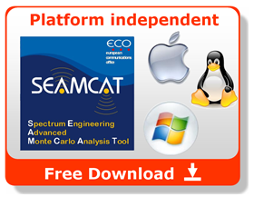
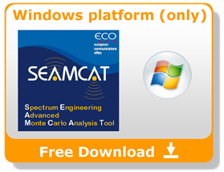
Installing SEAMCAT
(administrative right needed)
On-line Webstart:
Internet connection is needed at least for the installation; during later runs Internet used (if available) to check for updated version
(Windows, Linux, Mac)
Off-line
(Windows only)
1GB RAM needed
Java Runtime Environment (RTE) (version 1.6._027 and above)

Slide 15
Installing SEAMCAT
(without administrative right)
Off-line only using a USB stick
(Windows only)
http://tractool.seamcat.org/wiki/Manual/Introduction/Installing#Withoutadministrativeright

Slide 16
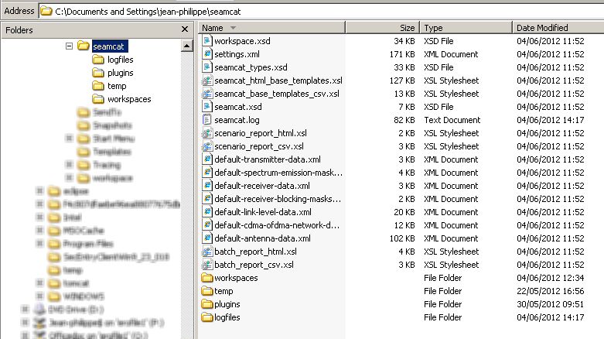
Files installation

Slide 17
Conclusions
Sharing rules are important element of spectrum optimisation process
Unless some intelligent interference avoidance is implemented in radio systems, the careful choice of sharing conditions is the only means for achieving successful co-existence and optimal spectrum use
Statistical tool SEAMCAT is a powerful tool for such analysis
Strategic tool for the CEPT
Reference tool – recognised at ITU
World wide usage
Free tool to run on any operating system platform

Slide 18
Thank you - Any questions?

