Slide 1
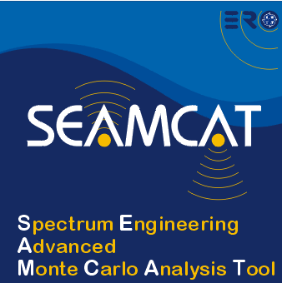

Principle of Monte-Carlo in a SEAMCAT environment
European Communications Office
Jean-Philippe Kermoal - SEAMCAT Manager (ECO)
June 2012
(Jean-Philippe.Kermoal@eco.cept.org)
EUROPEAN COMMUNICATIONS OFFICE | Nansensgade 19 DK-1366 Copenhagen Denmark | Telephone: + 45 33 89 63 00 Telefax: + 45 33 89 63 30 | E-mail: eco@eco.cept.org Web Site: http://www.cept.org/eco

Slide 2
Outline
Sharing/Compatibility studies
Conclusion
Event generation
MCL vs Monte-carlo approach

Slide 3
Sharing/compatibility
studies
Sharing: between different radio systems operating in the same frequency bands (ERC Report 68)
Compatibility: between different radio systems operating in the adjacent frequency bands
Analytical analysis: MCL (worse case)
Statistical analysis: Monte-Carlo method

Slide 4
The MCL approach
The stationary worst-case is assumed
Wanted
Signal
Victim
Interferer
Dmin, or minimum frequency separation for D=0
  However such worst-case assumption will not be permanent during normal operation and therefore sharing rules might be unnecessarily stringent – spectrum use not optimal!

Slide 5
Monte-Carlo approach
Repeated random generation of interferers and their parameters (activity, power, etc…)
Wanted
Signal
t=t₀
Victim
t=t_{i}
t=t₁
Active
Interferer
Inactive
Interferer
  After many trials, not only unfavourable, but also favourable cases will be accounted, the resulting rules will be more “fair” – spectrum use optimal!

Slide 6
Monte-Carlo Assumption
User will need to define the distributions of various input parameters, e.g.:
  How the power of interferer varies (PControl?)
  How the interferer’s frequency channel varies
  How the distance between interferer and victim varies, and many others
Number of trials has to be sufficiently high (many 1000s) for statistical reliability:
  Not a problem with modern computers

Slide 7
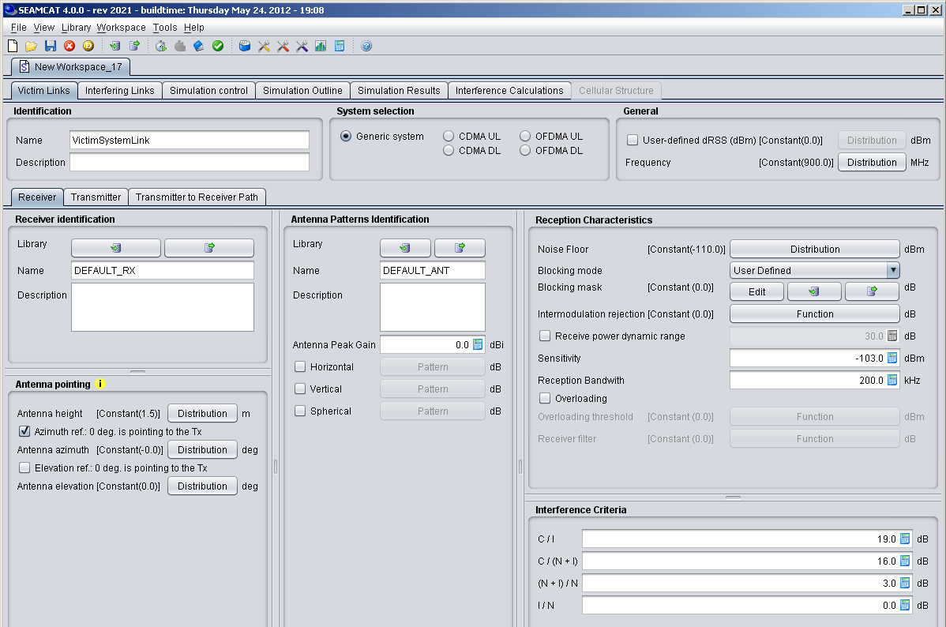
Scenario parameters
Positioning of two systems in frequency
Powers
Masks
Activity
Antenna
Etc...
Function
Double / integer field
Distribution
Pattern

Slide 8
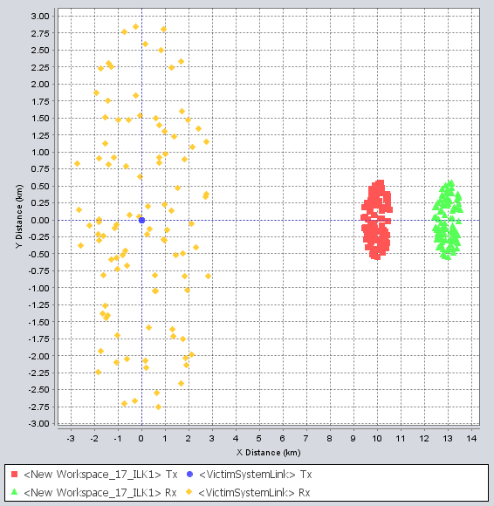
Event generation
Random generation of transceivers
Link budget
Signal values
Only 1 victim link
MANY interfering links

Slide 9
How event generation works*
Succession of snapshots…
dRSS
WT
1) Calculate d, Ptx, GaTx, GaRx, L
IT
Snapshot#
2) Calculate dRSSi
WT
iRSS
VR
VR
2) Calculate iRSSi
Snapshot#
1) Calculate d, Ptx, GaTx, GaRx, L
1) Calculate d, Ptx, GaTx, GaRx, L
IT
2) Calculate received signal, if PC, adjust Ptx
WR
WR
(*) Except CDMA/OFDMA systems

Slide 10
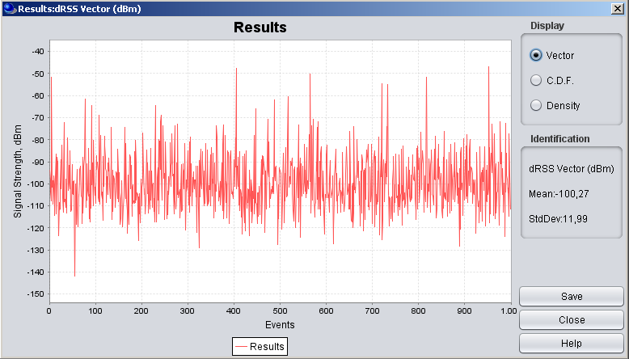
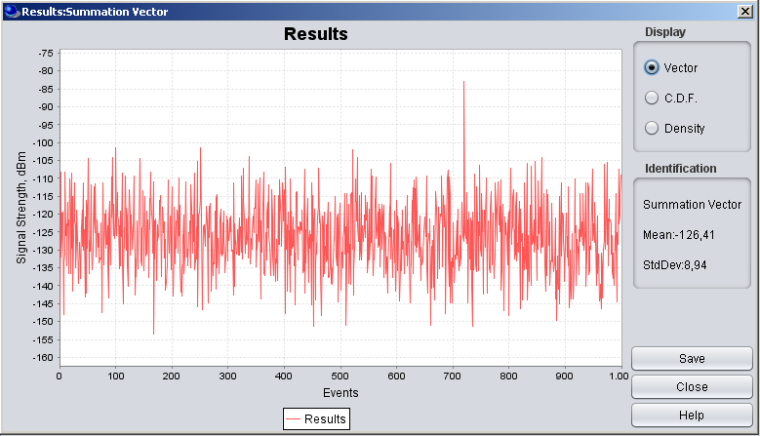
Results of event
generation
Vectors for useful and interfering signals:
dRSS
iRSS

Slide 11
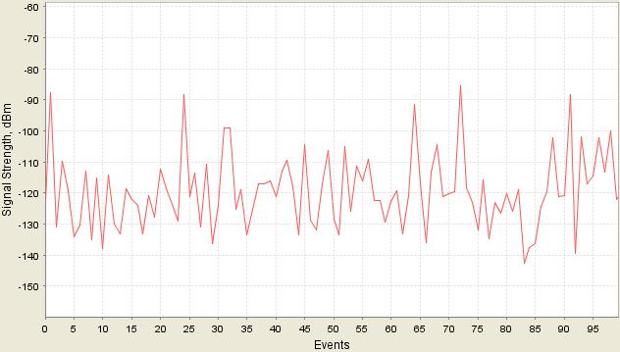
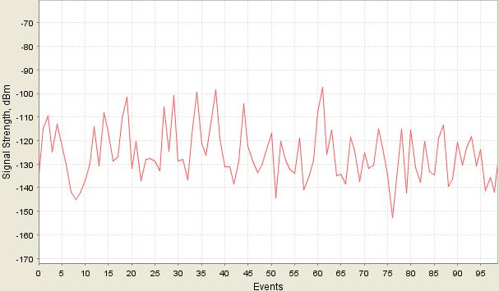
Evaluating probability of interference
dRSS -> (C)
        - For each random event where dRSS>sensitivity:
Desired signal value (dBm)
C/I_{trial} > C/I_{target}?
Interfering signal (dBm)
Interference (dB)
iRSS -> (I)
Noise Floor (dBm)
- If C/I_{trial}^{i} >C/I_{target}: “good” event
- If C/I_{trial}^{i} <C/I_{target}: “interfered”
- Finally, after cycle of N_{all} events:
Overall P_{interference}= 1- (N_{good}/N_{all})dRSS>sens

Slide 12
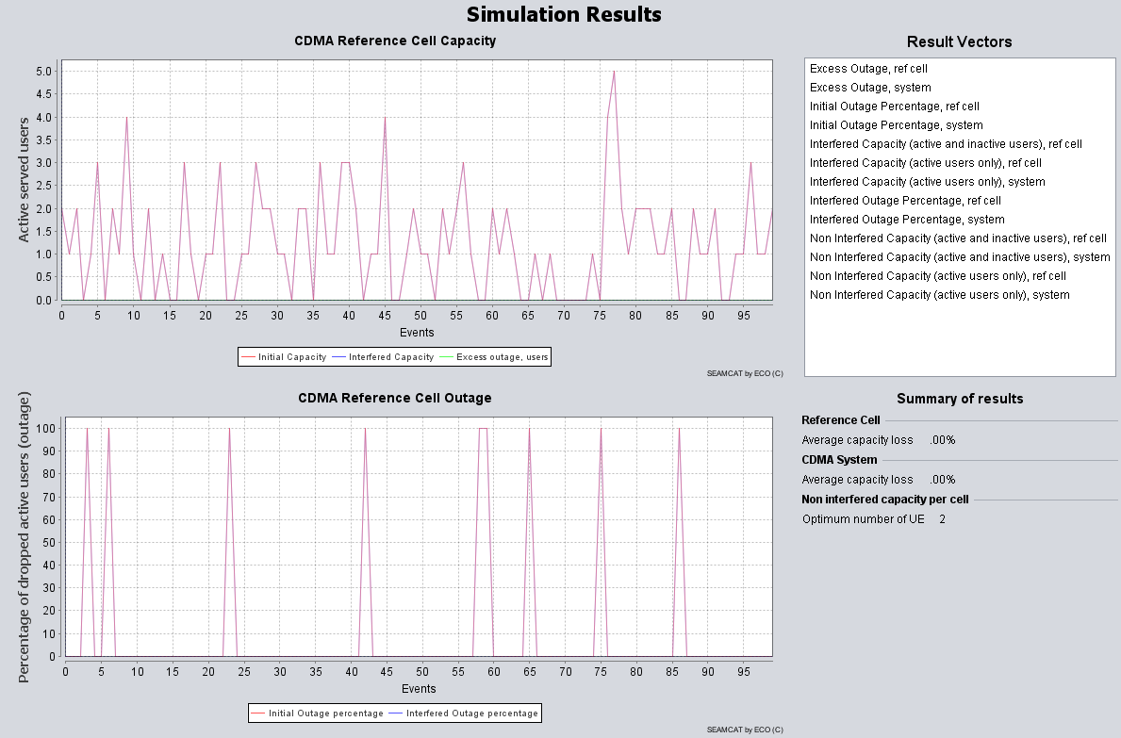
CDMA results
Initial capacity: Number of connected UEs before any external interference is considered.
Interfered capacity: Results after external interference is applied.
Excess outage, users: How many UEs were dropped due to external interference.
Outage percentage: Percentage of UEs dropped due to external interference.

Slide 13
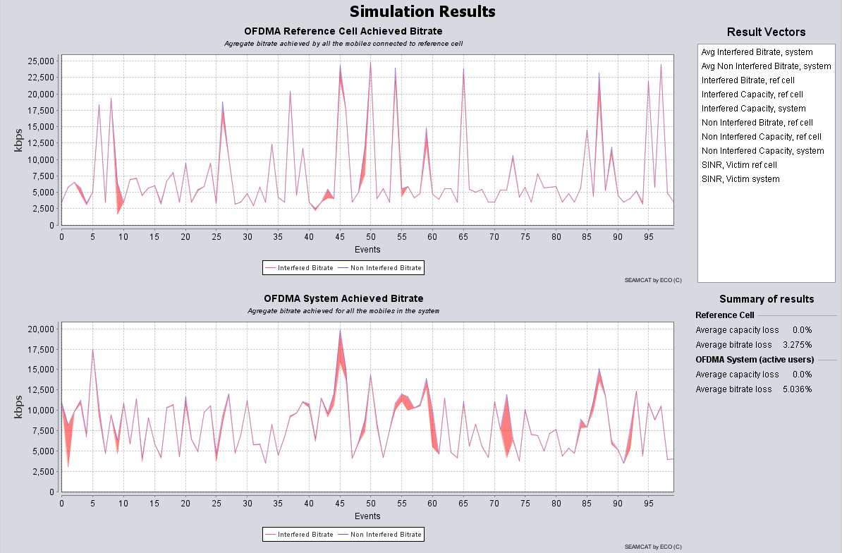
OFDMA results
Capacity results +
Non interfered bitrate: bitrate before any external interference
interfered bitrate: bitrate after external interference is applied.

Slide 14
Conclusions
Versatile tool to configure victim and interferer
SEAMCAT returns the following results
Victim system | Intereference criteria
Classical (i.e. non CDMA/OFDMA module) | Probability of interference based on C/I, C/(I+N), (N+I)/N, I/N
CDMA | Capacity loss (i.e. number of voice users being dropped)
OFDMA | Bitrate loss (i.e. number of bit rate lossed compared to a non interfered victim network) Capacity loss (i.e. number of voice users being dropped)

Slide 15
Thank you - Any questions?

