Slide 1
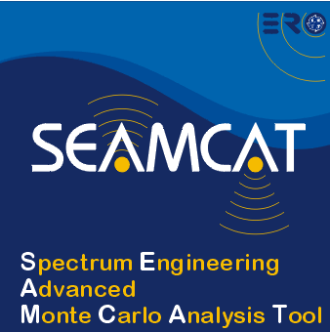

Basic functionality: coverage/simulation radius
European Communications Office
Jean-Philippe Kermoal (ECO)
05 June 2012
EUROPEAN COMMUNICATIONS OFFICE | Nansensgade 19 DK-1366 Copenhagen Denmark | Telephone: + 45 33 89 63 00 Telefax: + 45 33 89 63 30 | E-mail: eco@eco.cept.org Web Site: http://www.cept.org/eco

Slide 2
Outline
dRSS calculation
Probability of interference
Interference contribution
Exercise #6 – Coverage radius
iRSS calculation
Exercise #7 – Simulation Radius
Exercise #8

Slide 3
dRSS calculation
You will learn how to ...
✓
Define Victim Link Receiver (VLR)
Operating frequency
Receiver bandwidth
Antenna Characteristics
Interference criteria
Noise floor
Define Victim Link Transmitter (VLT)
Tx power
Antenna characteristics
Position the VLR to VLT
(Coverage Radius)
✓
Calculate the dRSS
Test propagation model
Launch simulation
Extract dRSS vectors
✓
✓
✓
✓
✓

Slide 4
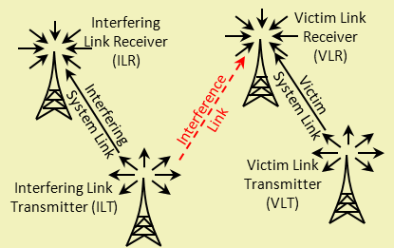
SEAMCAT scenario

Slide 5
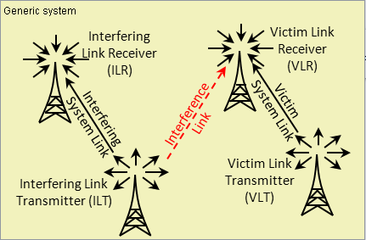
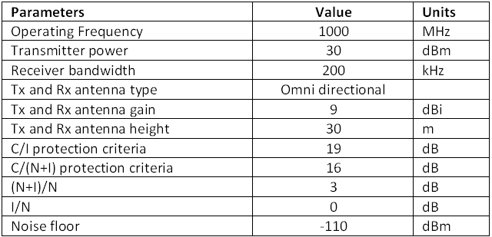
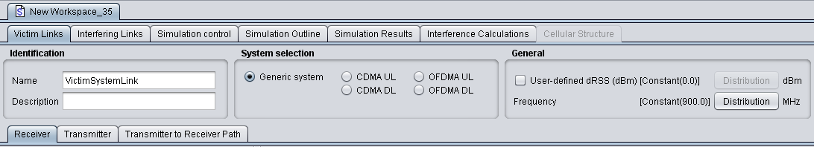
Exercise #6 - dRSS

Slide 6
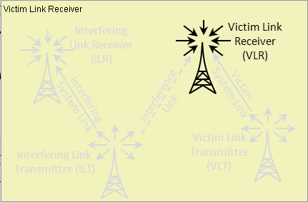
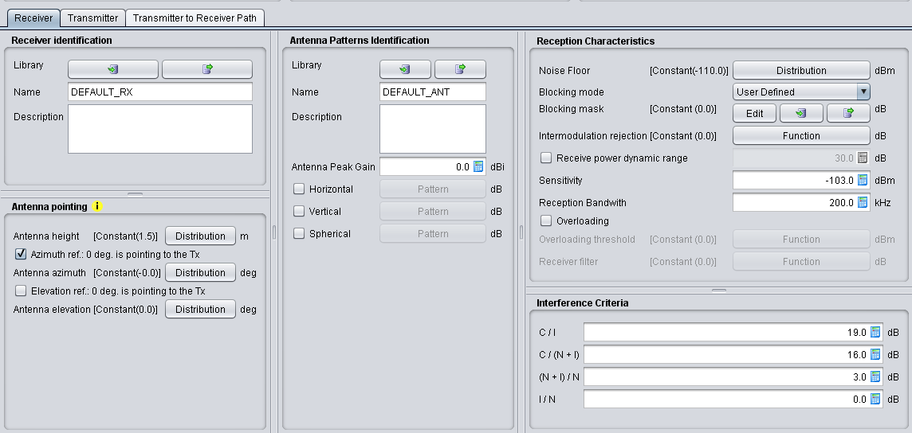
Victim Link Receiver

Slide 7
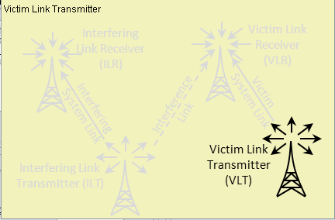
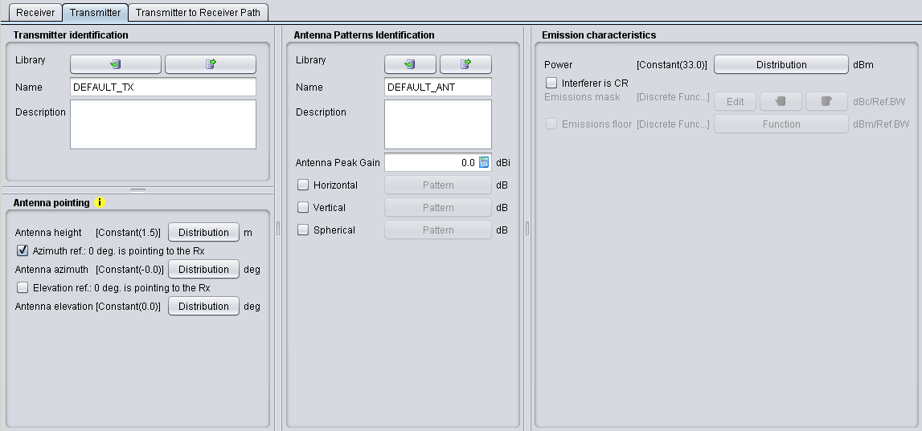
Victim Link Transmitter
VLT and VLR pointing at each other

Slide 8
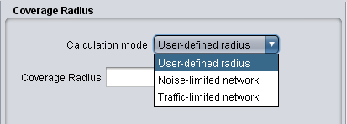
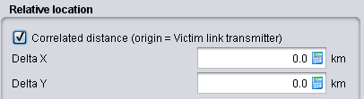
Position of the VLR to VLT (1/2)
Coverage radius
Uncorrelated mode
Noise limited Network
User-defined Radius
Traffic limited Network
VLT ↔ VLR
location
Correlated distance (origin = VLT)
Correlated mode

Slide 9
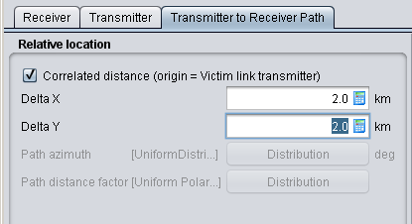
Position of the VLR to VLT (2/2)
Delta X = 2 km
y
dRSS
(2 km,2 km)
Delta Y = 2 km
Victim Link
Receiver
(VLR)
Victim link
(0,0)
x
Victim Link
Transmitter
(VLT)

Slide 10
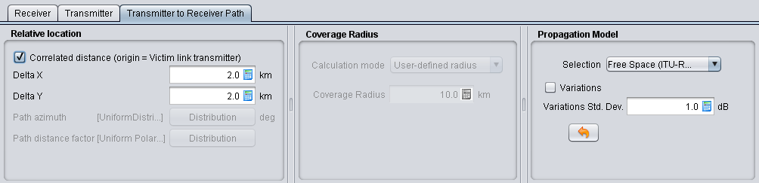
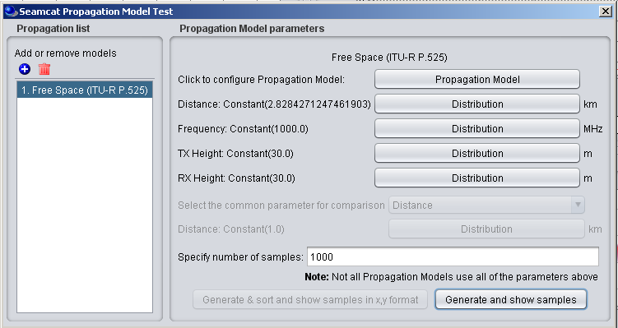
Calculation of the Path loss
L = 32.44+10log(8)+20log(1000))
L = 101.47 dB

Slide 11
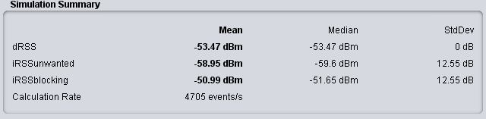
Calculation of dRSS
dRSS = Pe+Ge+Gr-L
dRSS = 30(dBm)+9 (dBi)+9 (dBi)-101.47 (dB)
dRSS = -53.47dBm

Slide 12
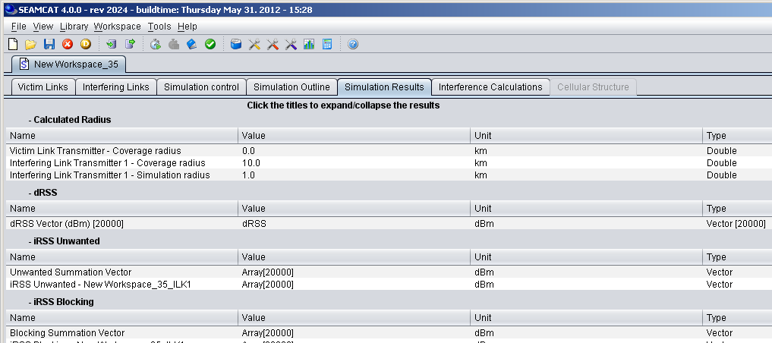
Extract dRSS
Only for uncorrelated mode

Slide 13
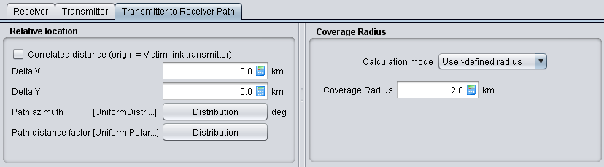
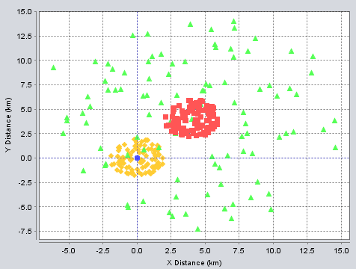
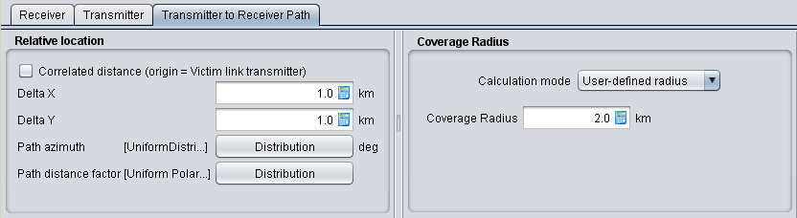
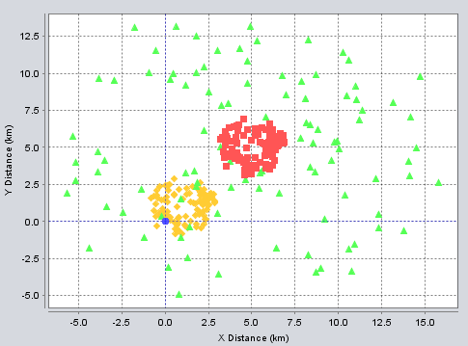
Coverage Radius
(Position of the VLR to VLT) and
(Position of the ILR to ILT)

Slide 14
iRSS calculation
You will learn how to ...
✓
Define Interfering Link Transmitter (ILT)
Tx power
Antenna Characteristics
Set the emission bandwidth
✓
Position the VLR vs ILT (Simulation Radius)
✓
Calculate the iRSS

Slide 15
SEAMCAT scenario

Slide 16
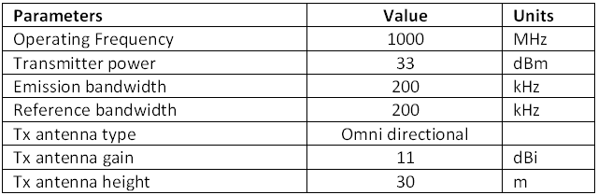
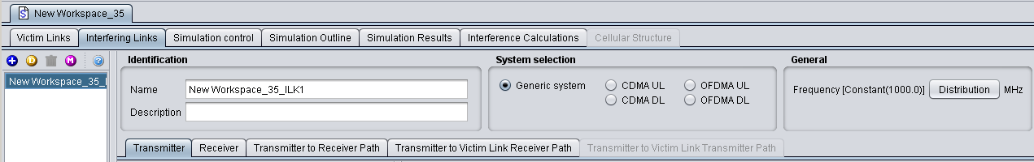
Exercise #7 - iRSS

Slide 17
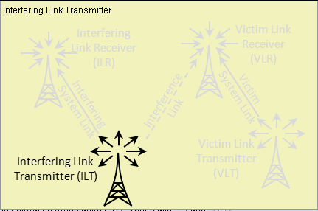

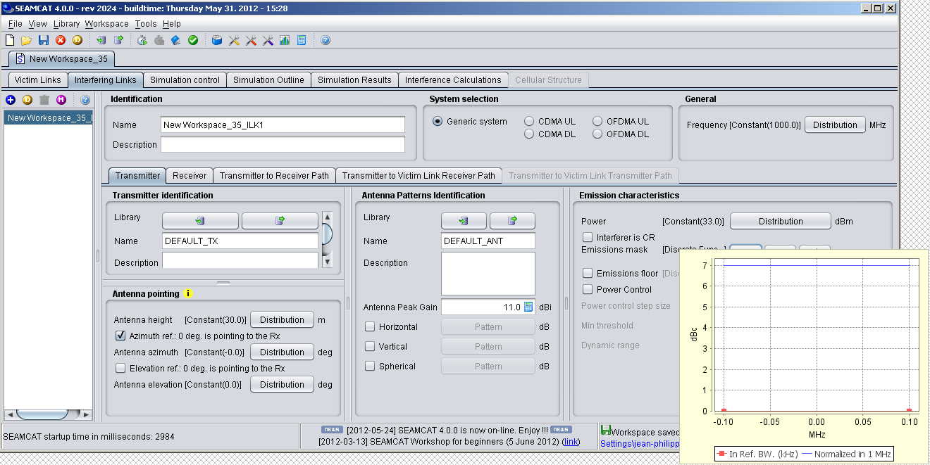
Interfering Frequency

Slide 18
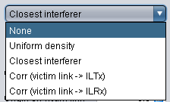

Position of the Vr vr It (1/2)
Simulation radius
Uncorrelated mode
Uniform density (n_{active} interferers)
None
(n_{active} interferers)
VLR ↔ ILT
location
Closest
(single interferer)
ILT /VLR
ILR/VLT
ILT /VLT
ILR /VLR
Correlated mode

Slide 19
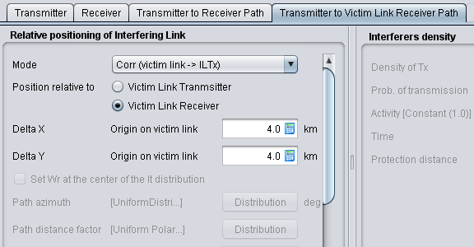
Position of the VLR vr ILR (2/2)
dRSS
Victim link
Transmitter
(VLT)
iRSS
Interfering Link
Transmitter
(ILT)
Victim link
Delta Y
= 4 km
Interfering link
Interfering Link
Receiver
(ILR)
Victim
Link Receiver
(VLR)
Delta X = 4 km

Slide 20
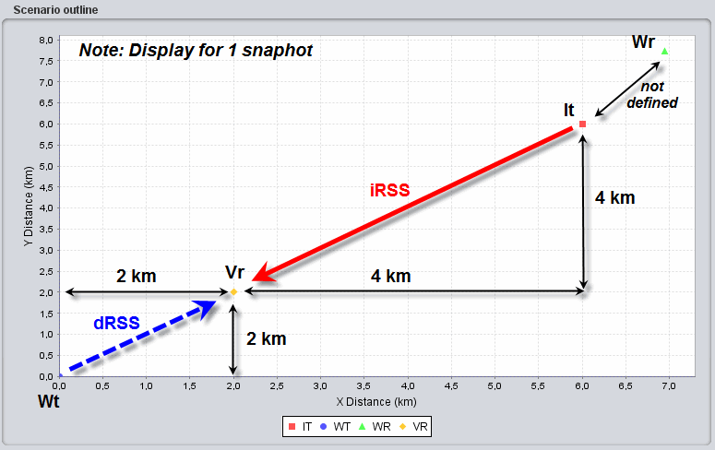
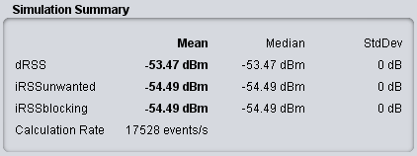
Calculation of the iRSS
P(dBm/Bref) = Pe (dBm)+Att(dBc/Bref)
33 (dBm/200KHz) = 33 + 0 (dBc/Bref)
iRSS = Pe+Ge+Gr-L
iRSS = 33(dBm)+11 (dBi)+9 (dBi)-(32.5+10log(32)+20log(1000))
iRSS = -54.5dBm

Slide 21
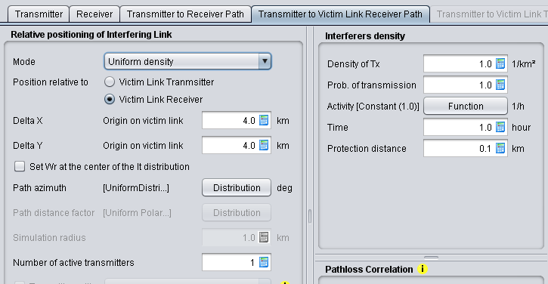
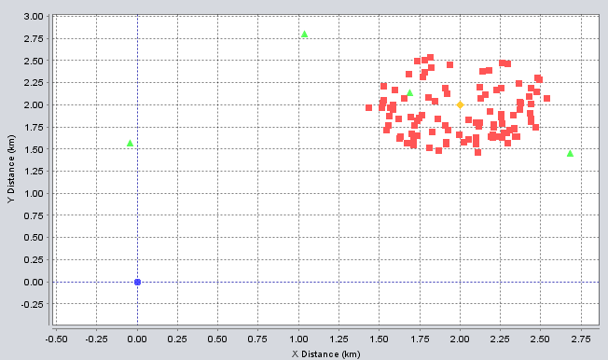
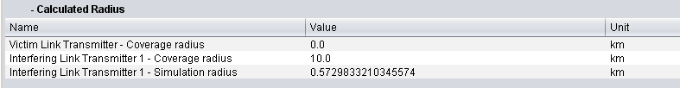
Simulation Radius
(Position of the VLR to ILT)

Slide 22
Probability of interference
You will learn how to ...
✓
Extract the Probability of Interference in ....
✓
Compatibility calculation mode
✓
Translation calculation mode

Slide 23
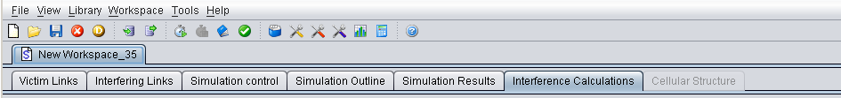
Probability of interference
  Calculation mode: compatibility or translation
  Which type of interference signal is considered for calculation: unwanted, blocking, intermodulation or their combination
  Interference criterion: C/I, C/(N+I), (N+I)/N or I/N

Slide 24
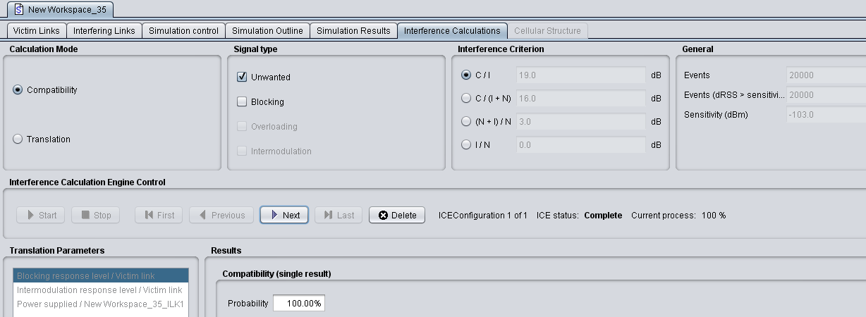
Compatibility calculation mode
the C/I (i.e. dRSS/iRSS) can be derived:
  dRSS/iRSS = -53.5-(-54.5) = 1dB
Make sure that dRSS>sensitivity

Slide 25
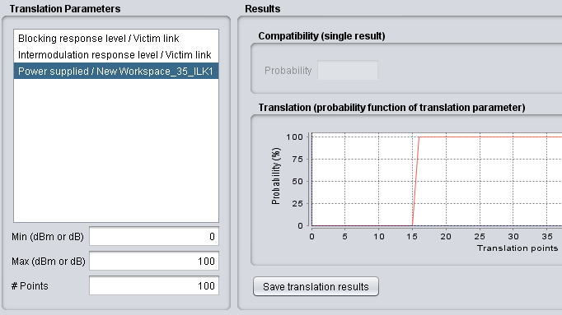
Translation calculation mode
ILT power is high enough to results in 100%
Low interfering Tx power results in no interference (p=0%)
Gradual increasein the ILT power results in increasing P%

Slide 26
Interference contribution
You will learn how to ...
✓
Modify the Unwanted Emission Mask
✓
Calculate the iRSS unwanted
✓
Calculate the iRSS blocking
user-defined mode
Sensitivity mode
Protection ratio mode
✓
Extract probability of interference
(i.e. unwanted vs blocking)

Slide 27
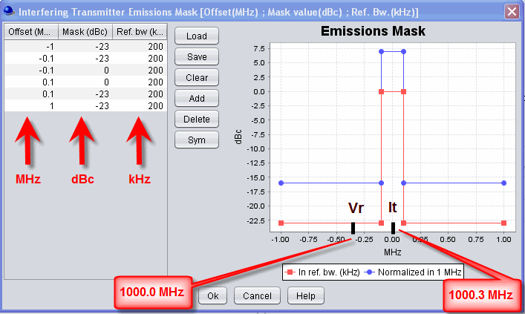
Exercise #8
Change the ILT frequency to 1000.3 MHz
Change the SEM as follow:
P = 33 +(–23(dBc/Bref)) = 10 (dBm/200kHz)

Slide 28
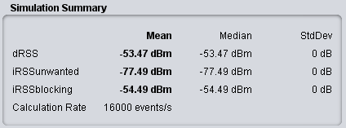
Calculate iRSS unwanted
iRSS unwanted calculate the interfering power received by the Victim receiver within its bandwidth
iRSSunwanted = P+Ge+Gr-L
iRSSunwanted = 10(dBm/200kHz)+11+9-(32.5+10log(32)+20log(1000))
iRSSunwanted = -77.5dBm
Interfering
emission mask
Unwanted:
Rx bandwidth
fVr
fIt
In this example there is no bandwidth correction factor to be applied to the calculation of the iRSS unwanted since the Vr bandwidth and the It reference bandwidth have the same value (i.e. 200 KHz).

Slide 29
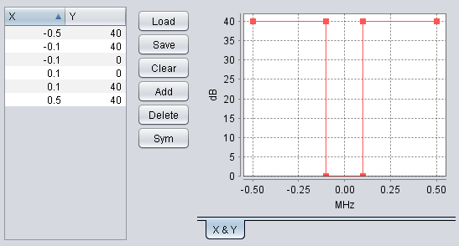
Calculate iRSS blocking (1/4)
Change the blocking mask as follow:
fVLR
fILT

Slide 30
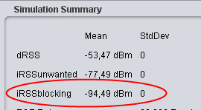
Calculate iRSS blocking (2/4)
The It bandwidth is not considered in the iRSS blocking calculation)
User-defined mode:
  iRSS blocking (fit) = Pe+Ge+Gr-L-Att (fit)
  iRSS blocking = 33(dBm)+11+9-(32.5+10log(32)+20log(1000))-40(dB)
  iRSS blocking = -94.5dBm
Receiver Mask
Rx bandwidth
Blocking:
Rejection
of the receiver
fVr
fIt

Slide 31
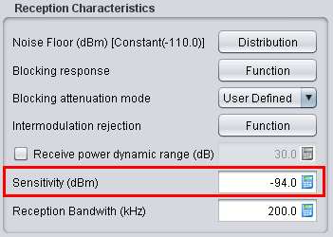
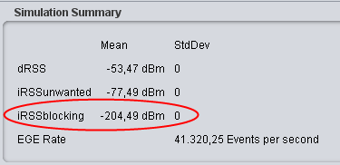
Calculate iRSS blocking (3/4)
Sensitivity mode:
  Attenuation(Δf) = block(Δf) [dBm] – sensvr [dBm] + C/(N+I) [dB]
  Sensitivity = Noise Floor + C/(N+I)
  Sensitivity = -110dBm + 16
  = -94dBm
  Attenuation (Δf ) = 40-(-94)+16= 150dB
  iRSS blocking (fit) = Pe+Ge+Gr-L-Att (fit)
  iRSS blocking = -54.5-150
  = -204.5dBm

Slide 32
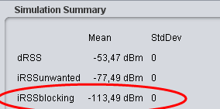
Calculate iRSS blocking (4/4)
Protection Ratio:
  Attenuation(Δf) = block(Δf) [dBm] + C/(N+I) [dB] + 3dB
  Attenuation(Δf) = 40 +16 +3 = 59 dB
  iRSS blocking (fit) = Pe+Ge+Gr-L-Att (fit)
  iRSS blocking = -54.5-59
  = -113.5 dBm

Slide 33
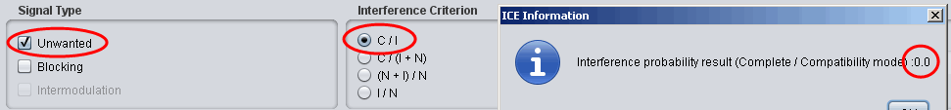
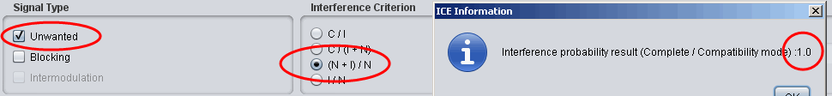
Probability of interference (1/2)
For the unwanted mode, the C/I can be derived as:
  dRSS/iRSS unwanted = -53.5-(-77.5) = 24dB
Since the resulting C/I is above the protection criteria (19 dB), the probability of interference is 0
It is also possible to derive the (N+I)/N= -77.5-(-100)= 22.5 (since I>>N). Since the (I+N)/N which is obtained is above the protection criteria (3dB), the probability of interference is 1

Slide 34
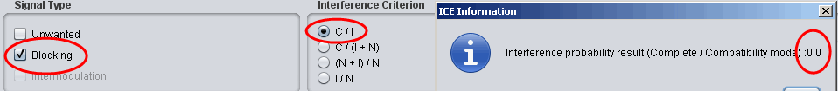
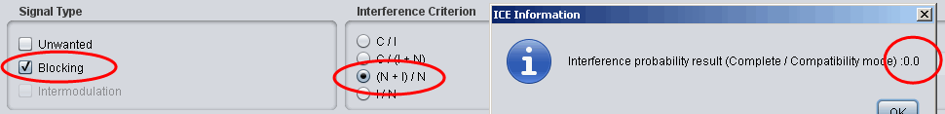
Probability of interference (2/2)
For the blocking mode, the C/I can be derived as:
  dRSS/iRSS blocking = -53.5-(-113.5) = 60dB
Since the resulting C/I is above the protection criteria (19 dB), the probability of interference is 0
It is also possible to derive the (N+I)/N= -113.5-(-100)= -13.5. Since the (I+N)/N which is obtained is below the protection criteria (3dB), the probability of interference is 0

Slide 35
Thank you - Any Questions?

