Slide 1
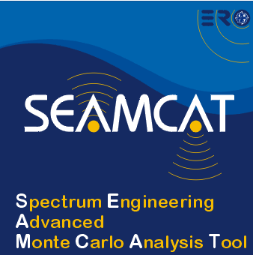

Analysis of real compatibility problem using SEAMCAT
European Communications Office
Jean-Philippe Kermoal (ECO)
05 June 2012
EUROPEAN COMMUNICATIONS OFFICE | Nansensgade 19 DK-1366 Copenhagen Denmark | Telephone: + 45 33 89 63 00 Telefax: + 45 33 89 63 30 | E-mail: eco@eco.cept.org Web Site: http://www.cept.org/eco

Slide 2
Hands on - TETRA vs PMR
Use the exercise from the SEAMCAT Handbook
Split the group in two small learning groups
  Hamlett room (JPK)
  Langelinie room (MLD)

Slide 3
Thank you - Any Questions?

