Slide 1
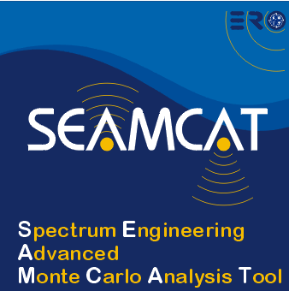

Management of the SEAMCAT tool
European Communications Office
Jean-Philippe Kermoal (ECO)
27 November 2012
EUROPEAN COMMUNICATIONS OFFICE | Nansensgade 19 DK-1366 Copenhagen Denmark | Telephone: + 45 33 89 63 00 Telefax: + 45 33 89 63 30 | E-mail: eco@eco.cept.org Web Site: http://www.cept.org/eco

Slide 2
Outline
How does STG works?
How is the new patch release handled?
On-Line management-based database
Conclusions
Mailing lists

Slide 3
STG
(SEAMCAT Technical Group)
The SEAMCAT project is an ongoing CEPT/WGSE (Working Group Spectrum Engineering) activity.
The daily maintenance of the project and the SEAMCAT software is entrusted to ECO.
STG acts as the supervising committee and source of technical expertise.
STG is open to Administrations, Industry and University. The STG participants are not just users, but also people who want to know and contribute to the insides of SEAMCAT.
Use of physical meeting but priority to netmeeting

Slide 4

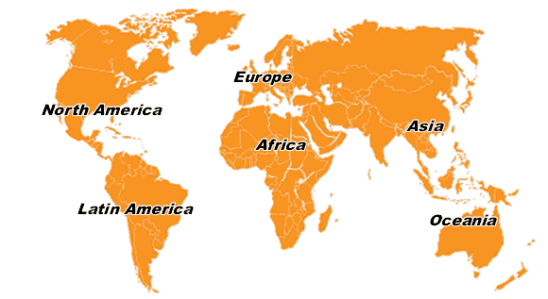
ECO council
(Funding)
ECO
Java programmer
WGSE
Issue contract
Chairmanship
Planning
Maintenance
Product distribution
Implementation
Term of reference
Feedback
Enhancement
STG
Technical expertise, testing, etc...
Priority settings
Promotion
Reporting
New features
Feedback
ECC and WGSE PT’s
Feedback
Testing
Enhancement
SEAMCAT users

Slide 5
2 distinct mailing lists
The public SEAMCAT E-mail reflector is maintained by the ECO for dissemination of useful information within the group of SEAMCAT users, such as user support messages, usage tips, information on updates and questions/answers from members of the group.
The public STG E-mail reflector is also maintained by ECO and is open to administration, industry and University.

Slide 6
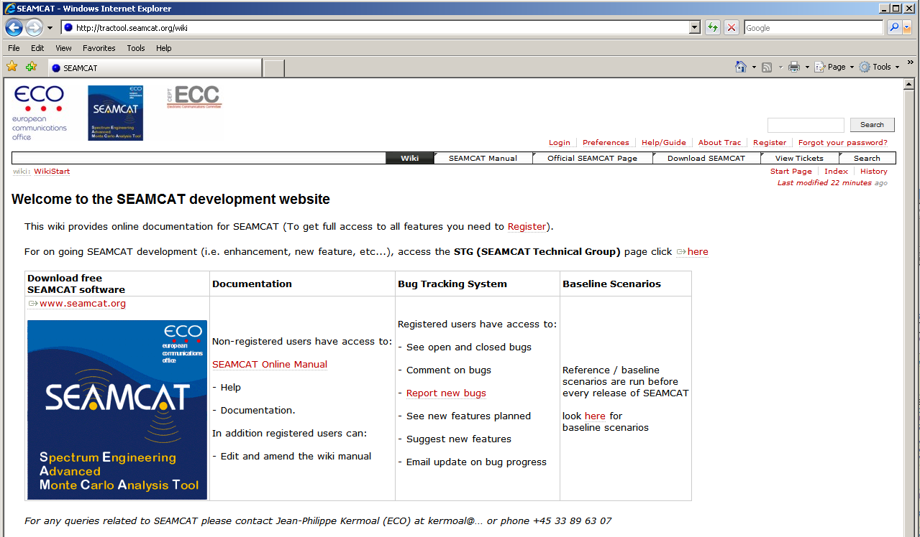
On-Line management based database

Slide 7
TracTool
Ticket based project and service desked management
Web based interface used to keep track of all technical SEAMCAT development tasks
Available for all registered users to follow at: http://tractool.seamcat.org
Report bugs and keep track of resolutions
Provides detailed information on the changes incorporated into every new release

Slide 8
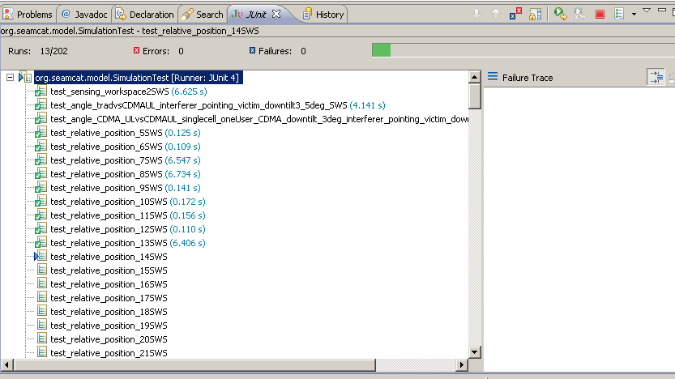
New patch release
Process of deciding what goes in a release
Quality control: Testing (Automated and mandatory)
Releasing

Slide 9
Conclusions
Fast response to CEPT needs via STG (SEAMCAT Technical Group)
  Reactivity between STG and other PTs to develop algorithms
  Quick approval process by STG (STG meets on request physically or via webmeeting)
History
  Of all changes since 2007
Quality
  Quality control protocol before releasing any new version

Slide 10
Thank you - Any Questions?

