Slide 1
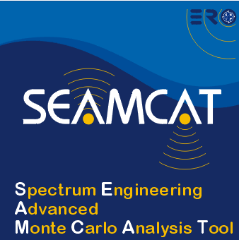

On-line tools and reporting an error
European Communications Office
Jean-Philippe Kermoal - SEAMCAT Manager (ECO)
27 November 2012
(Jean-Philippe.Kermoal@eco.cept.org)
EUROPEAN COMMUNICATIONS OFFICE | Nansensgade 19 DK-1366 Copenhagen Denmark | Telephone: + 45 33 89 63 00 Telefax: + 45 33 89 63 30 | E-mail: eco@eco.cept.org Web Site: http://www.cept.org/eco

Slide 2
Outline
On-line tools
Reporting an error
Conclusions
Activate the java console

Slide 3
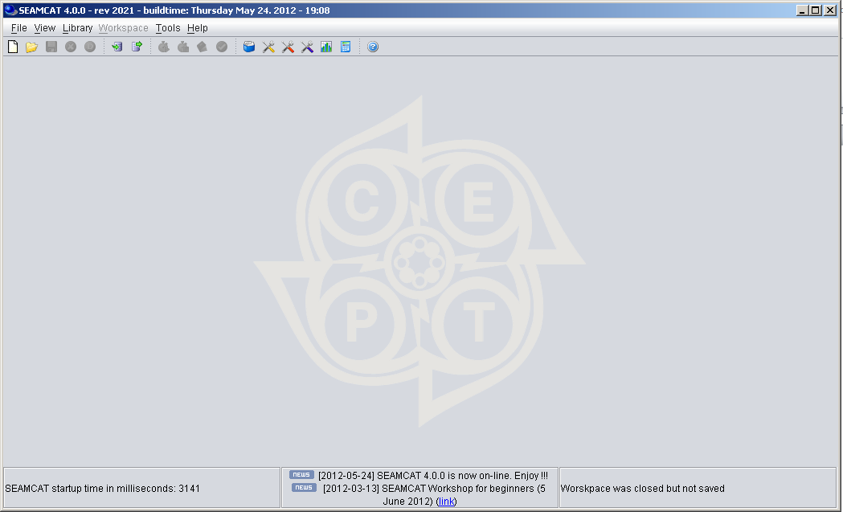
On-line news
Latest News on development, workshops, etc...

Slide 4
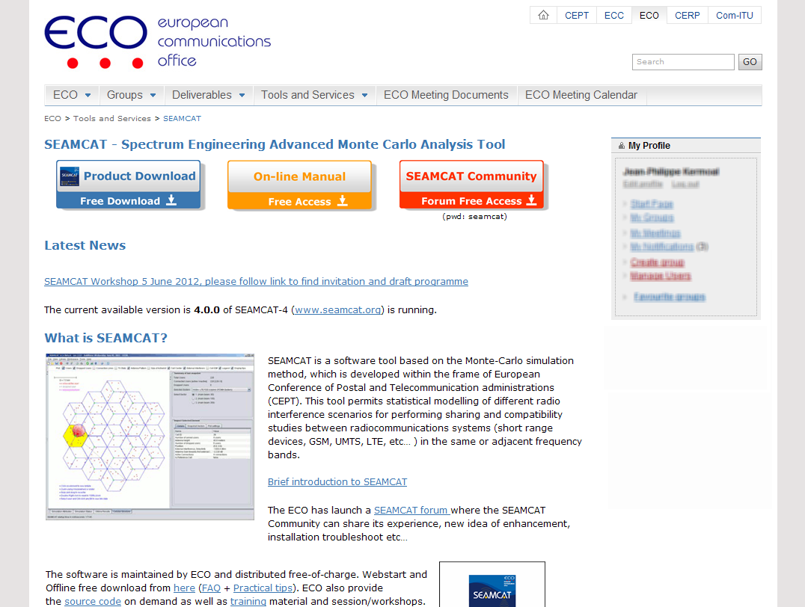
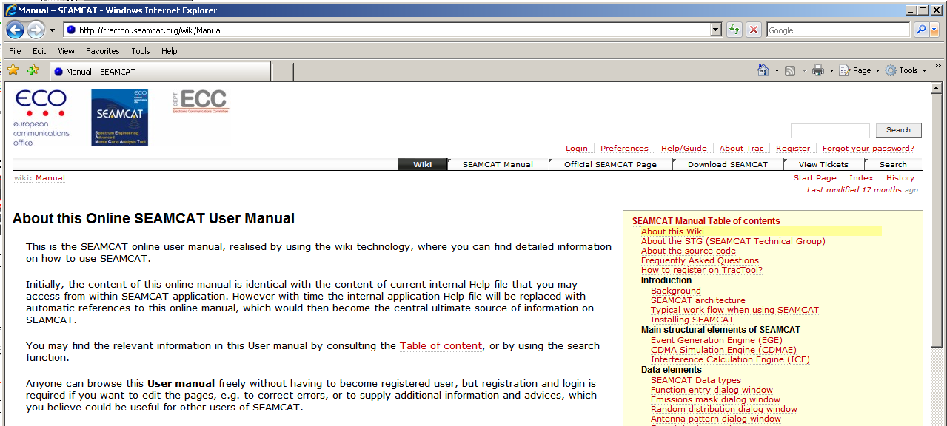
On-line manual
http://www.cept.org/eco/eco-tools-and-services/seamcat-spectrum-engineering-advanced-monte-carlo-analysis-tool
www.seamcat.org/xwiki

Slide 5
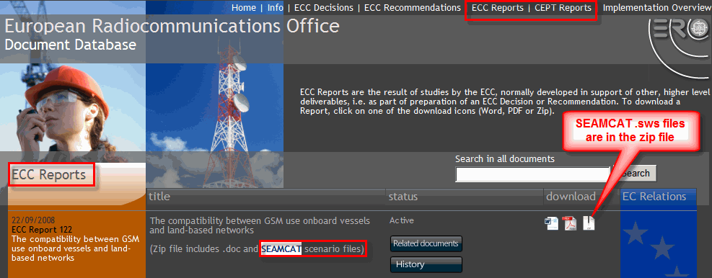
CEPT SEAMCAT workspace publicly available
Existing .sws files which have been generated as part of some ECC report or CEPT reports activities can be found at www.ecodocdb.dk (compatible with SEAMCAT 4.0.0)

Slide 6
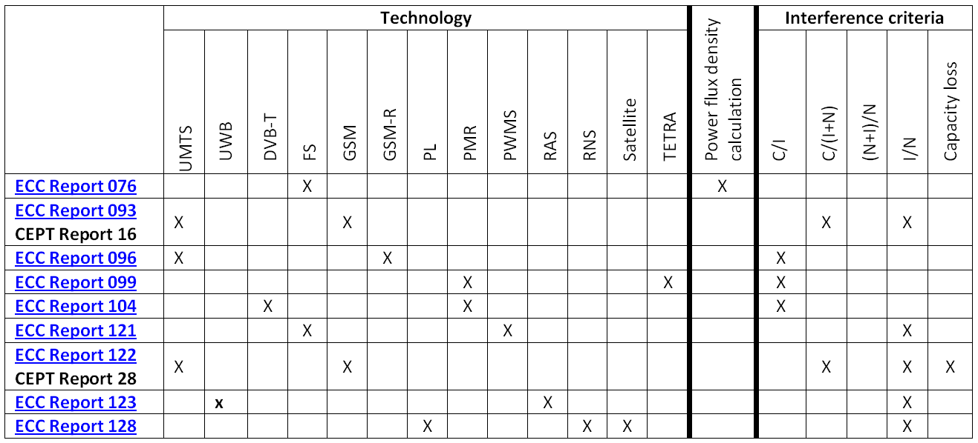
Reference material and workspaces

Slide 7
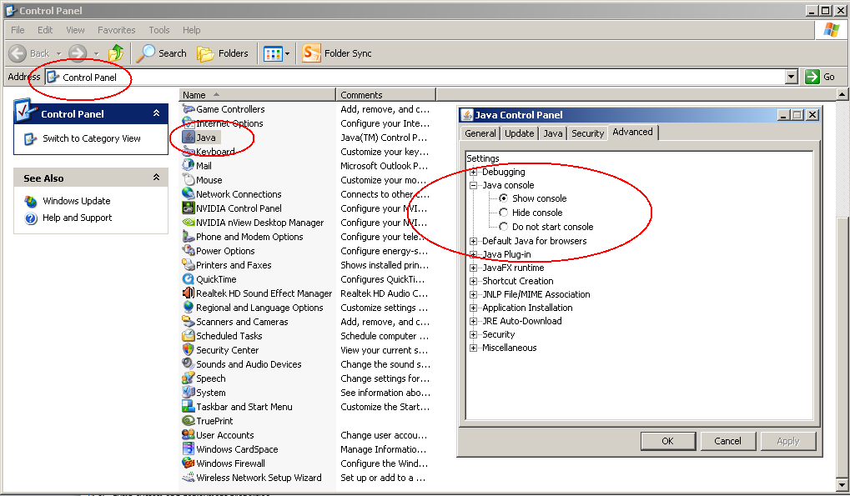
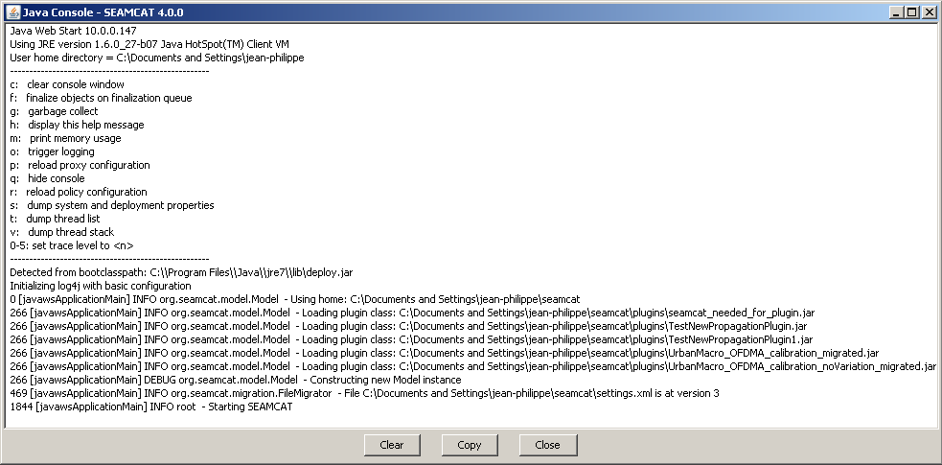
Java console (only with webstart)
Activate Java console on your machine
SEAMCAT startup

Slide 8
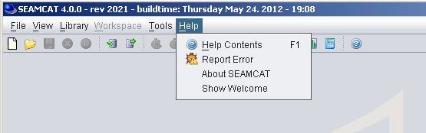
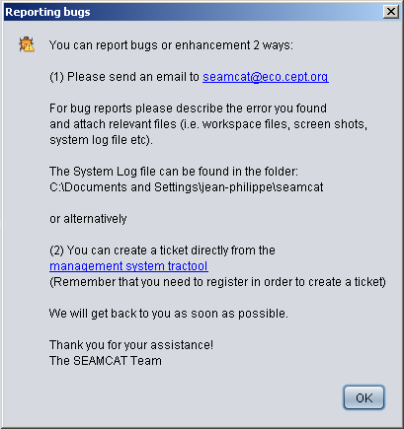
Reporting an error

Slide 9
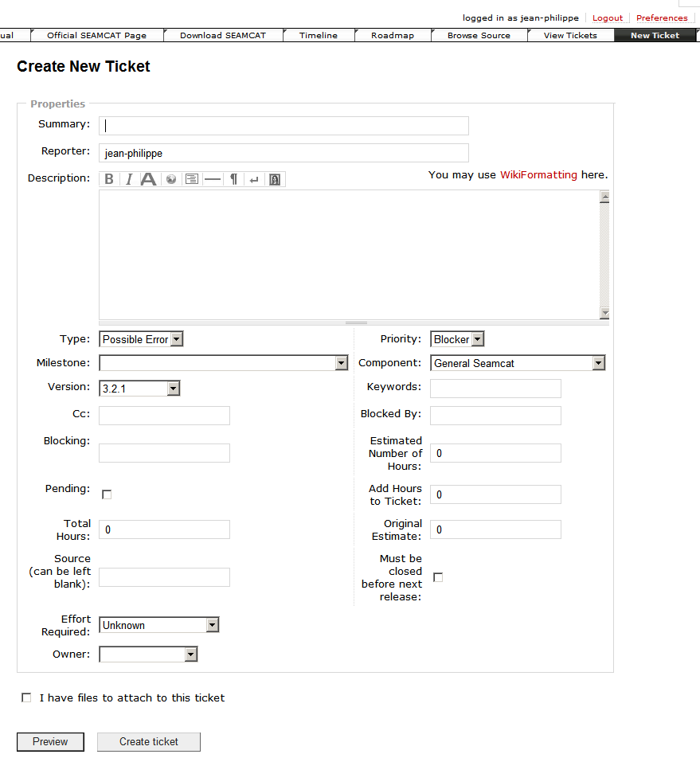
Creating a ticket

Slide 10
Conclusions
This is your tool
Users feedback of great importance for error or enhancement… future development.
On-line tools publicly accessible to users
  News
  Manual
Existing CEPT SEAMCAT workspaces publicly available

Slide 11
Thank you - Any questions?

