Slide 1

Setting Emission and
Blocking masks
European Communications Office
Jean-Philippe Kermoal (ECO)
27 November 2012
EUROPEAN COMMUNICATIONS OFFICE | Nansensgade 19 DK-1366 Copenhagen Denmark | Telephone: + 45 33 89 63 00 Telefax: + 45 33 89 63 30 | E-mail: eco@eco.cept.org Web Site: http://www.cept.org/eco

Slide 2
Outline
Using library
ACLR
Emission Mask
CDMA example
Blocking Mask / ACS
Emission floor
Exercise #1

Slide 3
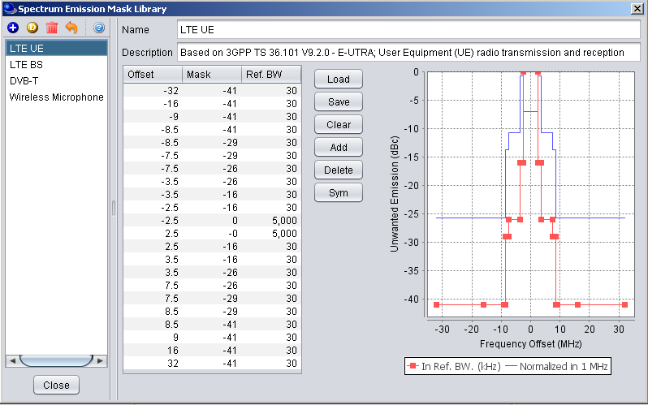
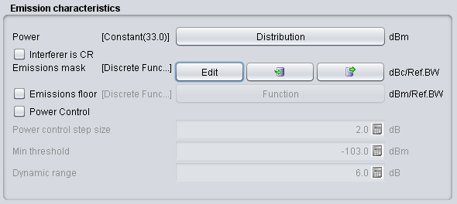
Using Library
Edit
Import from library
Export to library
Edit
Import
Export
Technical specifications commonly extracted from ETSI (see http://www.etsi.org/WebSite/Standards/Standard.aspx)

Slide 4
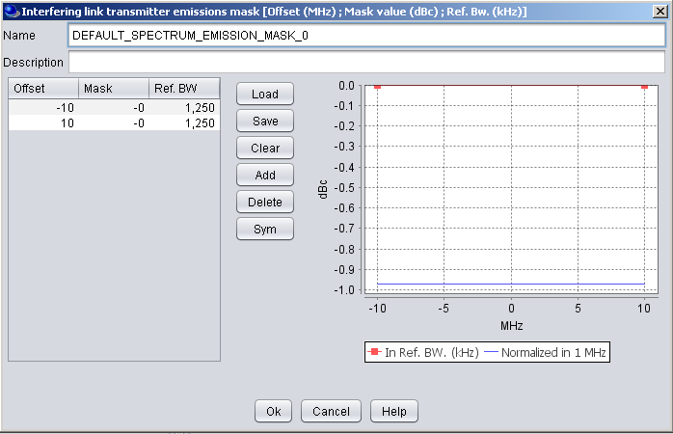
Editing the mask
The emission mask defaults value
Remove the default using the Clear button.
Then use the add button to add the enough blank rows for half of the emission mask.
Note the format of the data:
  Offset = MHz
  Unwanted = dBc
  Reference bandwidth = kHz

Slide 5
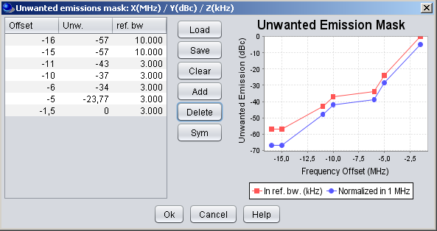
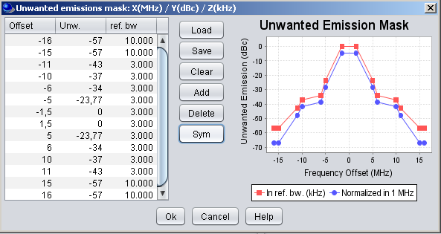
Symmetry
Then use the Sym button to get a symetric mask

Slide 6
Reference/normalised bandwidth
Once SEAMCAT has generated the whole mask, first check that the values are in the correct order.
The unwanted emission diagram shows two masks
The blue mask is normalised to 1MHz measurement bandwidth.
The user may normalise his input to 1MHz bandwidth but it can be useful to input the mask in the bandwidth defined in the standard and allow SEAMCAT to create normalised mask.
The red mask is the representation using the user defined reference bandwidth.

Slide 7
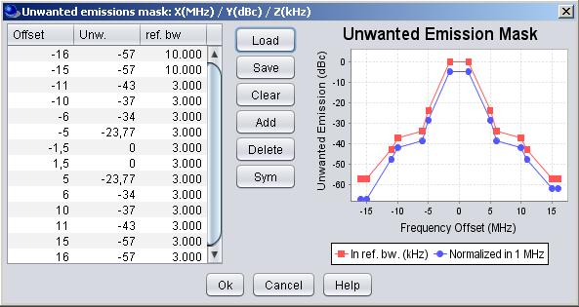
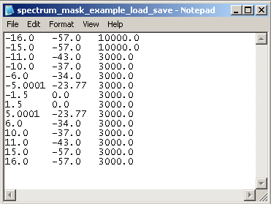
Store your mask on disk
Spectrum mask can be saved as .txt file
it can be reused for other workspaces using load buttons.

Slide 8
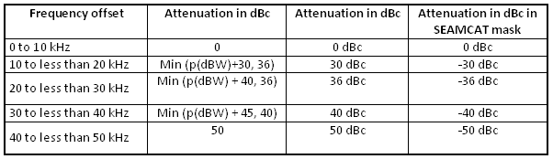
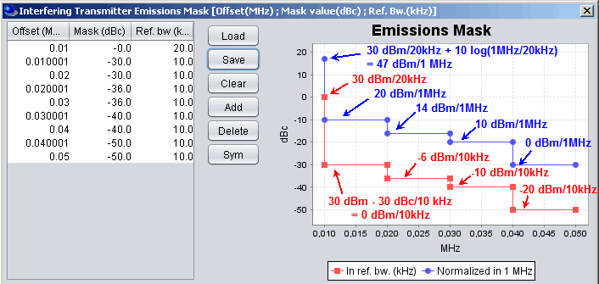
General
System with 30 dBm in a emission bandwidth of 20 KHz
Emission BW = Ref. BW = 20 KHz
Ref. BW 10 KHz

Slide 9
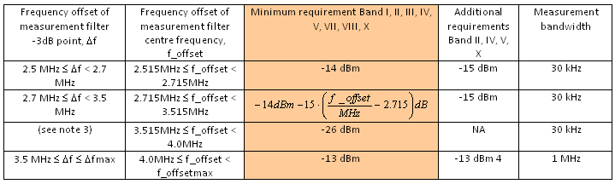
CDMA FDD emission mask -
BS example
3GPP TS25.104
Spectrum emission mask values, BS maximum output power P ≥ 43 dBm (TS25.104)

Slide 10
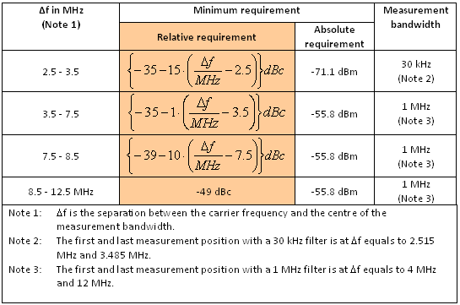
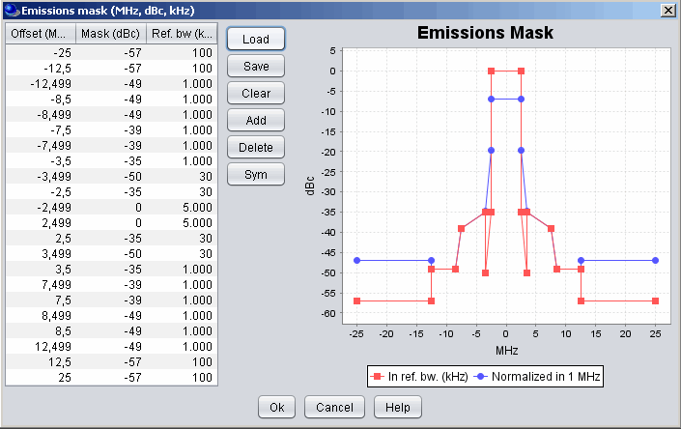
CDMA FDD emission mask -
UE example
3GPP TS25.101

Slide 11
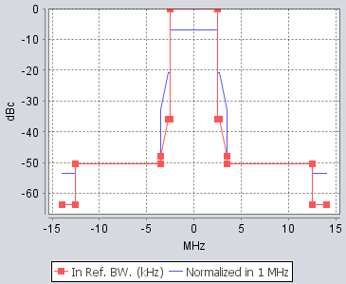
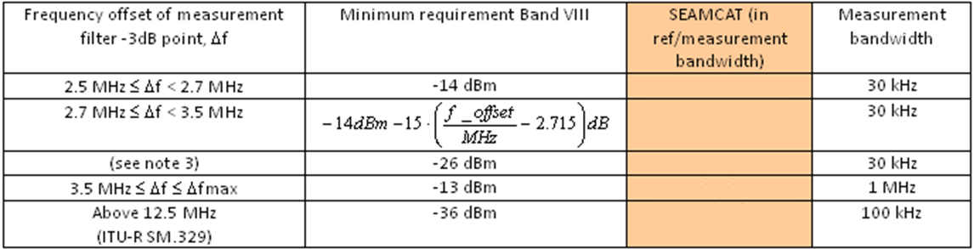
Exercise #1 – edit a Mask
Assuming a BS Tx power of 43 dBm (in band = 3.84 MHz), and with addition of the ITU-R SM.329 limit above 12.5 MHz, perform the following:
  Convert the dBm values into dBc. As the limits are given as an absolute power measured in the reference bandwidth, convert first the total powers to the same bandwidth (either to the bandwidth of the limit or the system).
  Load the .txt file
  Export it as your own spectrum library
Conversion | Conversion factor | Power in Ref./Measurement BW
3.84MHz → 30KHz | =10*log10(0.03/3.84) =-21 dB | 43-21 = 22 dBm/30KHz
3.84MHz → 1 MHz | -5.8 dB | 43-5.8 = 37.2 dBm/MHz
3.84MHz → 100 kHz | -15.8 dB | 43-15.8 = 27.4 dBm/100KHz
-14 -22 = -36 dBc
linear
-26 -22 = -48 dBc
-13 -37.2 = -50.2 dBc
-36 -27.4= -63.4 dBc

Slide 12
ACIR = f(ACLR, ACS)
ACIR = adjacent-channel interference ratio
In UL, the dominant part of ACIR is due to the UE adjacent channel leakage (ACLR) i.e. ACSBS is very large compare to ACLRUE and ACIR ≈ ACLRUE.
In DL, the dominant part of ACIR is due to the UE frequency selectivity (ACS) i.e. ACLRBS is very large compare to ACSUE and ACIR ≈ ACSUE

Slide 13
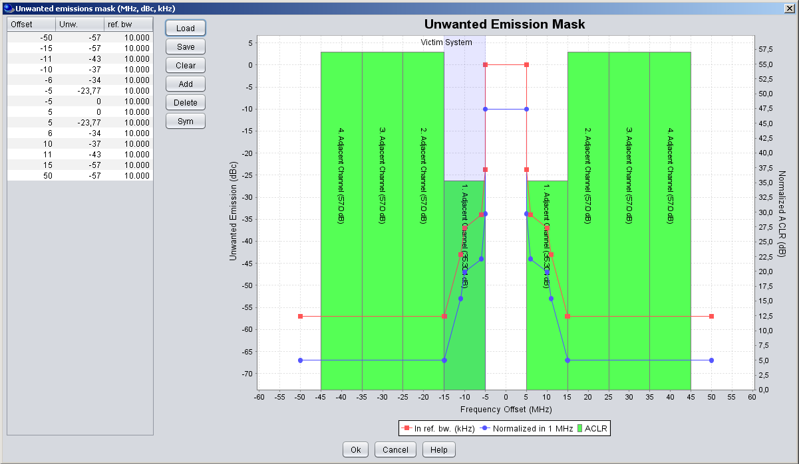
ACLR
No use of the ACLR value directly.
Emission spectrum Mask is used

Slide 14
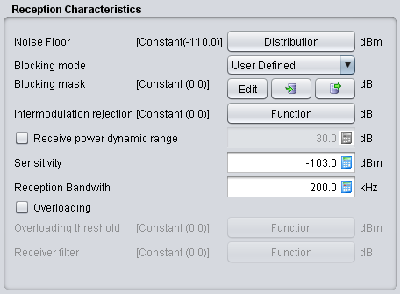
Blocking Mask (generic)
Receiver Mask
Rx bandwidth
Blocking:
User-defined mode
Protection ratio
Sensitivity modes
Rejection
of the receiver
fv
fI
Blocking Response = filtering (user defined mode)
Receiver Mask
Rx bandwidth
Blocking:
Rejection
of the receiver
fv
fI
Blocking Response =
ACS
(ETSI)
+
Blocking
(ETSI)
(PR and Sensitivity mode)

Slide 15

CDMA and OFDMA ACS
ACS is the same as the blocking attenuation input

Slide 16
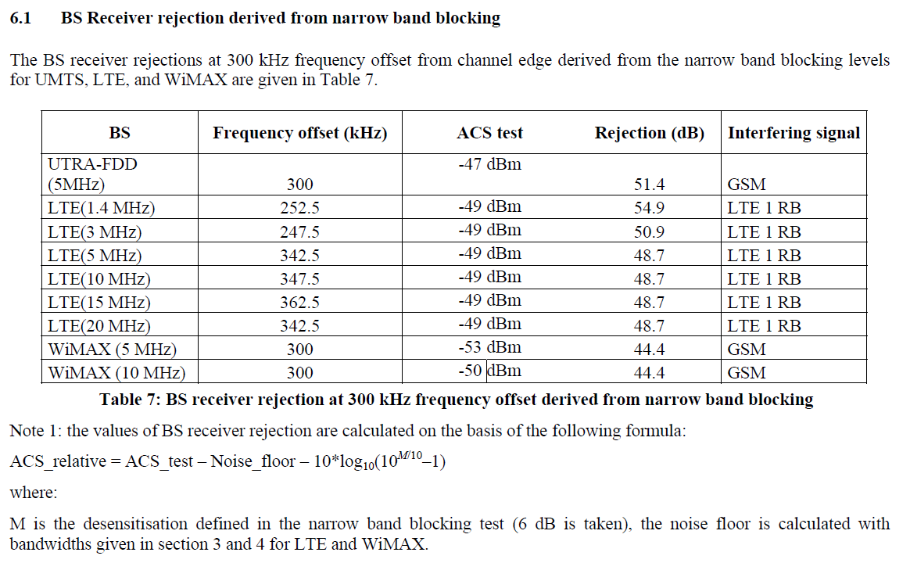
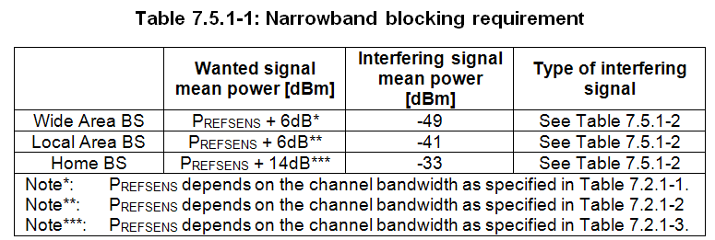

ODMA BS blocking Mask example
Extract from CEPT Report 40 (ITU-R Report M2039)

Slide 17
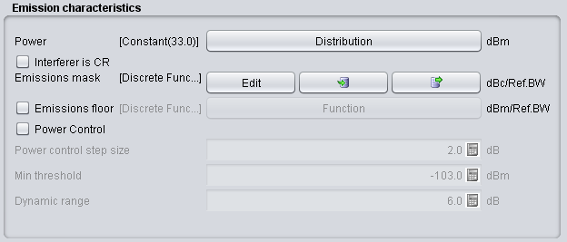
Emission Floor
Useful when power control is used
This emission floor mask (frequency offset (MHz), emission floor (dBm), reference bandwidth (MHz)).

Slide 18
Thank you - Any Questions?

