Slide 1
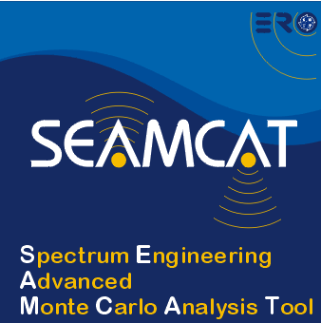

Modeling of
Unwanted and Blocking
Interference Modes
European Communications Office
Jean-Philippe Kermoal
27 November 2012
EUROPEAN COMMUNICATIONS OFFICE | Nansensgade 19 DK-1366 Copenhagen Denmark | Telephone: + 45 33 89 63 00 Telefax: + 45 33 89 63 30 | E-mail: eco@eco.cpet.org Web Site: http://www.cept.org/eco

Slide 2
Outline
Interfering modes
Blocking case
Unwanted emissions case
Exercise #2
Exercise #4
Exercise #3

Slide 3
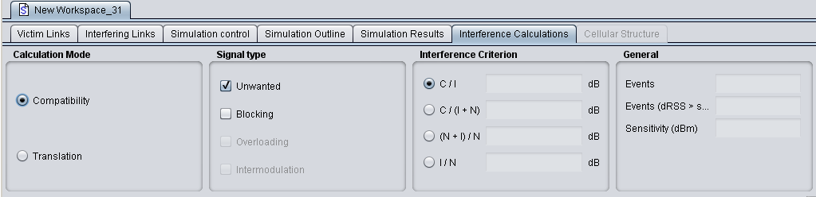
Interference Calculations
Interfering Modes
Interference Criteria
Unwanted and Blocking Signals

Slide 4
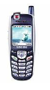
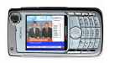
Unwanted Emissions
Victim
Receiver Bandwidth
Interferer emission mask
fv
fI
Interfering System
Interfering emission mask
fI

Slide 5

Exercise #2:
Unwanted calculation
Set victim link receiver (VLR)
  Name: VLR Exercise #2
  Frequency: 910 MHz
  Interference criteria: I/N = 0
  Noise level = -110
  Bandwidth = 150 KHz
Set interfering link transmitter (ILT)
  Name: ILT Exercise #2
  Frequency: 905 MHz
  Power: 23 dBm
  Emission mask: default mask
Path between VLR with ILT
  Propagation model:free space (no variation)
  Position (x,y): fixed, 10km apart

Slide 6
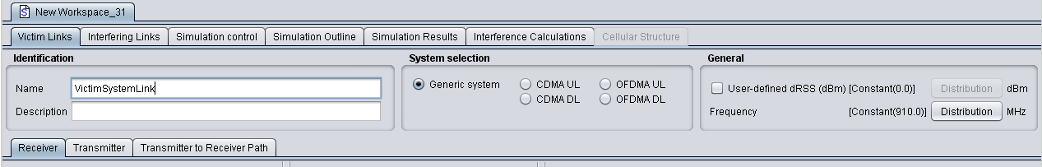
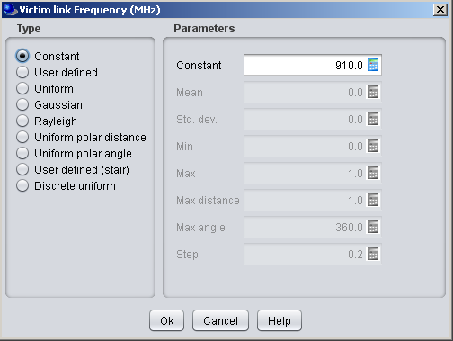
Victim link

Slide 7
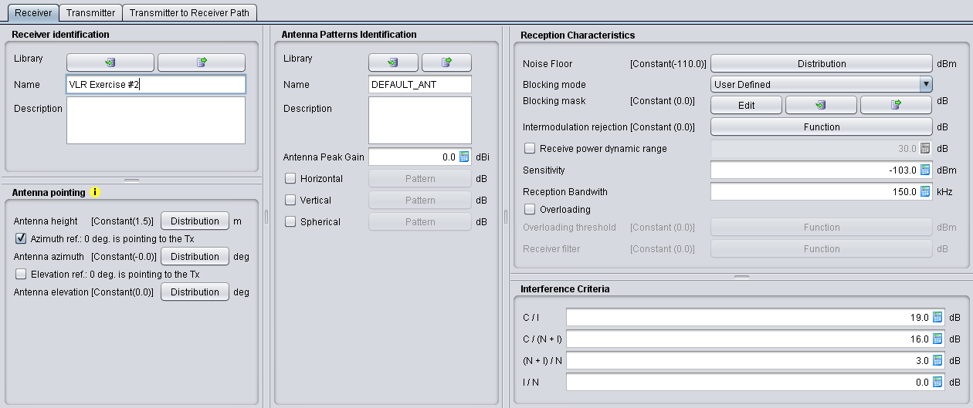
Victim Link Receiver
Noise floor
Description
Reception bandwidth
Interference criteria

Slide 8
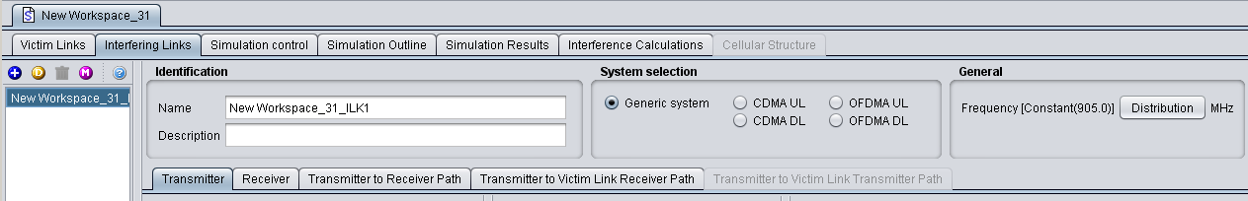
Interfering Link

Slide 9
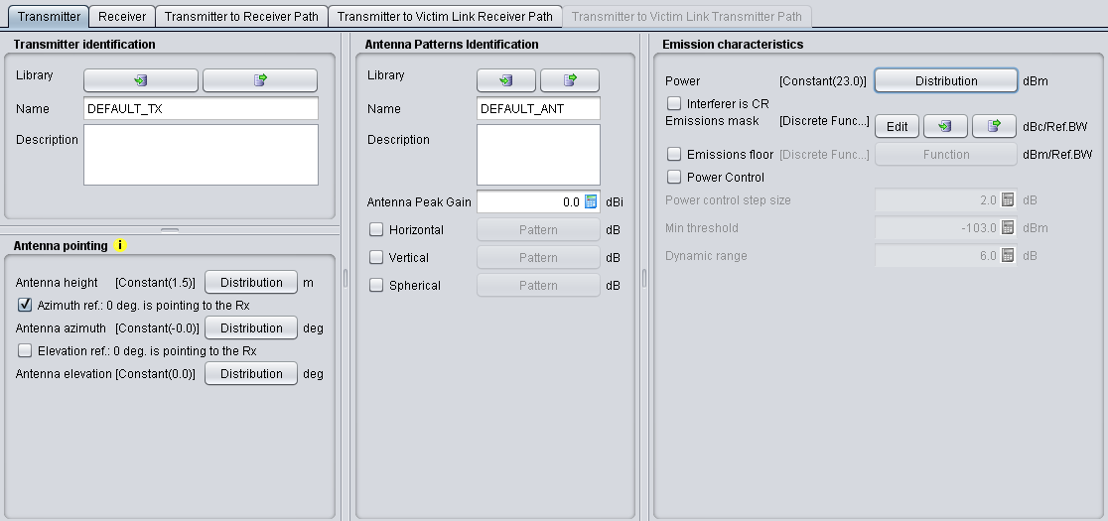
Interfering Link Transmitter
Power
Emission mask

Slide 10
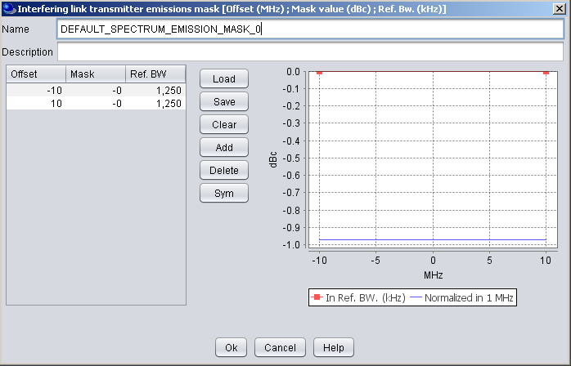
Unwanted emissions mask
Default value
erroneous value
See the following presentations...

Slide 11
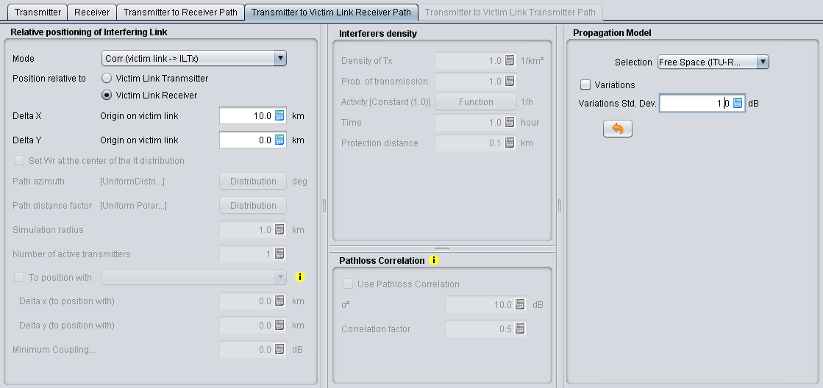
ILT → VLR Path
Att = 32.44 + 20 x log (f (MHz)) + 20 x log (d (km))
Att = 32.44 + 20 x log (905 MHz) + 20 x log (10 km)
Att = 111.57 dB

Slide 12

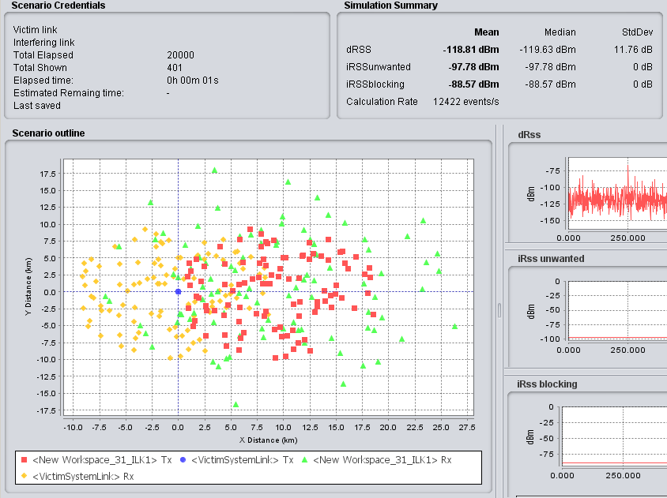
Simulations...
Power in the victim bandwidth:
P(dBm/Bref) = Pe(dBm) + att(dBc/Bref) + CF
Pe = 23 dBm + 0 + 10*log(150/1250)
Pe = 23 dBm + 0 - 9.21dBm
Pe = 13.79 dBm
10 km
Correction Factor (CF) needed because Vr BW < It BW
IRSS Unwanted = Pe + Ge + Gr – Att (free space)
IRSS Unwanted = 13.79 dBm + 0 dB + 0 dB – 111.57 dB
IRSS Unwanted = - 97.78 dBm

Slide 13
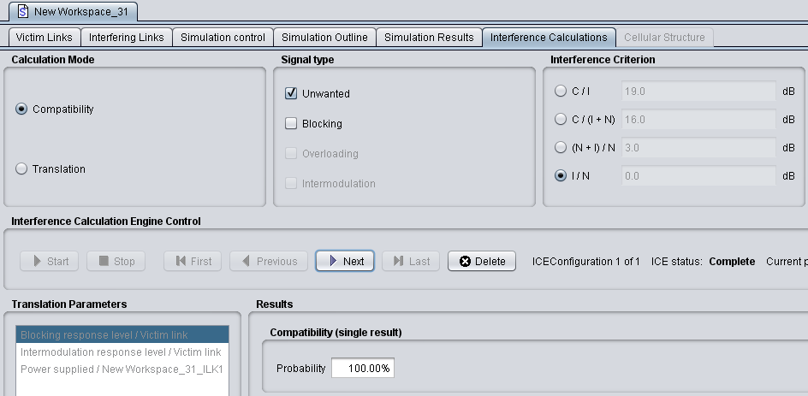
Results
N = -110 dBm
IRSS Unwanted = - 97.78 dBm
I/N = - 97.78 – (-110) = 12.21 dB (→ Calculated by SEAMCAT)
Interference Criterion was: I/N = 0 (→ Input to SEAMCAT)

Slide 14
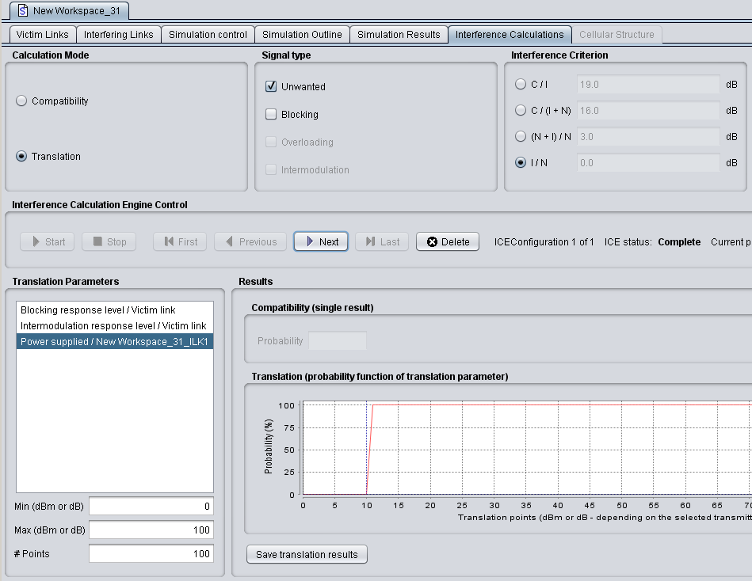
Results...
I/N = 0 respected for Pe < 12.5 dB at 50%

Slide 15
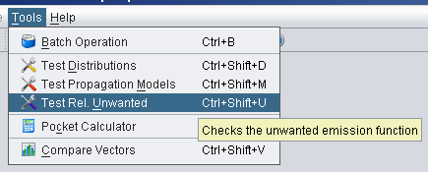
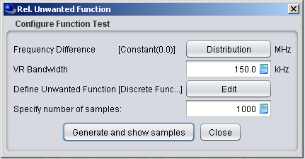
Exercise #3:
SEM calculation
How to check that the Spectrum Emission Mask is properly calculated?
Easy tool in SEAMCAT → “Test Rel. unwanted” tool
  Launch the “Test Rel. unwanted” tool
  Δf = fi-fv = 0
  Vr BW = 150 kHz
  SEM: same as in Exercise #2
  Results: __ dBm

Slide 16
Blocking
Victim
Receiver Bandwidth
Rejection of the receiver
fv
fI
Interfering System
Interferer
fI

Slide 17
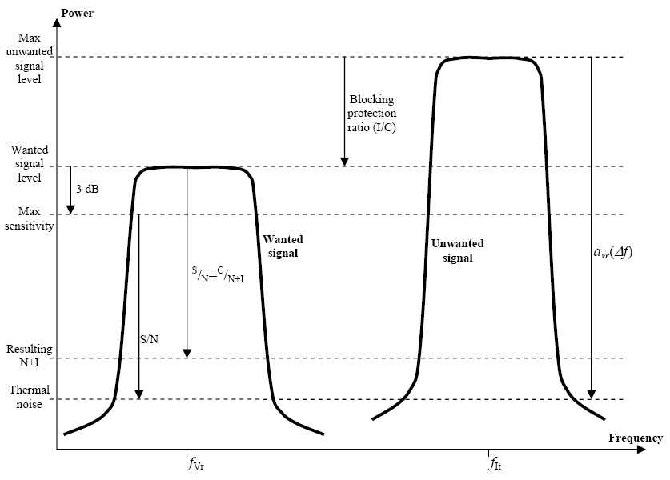
Blocking: 3 Modes
User Defined (dB): Rejection at the receiver
Att_{Blocking} = Block_{UD}
Protection Ratio (dB):
Att_{Blocking} = Block_{PR} + C/(N+I) + 3 dB
Sensitivity Mode (dBm): Maximum Acceptable Value of Power
Att_{Blocking} = Block_{Sens} (dBm) – Sensitivity (dBm) + C/(N+I)
A desensitisation (N+I/N) of 3 dB is assumed

Slide 18
But not so different
Protection Ratio:
Interfering Blocking Level = Pe + Ge + Gr – Att – Att_{Blocking}
Where: Att_{Blocking} = Block_{PR} + C/(N+I) + 3 dB
If C/(N+I) = - 3 dB
Att_{Blocking} = Block_{PR} - 3 dB + 3 dB = Block_{PR}
....equivalent to User Defined Mode
If C/I = 0 dB
Broadcast PR Mode...

Slide 19
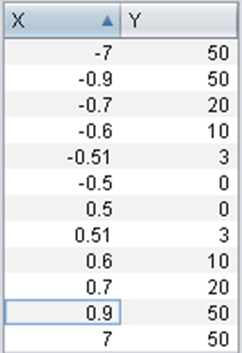
Exercise # 4: blocking calculation
Set victim link receiver (VLR)
  Blocking mode: user defined
  Blocking response: function
  Interference criteria: I/N = 0
  Noise level = -110
Set interfering link transmitter (ILT)
  No change
Path between VLR with ILT
  No change

Slide 20
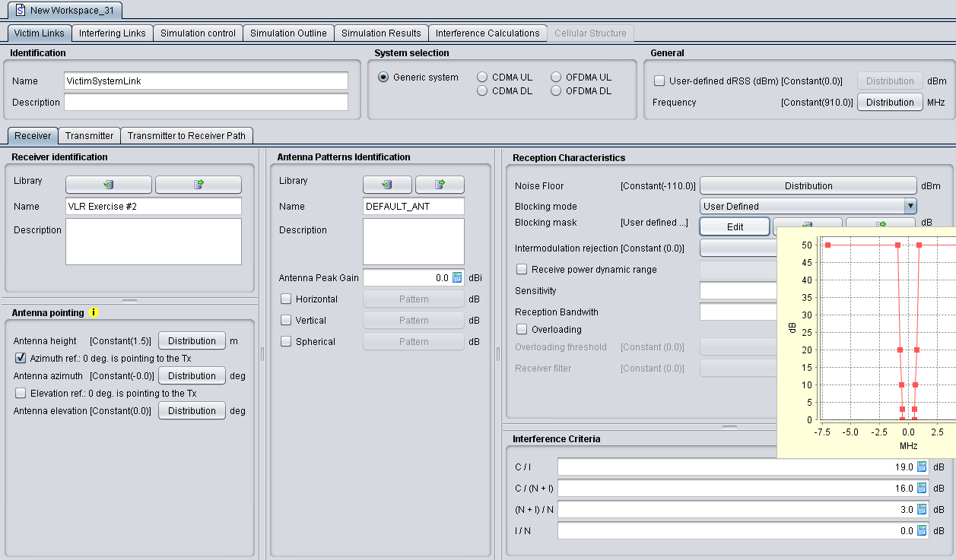
Victim link

Slide 21
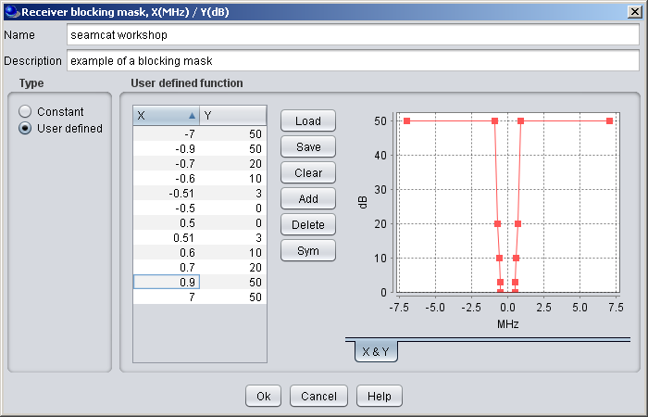
VLR Blocking Mask
fV
fI
Should be defined at the frequency of the Interferer
Att blocking = 50 dB
(e.g. Defined in ETSI Standards)

Slide 22
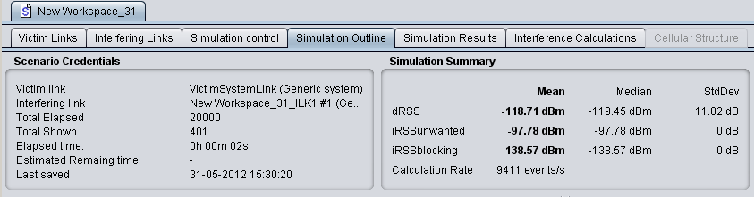
Simulations
IRSS Blocking= Pe + Ge + Gr – Att (free space) – Att block
IRSS Blocking= 23 dBm + 0 dB + 0 dB – 111.57 dB – 50 dB
IRSS Blocking = - 138.57 dBm

Slide 23
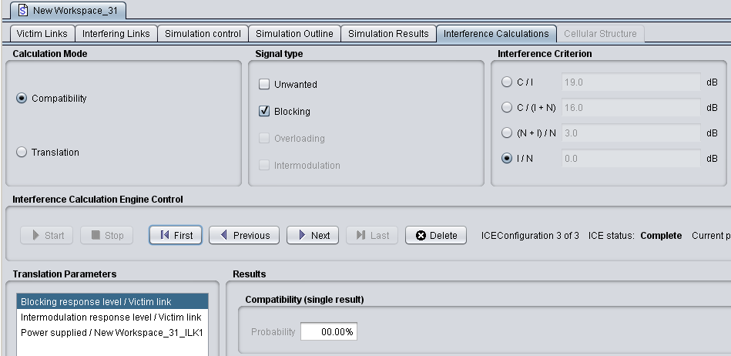
Results
IRSS Blocking Level = - 138.57 dBm
N = -110 dBm
I/N = 0 dB (Criterion) always met

Slide 24
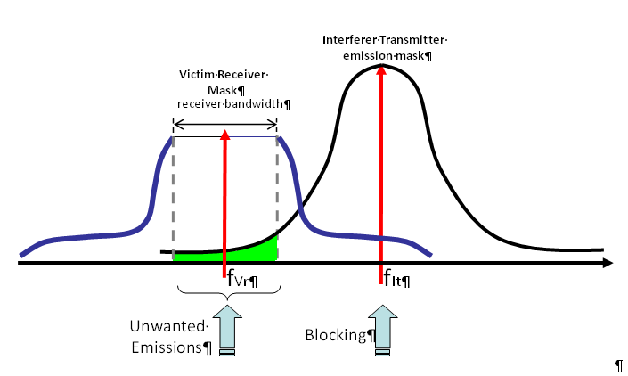
Question?
Can I make simulation for unwanted and blocking in the same workspace?

Slide 25
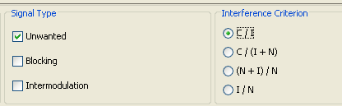
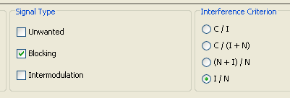
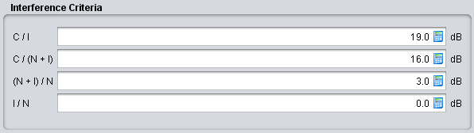
Question: Can I make simulation for unwanted and blocking in the same workspace?
2 Interference Criteria / 2 runs

Slide 26
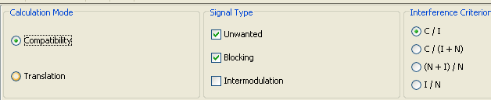
Question: Can I run simulations for unwanted and blocking in the same workspace in a single run?
If the interference criteria are not the same... You can compensate this when defining the mask (unwanted or blocking)
Blocking: PR mode + Criterion: C/I=0 dB
Unwanted: Criterion C/I=10 dB
Remove 10 dB from blocking mask
Criterion C/I=10 dB

Slide 27
Questions?
Thanks for your attention

