Slide 1
Basic functionality: Antenna Pattern Antenna positioning Reports and debug mode
European Communications Office
Jean-Philippe Kermoal (ECO)
27 November 2012
EUROPEAN COMMUNICATIONS OFFICE | Nansensgade 19 DK-1366 Copenhagen Denmark | Telephone: + 45 33 89 63 00 Telefax: + 45 33 89 63 30 | E-mail: eco@eco.cept.org Web Site: http://www.cept.org/eco

Slide 2
Outline
Antenna pattern
Antenna pointing
Exercise #9
Reports + debug mode
Exercise #10

Slide 3
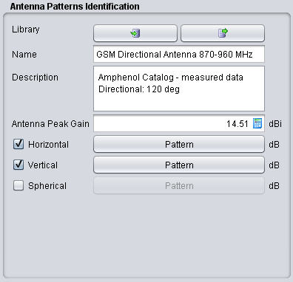
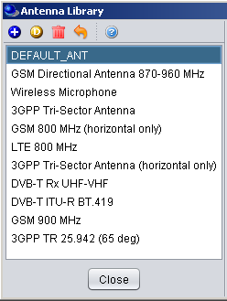
Antenna pattern
”generic”, CDMA and OFDMA use the same antenna pattern convention
Horizontal: 0 to 360 deg
Vertical: -90 to 90 deg
Spherical: 0 to 180 deg
Hori. and Vert. Can be combine (pseudo 3-D)
Use library to ease your work

Slide 4
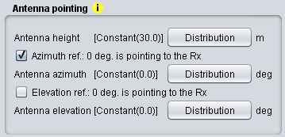
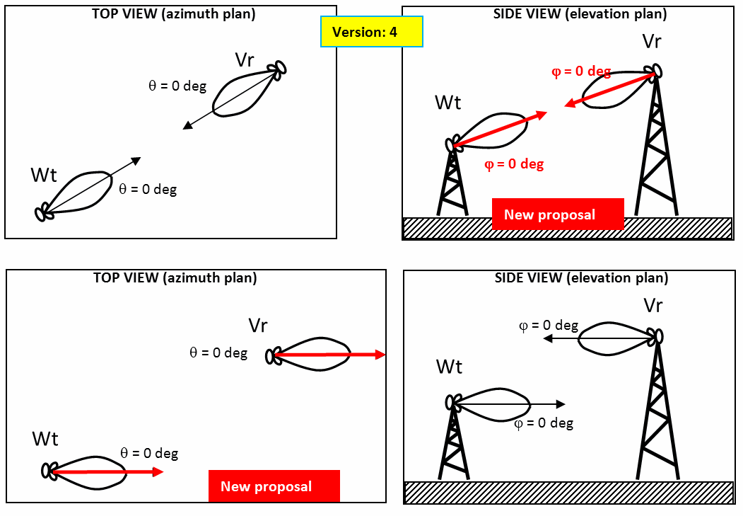
Antenna pointing
Allows beamforming tracking (e.g. Airplane)

Slide 5
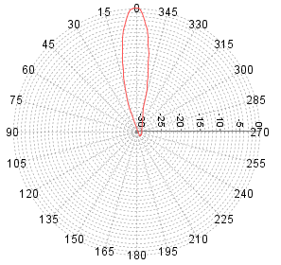
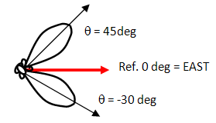
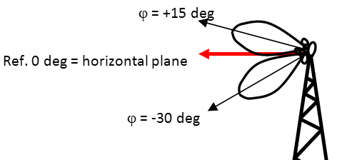
Antenna pointing convention
Horizontal antenna pattern angle definition:
positive → counter-clockwise to the 0 deg reference
Azimuth angle:
positive → counter-clockwise to the 0 deg reference
Elevation angle:
positive → clockwise to the 0 deg reference

Slide 6
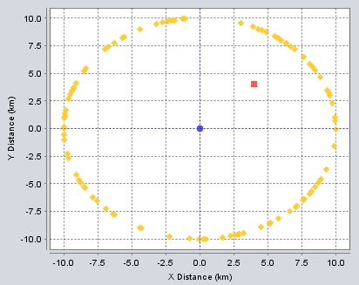
Exercise #9 - Antenna
Focus on the dRSS (ILT and ILR not important)
Select VLT antenna: ” GSM Directional Antenna 870-960 MHz”
Position the VLR arround the VLT in a circle (10 km radius)
Fix the path loss to free space and no variation
6 positions of the VLR
0, 30, 60, 90, 120 deg
Calculate the dRSS where VLT azimuth ref. is:
Selected
Not selected
Not selected with + 60 deg azi. shift

Slide 7
Exercise #9 – dRSS results
position | 0 deg | 30 deg | 60 deg | 90 deg | 120 deg
 | -58.99 | -58.99 | -58.99 | -58.99 | -58.99
 | -58.99 | -59.07 | -73.3 | -78.59 | -81.78
+ 60 deg Azi | -73.05 | -58.99 | -58.99 | -59.07 | -73.3

Slide 8
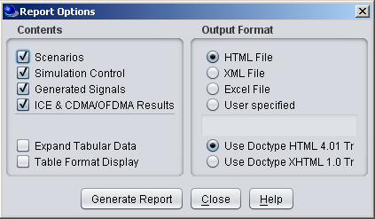
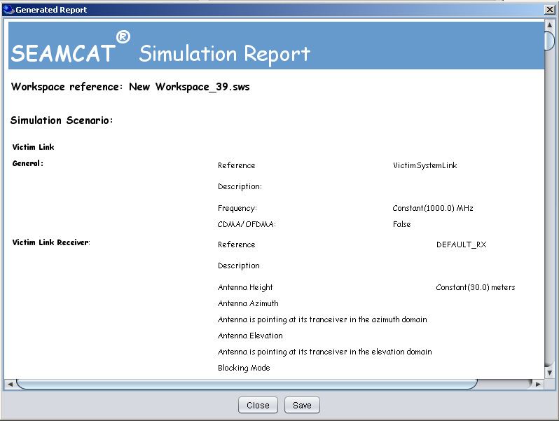
Report generation

Slide 9
Debug mode
Allows you to cross check the intermediary results of SEAMCAT
Should select only 1 or 2 events to limit the size of the logfile

Slide 10
Exercise #10 - debug
Generate your own report
Generate a logfile and cross check
Allows you to cross check the intermediary results of SEAMCAT
Should select only 1 or 2 events to limit the size of the logfile

Slide 11
Thank you - Any Questions?

