Slide 1
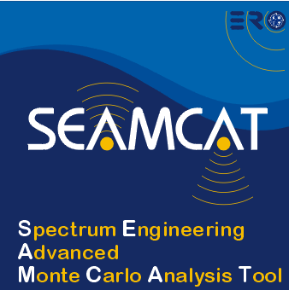

Basic functionality:
Batch operation
Multiple vector display
Compare propagation model
European Communications Office
Jean-Philippe Kermoal (ECO)
27 November 2012
EUROPEAN COMMUNICATIONS OFFICE | Nansensgade 19 DK-1366 Copenhagen Denmark | Telephone: + 45 33 89 63 00 Telefax: + 45 33 89 63 30 | E-mail: eco@eco.cept.org Web Site: http://www.cept.org/eco

Slide 2
Outline
Exercise #10: Batch operation
Exercise #11: Multiple vectors
Exercise #12: Compare propagation models

Slide 3
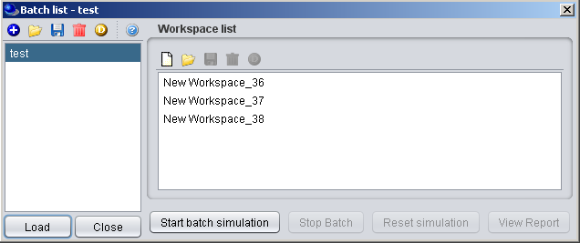
Exercise #10:
Batch operation
Start SEAMCAT batch mode
Create 3 new workspaces
Change the VLT power:
  33 dBm
  20 dBm
  10 dBm
Launch the batch simulations

Slide 4
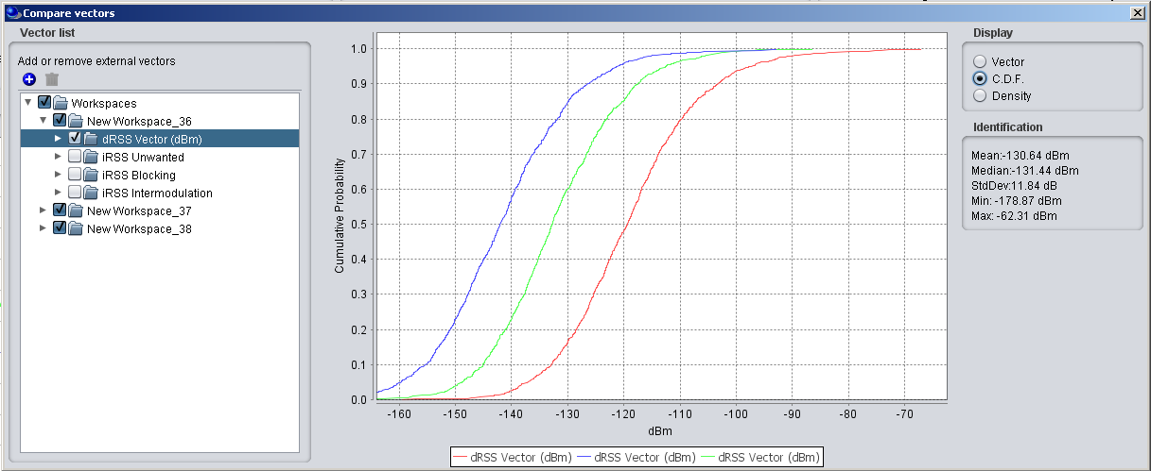
Exercise #11:
Mutiple vector display
Display the 3 dRSS vectors resulting from the batch simulation
Possibility to add external vectors from past simulation

Slide 5
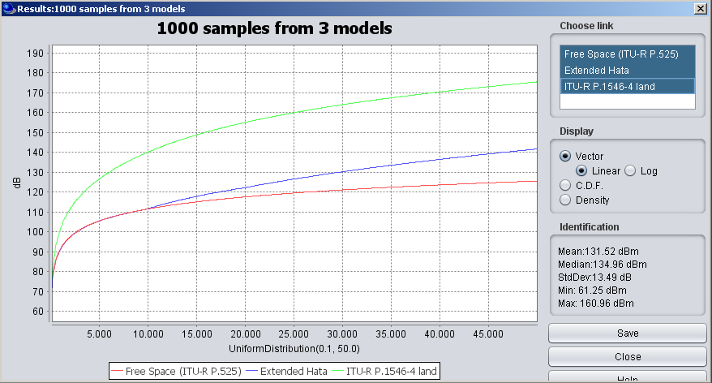
Exercise #12:
Compare propagation model
Select 3 propagation models
  Free space
  Extended hata
  ITU-R P.1546-4
Assumptions
  no variations
  Tx: 30 m, Rx: 10 m
  Distance from 100m to 50 km

Slide 6
Thank you - Any Questions?

