Slide 1
1 Gbps Over-the-Air (OTA) Measurements of 802.11ac
May 10, 2018
Version 3
Liang Li
Chuck Lukaszewski
Hewlett Packard Enterprise

Slide 2
Next-Gen 802.11ax Radios Will Enhance 6 GHz Coexistence…
802.11ax Channelizations
20
802.11ax and 3GPP NR-U are minimum technologies
  No legacy 802.11 a/n/ac or LTE radios are expected in 6 GHz
80% or more of 6 GHz devices will use 80 MHz or wider channels
11ax devices will be capable of bidirectional multi-user operation (OFDMA and MU-MIMO)
Gigabit+ data rates allow very low duty cycles
Gigabit+ data rates reduce time domain interference
Wide channels reduce frequency domain interference
40 MHz
80 MHz
160 MHz
802.11ax Data Rates
Spatial Streams | 80 MHz | 160 MHz
1SS | 600 Mbps | 1.2 Gbps
2SS | 1.2 Gbps | 2.4 Gbps
4SS | 2.4 Gbps | 4.8 Gbps
6SS | 3.6 Gbps | 7.2 Gbps
8SS | 4.8 Gbps | 9.6 Gbps

Slide 3
… But Current Generation 11ac Radios Already Deliver 1+ Gbps
802.11ac supports up to 4 spatial streams, and Multi-User MIMO in downlink direction
802.11ac “Wave 1” products deliver ~900 Mbps using 3 spatial stream clients
  These products have been shipping since 2013
802.11ac “Wave 2” products deliver 1 Gbps in multiple ways:
  Multi-User MIMO (MU-MIMO) to 4 single-stream clients in 80 MHz channel
  Single-User to 1 dual-stream client in 160 MHz channel
  Single-User to 1 dual-stream client in 80 MHz channel with prestandard 1024QAM
  Single-User to 1 quad-stream client in 80 MHz channel
  These products have been shipping since 2017
This contribution provides measurements at Layer 4 (e.g. UDP or TCP) of these modes
  The Layer 1 PHY rate is 20-30% higher.
802.11ac Data Rates (256QAM)
Spatial Streams | 80 MHz | 160 MHz
1SS | 433 Mbps | 867 Mbps
2SS | 867 Gbps | 1.7 Gbps
3SS | 1.3 Gbps | 2.7 Gbps
4SS | 1.7 Gbps | 3.4 Gbps

Slide 4
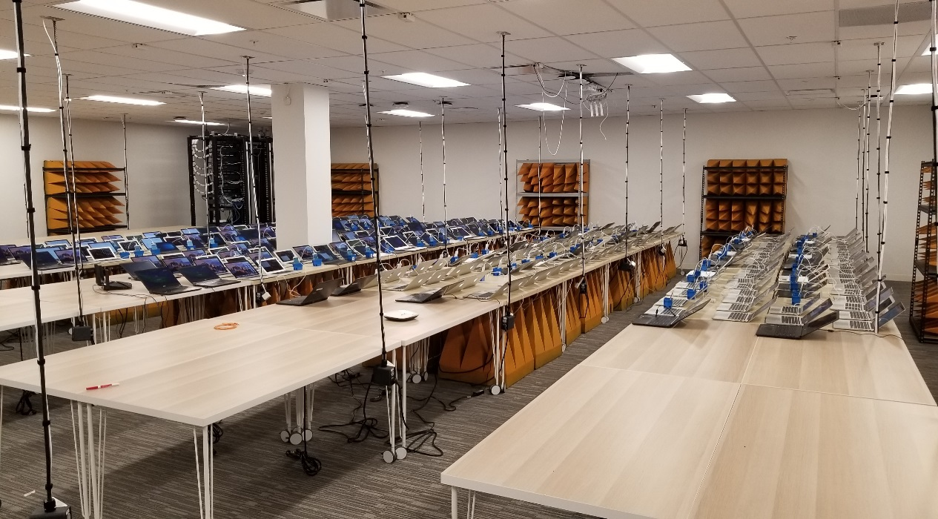
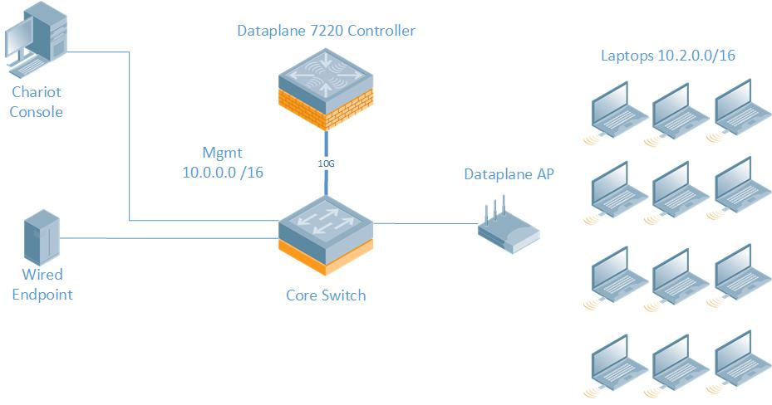
HPE High Density Testbed
RF chamber 18m * 18m * 4m
Over 400 laptops, tablets and phones (802.11ac Wave 1 and Wave 2)
10 Gbps backbone to enable multi-Gbps OTA tests
IxChariot automation tool generates synchronized loads across large numbers of stations
Multiple IxChariot wired endpoint machines to enable multi-Gbps full buffer traffic loads
IxChariot agent installed on the wireless STAs
Dedicated wireless sniffers for lossless packet capture

Slide 5
802.11ac Wave 1 Delivers 900 Mbps TCP
Testbed Details
AP | Aruba AP-335 (4x4:4 802.11ac Wave 2)
Channel | 149E
Bandwidth | 80 MHz
Stations | 100
Client Type | Vendor B 13” Laptop (2013 model)
Radio | Vendor M 3x3 802.11ac Wave 1 (2013 model)
Traffic | TCP Uplink
802.11ac Wave 1 delivers up to 900 Mbps over the air at Layer 4 with TCP
Performance is very stable out to 100 stations all pushing full buffer traffic

Slide 6
Wave 2 Delivers Over 1 Gbps with Multi-User MIMO in 80 MHz
Testbed Details
AP | Aruba AP-345 (4x4:4 802.11ac Wave 2)
Channel | 149E
Bandwidth | 80 MHz
Stations | 10
Client Type | Vendor A 13” Laptop (2016 model)
Radio | Vendor N 2x2 802.11ac Wave 2 (2017 model)
Traffic | UDP Downlink
802.11ac Wave 2 delivers more than 1 Gbps over the air by addressing multiple users simultaneously
Wave 2 supports up to 4 concurrent stations in a single transmission in downlink direction

Slide 7
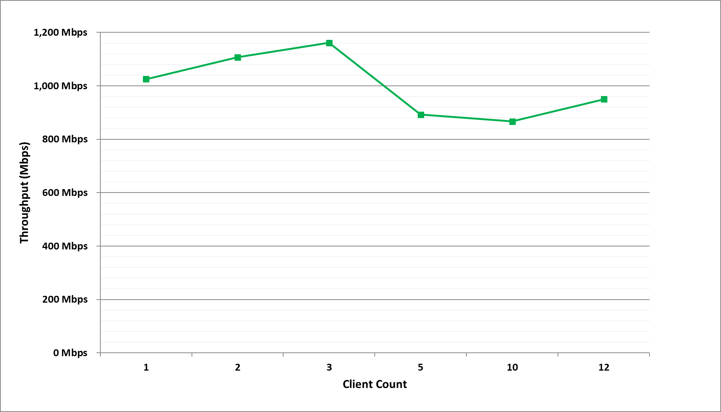
Wave 2 Delivers Over 1Gbps with 160 MHz Channels
Testbed Details
AP | Aruba AP-345 (4x4:4 802.11ac Wave 2)
Channel | 36S
Bandwidth | 160 MHz
Stations | 12
Client Type | Vendor A 13” Laptop (2016 model)
Radio | Vendor N 2x2 802.11ac Wave 2 (2017 model)
Traffic | UDP Downlink
802.11ac Wave 2 delivers more than 1 Gbps over the air when using ultra-wide 160 MHz channels
Stations are served one-at-a-time; The AP can maintain gigabit-level performance to multiple stations

Slide 8
Wave 2 Delivers Over 1 Gbps with 4 Spatial Stream SU Clients
Testbed Details
AP | Aruba AP-345 (4x4:4 802.11ac Wave 2)
Channel | 149E
Bandwidth | 80 MHz
Stations | 1
Client Type | Vendor C (2018 model)
Radio | Vendor M 4x4 802.11ac Wave 2 (2018 model)
Traffic | UDP & TCP
Using 4 spatial streams, 802.11ac Wave 2 delivers achieves over 1 Gbps between AP and STA
This would be typical of 4K TV sets, set top boxes, and mesh links between consumer APs

