Slide 1
Bluetooth SIG conclusions on the 5 MHz RI impact on WDTS battery powered RFIC receivers
Magnus Sommansson, vice chair Bluetooth SIG Regulatory Expert Group
WG SE #96 – input contribution
3 May 2024

Slide 2
Bluetooth SIG summary of events
Initially SE21 only referred to WAS/RLAN; Bluetooth was added for clarity due to the shared HS: EN 300 328
To manage, from WG SE #95 the public consultation on Rec(24)01 was associated the following cover note
During the consideration of the RLAN 2.4 GHz at WG SE 95th meeting, it was agreed to point out for the public consultation that it may be required to split the current table (Annex 6, Table 29) to create a dedicated table for Bluetooth and a dedicated table for medical devices and a dedicated table for RLAN client devices in the same format as this current table (to note that this current table would remain applicable for RLAN access points). These values could be based on the current standards and extended with additional values as necessary. This may be also applicable for medical devices in other frequency bands.
The Bluetooth SIG public consultation response included only a CW table values derived from current HS.
In the WG SE 21, 10-12 April:
  the addition of 5 MHz RI equivalent for Bluetooth was mandated and
  it was indicated that France (and other administrations) and the EC are strongly in favour of applying RI instead of CW
In parallel with the WG SE 21 comment resolution sessions, a substantial number of members of the Bluetooth SIG managed to do first measurements for the CW and RI signal, using the golden wave form from JRC representing the RI signal

Slide 3
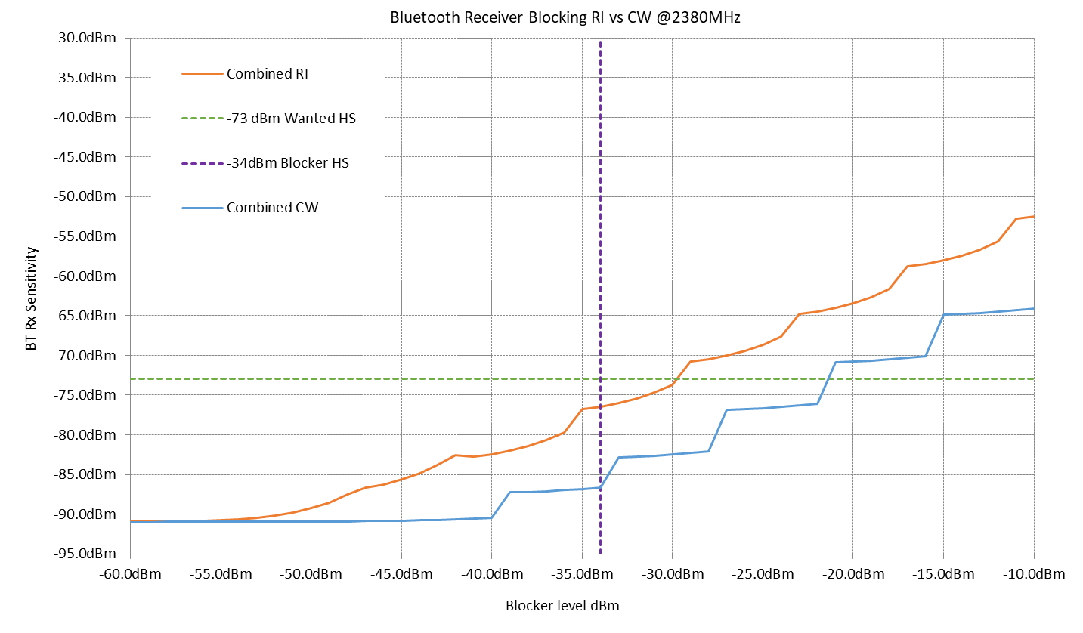
Impact of RI on low power RFIC receivers - Bluetooth and other WDTS
Golden RI signal has 9.4 dB peaks compared to CW
Low power receivers have a modest dynamic range (capability of handling high and low power signals at the same time) due to power consumption limitations
The high peaks of an interference signal close to the wanted signal triggers reduction of the gain of the AGC to avoid non-linearity
AGC reduction causes less power of the wanted signal at the detector compared to CW, so noise starts to affect a weak wanted signal sooner
In this example blocking performance with RI is reduced by 8dB

Slide 4
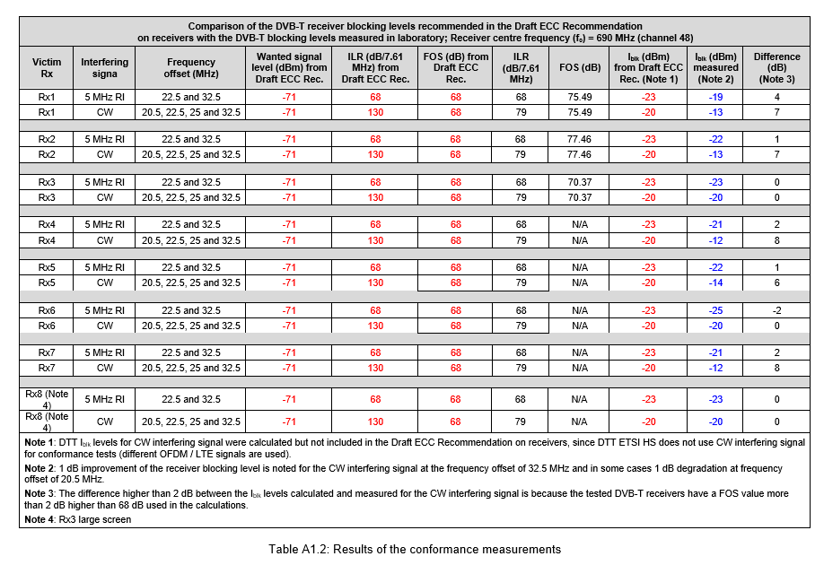
Difference in measured receiver blocking level between Reference Interferer & CW Signal – ANFR Measurements, input to SE21#120 Oct 2023, in document SE21(23)042,
DVB-T Receiver Sample | Measured difference in blocking I_{blk}
Rx1 | 6dB (-19dBm/-13dBm)
Rx2 | 9dB (-22dBm/-13dBm)
Rx3 | 3dB (-23dBm/-20dBm)
Rx4 | 9dB (-21dBm/-12dBm)
Rx5 | 8dB (-22dBm/-14dBm)
Rx6 | 5dB (-25dBm/-20dBm)
Rx7 | 9dB (-21dBm/-12dBm)
Rx8 | 3dB (-23dBm/-20dBm)
RI/CW delta average 7.1 dB
(8 DVB-T samples)
ANFR data (left), is in line with the Bluetooth SIG view and justifies an offset in power levels between RI & CW for the same effect
Bluetooth SIG member measurement show that there is a delta in the value of I_{blk} between the RI and CW signal of around 8 dB.

Slide 5
Bluetooth SIG conclusions
A substantial number of Bluetooth SIG member results show that the RI signal induces between 2dB and 12dB of additional receiver desensitisation above that experienced by a CW test
8dB is a good average
On mains powered OFDM receivers (DVB-T) tested by ANFR, results are comparable
Since the CW interferer is at -34dBm in EN 300 328 the Rec24(01) can be published with CW figures only, OR additionally include the equivalent RI at level: -42dBm for 1 & 2 MHz WDTS (in table 31),
Otherwise, more testing is needed
  Bluetooth SIG will support further testing together with interested administrations

Slide 6
Way forward on low power WDTS receiver resilience
Considering the enormous impact on the IoT industry:
  There are currently no problems due to blocking in practice
  If further improvement is requested, figures should be selected with realistic system inteference mitigation factors taken into account such as Adaptive Frequency Hopping (AFH) and interference statistics based on Seamcat simulations
  Higher blocking performance requirement leads to:
    low power operation impacts: affects battery life / ability to operate without battery
    impacts the size of highly miniaturized products
    higher cost for the public
  Ensure a substantial lead time for industry to handle new target figures: at least 5 years
  Some important sectors will need longer lead times

Slide 7
Backup slides

Slide 8
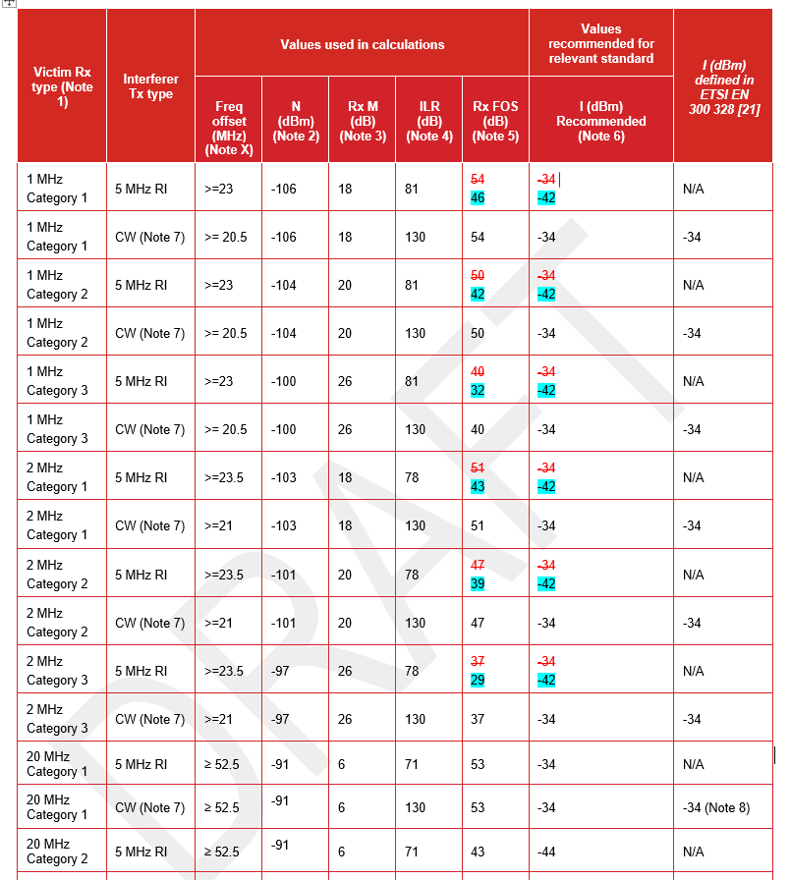
Bluetooth SIG suggested updates to
Rec 24(01) table 31, RI figures for
Cat 1 to 3, 1 & 2 MHz WDTS receivers

Slide 9
Abstract
This presentation will show that RFIC receiver “Frequency Offset Selectivity” (FOS) is a function of the type of blocking interferer used – Continuous Wave (CW) or Reference Interferer (RI).
The RI waveform is a 5MHz LTE-like OFDM signals and is a more demanding test than CW due to the PAPR of 11dB.
RI signal is a good representation for OFDM type interferers, e.g. mobile infrastructure, mobile handsets, Wi-Fi.
But CW testing is a good representation for blocking from other Bluetooth interferers, especially Bluetooth Low Energy as this uses GFSK modulation.
CW testing is used for out-of-band blocking (OOBB) in most standards, e.g. 3GPP, Bluetooth - (OOB meaning outside the declared operating band ± 20MHz Typ).
Recommended blocking test levels in SE21 Rec 24(01) should be approximately aligned to both signal types.

Slide 10
Receiver Blocking Interferer Mechanisms
It is understandable that SE21 wish to use a simple “additive” mechanism for the on-channel interference that the parameter M refers to, for quantifying receiver desensitisation.
However, receiver blocking mechanisms are complex and can be highly non-linear.
Receiver AGC/RSSI performance is important and is a function of the signal type (wanted and blocking), being processed.
Next we summarise the various mechanisms and include the ones which are relevant to the results in this contribution.

Slide 11
Receiver Blocking Mechanisms – single blocker only
Mechanisms that cause a linear dB_{noise} for dB_{OOBB} noise increase (M in the SE21 calculations) ...
  Reciprocal mixing due to LO phase noise (PN) mixing with the OOBB at the frequency offset between the Rx W and the OOBB signal.
    Affects CW and Modulated OOBB. Included in this study
  Rx NF rise due to OOBB AGC "gain stealing" in the Rx. Gain stealing is where the level of the OOBB signal activates the RSSI detectors in the Rx causing the AGC to reduce Rx gain before the triggered RSSI to maintain Rx linearity. The reduced Rx gain increases the Rx NF.
    Affects CW and Modulated OOBB. Included in this study. The higher PAPR of the RI signal activates more Rx gain reduction, which increases noise and desensitization.
  Noise folding of image noise which appears at the image of the OOBB and the Rx wanted.
    Affects CW and Modulated OOBB. Not included in this study as this is normally a problem for very low SNR systems with potentially high blocker levels, e.g. GPS jamming
  RF and Analogue filter attenuation floor limitations. In effect LO PN reciprocal mixing generates an equivalent filter floor.
    Affects CW and Modulated OOBB. Not included in this study.

Slide 12
Receiver Blocking Mechanisms – single blocker only
Mechanisms that cause an expansive non-linear dB_{noise} for dB_{OOBB} noise increase (M in the SE21 calculations) ...
  Intermodulation products from distortion of a single modulated OOBB.
    Modulated OOBB only for 1x OOBB signal. Not included in this study as the center of 4.5MHz OFDM signal is at 22.5MHz offset (2380 MHz). The order of modulation distortion that appears in the wanted BT channel at 2402 MHz will be 9th and 11th order.
  Square-law distortion from rectification of the power envelope of the modulated OOBB waveform, (also known as IMD2 and defined by IIP2).
    Modulated OOBB. Included in this study. The mechanism is frequency offset agnostic, any modulated blocker within the tuned RF passband of the Rx can self-mix to the IQ baseband.

Slide 13
Receiver Blocking Mechanisms – single blocker only
Mechanisms that do not cause a noise rise (M) ...
  Gain Compression from clipping of OOBB signal.
  Affects CW and Modulated OOBB. Actually reduces noise, but also signal as well. Not included in study.
  Cross-modulation of the power envelope of the modulated OOBB signal onto the Rx wanted signal - reduces Rx Wanted SNR and is a problem for very high SNR systems, e.g. 1KQAM, 4KQAM.
  Modulated OOBB only. Not included in this study since BT uses a relatively low SNR.

Slide 14
Rx Blocking RI vs CW, Inc LO PN, IMD2 and AGC Rx NF
The plot on the right shows BT Rx sensitivity vs blocker level.
Red is the RI blocker, blue is CW.
The EN 300 328 HS requirements for Rx blocking with CW at the wanted level for 2380 MHz are shown
There is an 8dB difference between the results.
RI passes the HS test with 4dB margin, CW passes with 12dB margin.
The sources of noise/distortion are:
Rx noise figure rise due to AGC activity to keep the receiver operating in a linear region. AGC steps are 6dB.
2. Phase noise (PN) from the Local Oscillator (LO) from reciprocal mixing at the blocker frequency offset
3. Square-law distortion from the IMD2 products resulting from the RI blocker self-mixing down to IQ baseband. Governed by IIP2 of receiver. IIP2 calibration methods are used with some success. Good AGC operation is important to avoid clipping on the peaks of the RI signal. CW blockers can cause dc offsets.

Slide 15
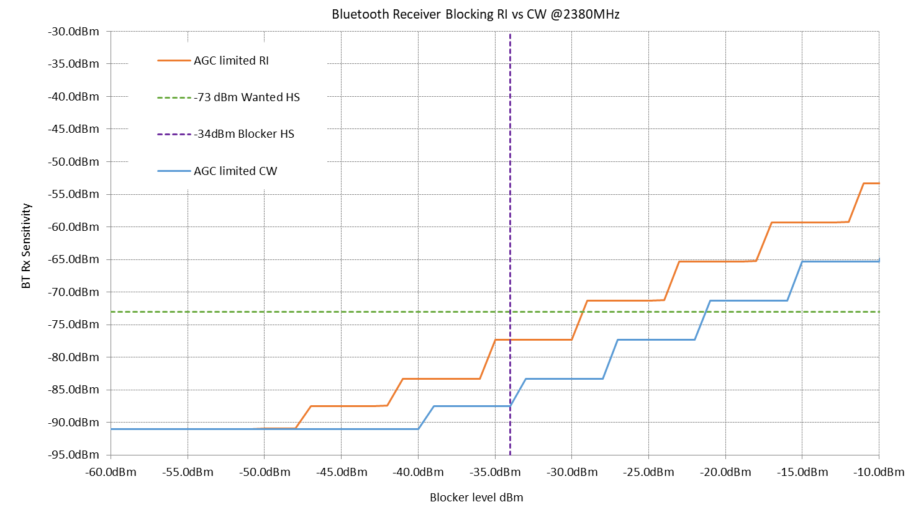
Rx Blocking RI vs CW - AGC Rx NF rise only
Rx blocking is limited to AGC effects only.
Increasing blocker levels are detected in the distributed RSSI and if an overload occurs the AGC is activated to reduce the gain from the stages before the overloading RSSI.
Reducing the gain increases the receiver noise figure (Rx NF).
If the RSSI detects the peaks accurately then the curves are offset by the PAPR of the RI signal.
In practical AGC for BT, the RSSI are sampled for short periods at the beginning of the packet and may miss the peaks.
The RSSI detectors themselves may not represent the peaks very accurately.
This RSSI measurement spread can lead to AGC convergence variation. Failure to reduce the gain by enough can cause clipping of the blocking signal in the receiver. If the gain drops by too much then Rx NF increases needlessly.
In the plot above, with perfect AGC, the peaks are detected resulting in an 8dB offset between RI and CW.

Slide 16
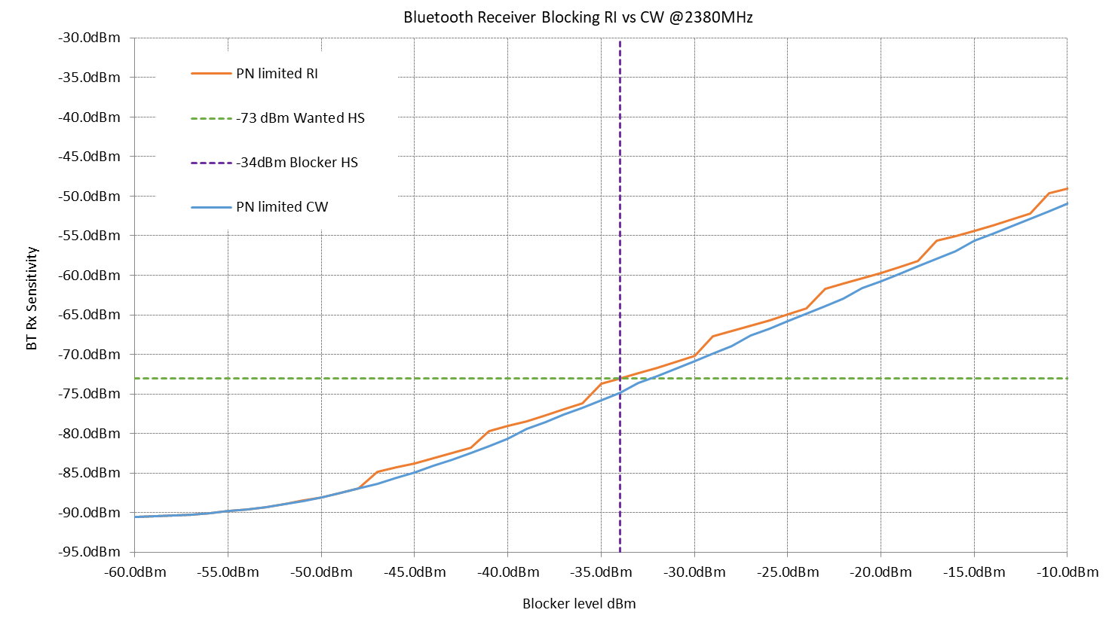
Rx Blocking RI vs CW - LO PN dominating
RX blocking limited to LO phase noise only. Failure aligned around HS signal levels. Achieved by degrading BT LO PN by 19dB to make PN dominant.
Note how the PN drowns out the AGC “staircase” noise and reduces the difference between RI and CW.
RI is still approx. 2dB worse than CW due to contributions from the AGC staircase noise, which occurs at 8dB lower blocker rms level.
LO PN limitation is a small contributor to Bluetooth since the LO is shared with transmit and the transmit requirements are tougher than Rx (due to Tx mask measurement method), which results in plenty of margin for BT Rx LO PN
In other receivers, LO PN is often a larger contributor hence the observation from SE21 of only a 2-3 dB difference between CW and RI from measurements. Would be interesting to see which technologies were measured.
LO PN is the blocking mechanism that best fits the current SE21 methodology as it creates a dB for dB noise rise in the victim channel

Slide 17
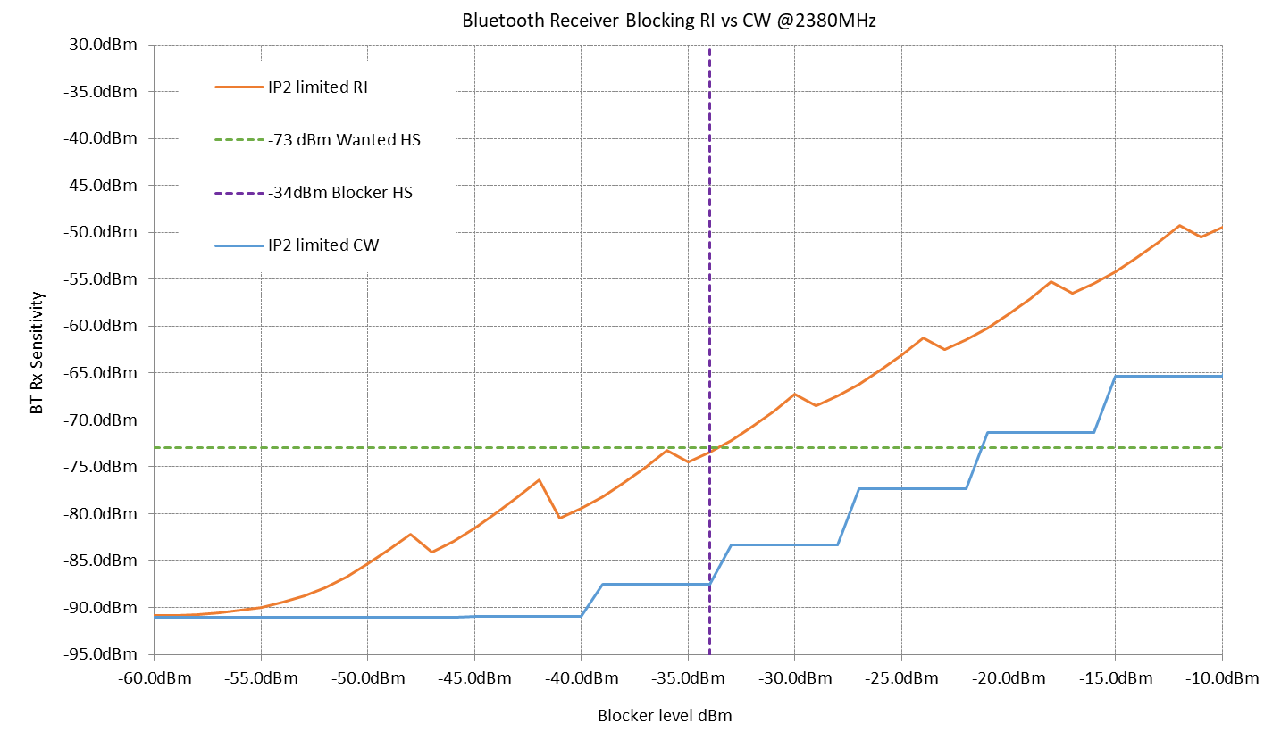
Rx Blocking RI vs CW - IMD2 dominating
In this example IMD2 distortion is dominating, which is achieved by degrading IIP2 by 8dB.
This distortion results from the blocker self-mixing down to IQ baseband in the ZIF or Lo IF RF front-end mixers.
For every dB increase in the blocker level, the noise in the IQ baseband increases by 2dB.
Notice around the AGC step transition points how the Rx sensitivity actually improves a little with increasing blocker level. This is because a 6dB drop in Rx gain causes a 12dB drop in IQ baseband noise, which more than offsets the RF NF increase. These Rx Sensitivity “switchbacks” are typical of an IIP2 limited system.
This can be due to poor design, or a calibration issue, or clipping due to poor AGC RSSI detection.
The difference between CW and RI in this case is 12dB and the RI test is exposing a problem in the design.

Slide 18
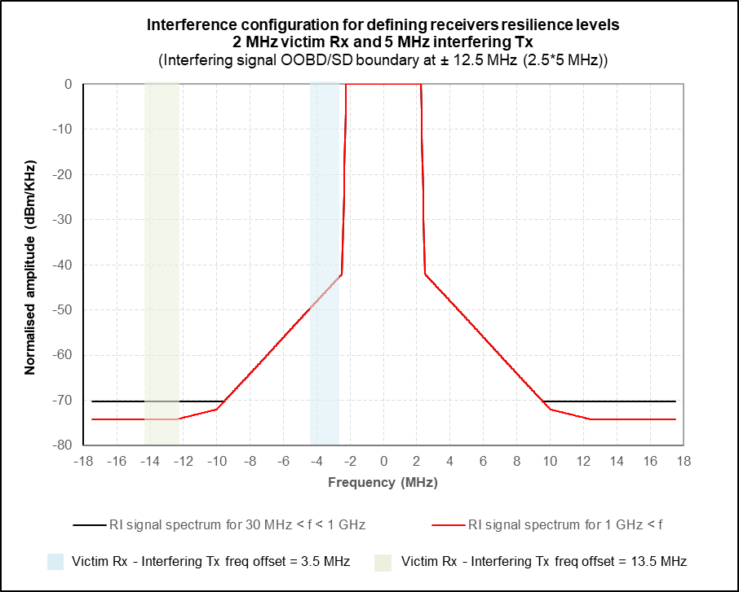
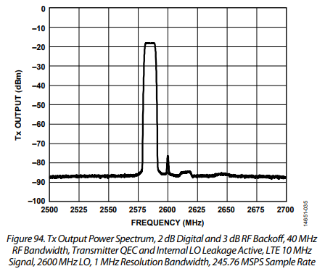
Modulated (RI) Signal Spectra for >1GHz – RI signal isn’t very representative of a practical LTE infrastructure transmission
Noted as BTSIG/8 comment to PC on report 356
https://www.analog.com/media/en/technical-documentation/data-sheets/AD9371.pdf ➔
The current FOS method has typically a 50:50 split between the desensitisation from the wanted channel ILR noise of the RI signal and the receiver blocking effect at the blocker frequency offset. In the SE21 report-356, this is why the rms of the RI signal is -3dB lower than the CW signal, since the CW signal contains negligible ILR noise and is responsible for close-on 100% of the victim Rx blocking effect.
To justify a high Rx FOS, the blocker ILR needs to be very low. The left hand plot shows a spectral plot of the SE21 golden waveform. The right hand plot shows the output of a typical mobile infrastructure RF SoC, AD9371. This is a 10MHz LTE signal at a -15MHz offset IF. The baseband IQ bandwidth is set to 40MHz and the image at +15MHz is just visible above the noise from the DACs, Analogue filters, RF mixers and RF buffers. The rms output level is -8dBm. The plot is using an RBW of 1MHz.
In the SE21 waveform, for signals >1GHz (in red), the flat floor noise (ILR) is -74dBc. The was derived from +48dBm/5MHz - -33dBm/MHz +7dBMHz = 74dBc. However the practical signal source (AD9371), is more like 68dBc, 6dB worse.
Neither of these waveforms have any contribution from the RF transmit line-up that needs to translate the low power signal up to +48dBm for a macro cell level transmission. This gain would be around +51.5dB for the RI waveform and +66dB for the AD9371 waveform. It would not be unreasonable to add a further +3dB for the noise contribution of the succeeding RF stages, bringing the RI waveform up to -71dBc, and the practical waveform up to -65dBc. 3GPP spec for wide area macro cell inband floor noise is -15dBm/MHz which is 56dBc from a 48dBm/5MHz transmission. The RF SoC + RF transmit line-up would have 9dB margin to this 3GPP spec.
The RI waveform would just meet the -30dBm/MHz OOBE noise floor limit without any RF filtering, whereas the practical waveform would be at -24dBm/MHz and need a further 6dB attenuation (from RF filtering), to get below the OOBE limit. This is why there is typically a 10MHz guard-band at either edge of the downlink bands to provide some transition bandwidth for the RF filtering.
The RI waveform is not representative of a blocking case where the interferer band edge is very close to the victim band edge as the OOBE noise level is not representative of practical infrastructure equipment. Allowing for real-world RF transmit noise and the spectral purity of a typical RF SoC used in a base station, the band-edge to band-edge ILR should be relaxed by 9dB, with a resulting relaxation of the maximum RI FOS of 9dB.

Slide 19
Other Real World Effects
Static receiver blocking is one of many parameters that influence the user experience in a dense radio environment. This normally manifests as a “dead zone” within a few meters of the offending interferer.
But time-domain radio systems can use ARQ/HARQ and MCS rate adaption to help mitigate against interference.
Bluetooth and LE use Adaptive Frequency Hopping (AFH) with frequent band-scanning to identify and avoid inband inference
Very few radio links are running at close to 100% utilisation. Bluetooth audio is often running at around 30% occupancy. There is time between bursts of packets for retransmissions or just avoiding the interference all together – note the interference itself is often temporal.

Slide 20
Proposal
Some compromise should be made on the blocking levels for RI and CW.
If the RI level is the same as CW, then the RI test will drive design making the CW test redundant.
LO PN reduces the gap between RI and CW.
In BT Rx, LO PN is not a limiting factor.
Poor IIP2 performance exacerbates the gap between RI and CW. This is a good reason why the RI waveform should be used.
But there needs to be a compromise to reach rough equivalence with the current HS for a “well designed” receiver.
2dB seems to be the minimum for an LO PN limited system, while 8dB is around the upper limit for a well designed Rx. More work should be done to narrow down this range
In the current HS, the -34dBm CW signal would have an equivalent victim receiver blocking effect to a -36 to -42 dBm RI signal.

Slide 21
Are next steps for Bluetooth blocking performance needed?
A considerable number arguments were raised during PCR to have mitigation of the MRR based “target figures”:
  There are no problems in practice
  Progress in recent past (EN 300 328 v2.2.2) July-2019
  Interference mitigating factors like typical high link budgets, shielding (e.g. typical indoor use)
  No Seamcat simulation based analysis
  Resilience against interference in higher layers of the protocol stack
  Frequency hopping – automatically avoids worst parts of the 2.4GHz spectrum
  Need to take appropriate account for constraints in power consumption, size, cost
  Need to account for variance in noise figures in receiver populations (now a footnote in one annex)
All (except one) were rejected

Slide 22
Requirement predictability – a necessity in the integrated RF SOC life cycle
Recommended values for 5 MHz RI create great industry uncertainty in combination of the anticipated revision of EN 300 328
2-3 years
2 years
3 years
Medical 5-8 years
Automotive >5 years
Less predictability, more industry disruption
Silicon
maker
productize & derivatives
IP development
new design-ins
production till EOL
OEM
first product
development
new/derivative
developments
derivative
developments
Product in the field
New REC(24)01
with final blocking values for next HS
New HS in OJ
All products need to be compliant to new HS

