Slide 1


Arab Spectrum Management Group
&
Agenda Items of the WRC-15
As of 19th Meeting, Doha, Qatar: 15 – 19 February 2015

Slide 2
Content:
  Structure of ASMG
  ASMG Mechanism of Work
  ASMG Initial Positions to WRC-15 Agenda Items
  ASMG Upcoming Meetings

Slide 3
Structure of ASMG

Slide 4
Arab Spectrum Management Group (ASMG)
The ASMG was established by the Arab Ministerial Council for ICT to cooperate and collaborate in the filed of Spectrum Management and preparation to Radio Conferences.
The twenty two Arab States utilize this platform for the following major activities:-
  Coordinate among the Member States on all issues related to the Spectrum Management, including sharing views on the emerging radio aspects.
  Negotiating to develop common Arab proposals for the agenda items of World Radio Conferences (WRC) held every four years at the ITU.
  Preparing common contributions for the meetings of the ITU-R Study Groups and Working Parties.

Slide 5







ASMG Management Team
Chairman
Mr. Tariq Al Awadhi
Dr. Alsayed Azzouz
Vice-Chairman
Mr. Mustafa Bessi
Vice-Chairman
Mr. Yousuf AlBelushi
Vice-Chairman
Mr. Mustafa Abdelhafiz Vice-Chairman
Dr. Imad Hoballah
Vice-Chairman
Mr. Samir Arroudj
Vice-Chairman

Slide 6
ASMG Structure
The new Structure of the ASMG consists of:
ASMG Management Team (Chairman and Vice-Chairmen),
5 Working Groups
General Coordinator
Drafting Group
Chairman
& Vice-Chairmen
General Coordinator
Drafting Group
Working Group (1):
Mobile Broadband Services
Working Group (2):
Science Services
Working Group (3):
Terrestrial, Navigation and Amateur Services
Working Group (4):
Space/Satellite Services
Working Group (5)
General Issues

Slide 7
ASMG Working Groups
Chairmen and Attributions of WRC-15 Agenda Items
WG | WG Title | WRC-15 Agenda Items | WG Chairman
1 | Mobile Broadband Services | 1.1, 1.2, 1.3 | Mr. Sultan AlBalooshi (UAE)
2 | Science Services | 1.11, 1.12, 1.13, 1.14, 9.1.8 | Ms. Jenane Karam (Lebanon)
3 | Terrestrial, Navigation and Amateur Services | 1.4, 1.5, 1.14, 1.15, 1.16, 1.17, 1.18 | Mr. Wael Sayed (Egypt)
4 | Space/Satellite Services | 1.6, 1.7, 1.8, 1.9.1, 1.9.2, 1.10, 7, 9.1.1, 9.1.2, 9.1.3, 9.1.5, 9.3 | Mr. Khaled Al Awadi (UAE)
5 | General Issues | 2, 4, 9.1.4, 9.1.6, 9.1.7, 10 | Mr. M. Omar (Sudan)

Slide 8
Responsibilities of Chairmen of Working Group
Follow up on the activities of the responsible and relevant Study Groups and related Working Parties in the ITU-R about the relevant agenda items under his/her WG.
Follow up on issues which are studied in the Study Groups and related Working Parties in the ITU-R falling under the specialization of the WG.
Prepare a comprehensive report after each Study Group and related Working Parties meeting about the activities related to the WRC agenda items based on Coordinators reports, as well as the other issues which are studied and distribute the report to the Arab administrations via the ASMG Chairman in order to be studied by them and discussed in the ASMG meetings.
Follow up on the results of the other regional groups meetings, and being aware of their position in order to analyze them and coordinate with them about the WRC activities and participate in the regional groups meetings whenever is required.
Submit proposal about the WRC agenda item to the ASMG meeting based on the results of the studies.

Slide 9
ASMG Mechanism of Work

Slide 10
ASMG WRC Preparations
The ASMG during the ITU-R Study Cycle between the two WRC Conferences meets at least once every year.
In the beginning of this Study Cycle, the ASMG:
  Elects the ASMG Management Team when necessary.
  Establishes the working groups and assigns a chairman for each of them.
  Attributes WRC Agenda Items to the relevant working group.
  Assigns Coordinator each of the WRC Agenda Items.
  During the ASMG meeting the team:
  Considers the reports by each of the above Working Groups’ Chairmen as well as the other contributions from members sent to the meeting,
  Discusses and analyses the different issues in relation to each of the WRC Agenda Items.
  Updates the Common ASMG Positions from each of the WRC Agenda Items accordingly.

Slide 11
ASMG WRC Preparations
The ASMG Mechanism for Preparing Arab Common Proposals:
  The working document which have approvals of 9 Arab Administrations at least is considered as an Arab Common Proposal.
  A Drafting Group is formed in order to finalize the common proposals before the submission to the WRC
  During the last meeting of ASMG before the WRC, Arab Administrations will sign the agreed on common proposals for the WRC Agenda Items with the authority delegated to them in order to send the Arab Common Proposals to the WRC.
  After Finalizing the Arab Common Proposals, they will be sent to the ITU as WRC Contributions in addition to the table which shows the WRC Agenda Items and the approving Administrations to each Agenda Item.

Slide 12

ASMG Initial Positions to WRC-15 Agenda Items

Slide 13

Agenda Item 1.1
“to consider additional spectrum allocations to the mobile service on a primary basis and identification of additional frequency bands for International Mobile Telecommunications (IMT) and related regulatory provisions, to facilitate the development of terrestrial mobile broadband applications, in accordance with Resolution 233 (WRC‑12)”
ITU-R Responsible Group: JTG 4-5-6-7
ASMG Position:
  It was agreed that the current drafts of the CPM methods are sufficient and there is no need for further modifications.
  The preliminary views about the candidate frequency bands to be allocated for Mobile Service and/or identified for (IMT) are shown in the Table below.
  More detailed table with all candidate frequency bands and names of Arab administrations is also updated and attached to the Chairman’s Report.
  Bands Not Supported by ASMG at its 19th meeting:
  1518-1525 MHz, 2700-2900 MHz, 3800-4200 MHz, 4500-4800 MHz, 5 350-5 470 MHz, 5 725-5 850 MHz.
13

Slide 14
Agenda Item 1.1 (cont.)
14

Slide 15
Agenda Item 1.1 (cont.)
15

Slide 16
Agenda Item 1.1 (cont.)
16

Slide 17

Agenda Item 1.2
“to examine the results of ITU‑R studies, in accordance with Resolution 232 (WRC‑12), on the use of the frequency band 694-790 MHz by the mobile, except aeronautical mobile, service in Region 1 and take the appropriate measures”
ITU-R Responsible Group: JTG 4-5-6-7
ASMG Position:
Issue A: Options for the refinement of the lower edge
Determine the lower edge for the 700 MHz for the Mobile Service by 694 MHz.
Ensure the protection of the broadcasting service in particular channel 48 (686-694 MHz) in the lower adjacent band.
Support the update of Table of Frequency Allocation and include the allocation of Mobile Service in the band 694-790 MHz on primary basis.
Modify footnote 5.317 A to extend the use of (IMT) in the band down to 694 MHz.
Modify or suppress footnote 5.312 A, according to the decision on modifying or suppressing Resolution 232, while ensuring the update of Table of Frequency Allocation with the allocation of Mobile Service in the band 694-790 MHz on primary basis.
17

Slide 18
Agenda Item 1.2 (cont.)
Issue B: Technical and regulatory conditions applicable to the mobile service concerning the compatibility between the mobile service (MS) and the broadcasting service (BS).
Support Method B1 in the current Draft CPM Report which specifies that The GE06 Agreement contains the necessary provisions to provide protection to the BS in neighbouring countries. And no additional measures are required.
Provision 9.21 is not acceptable as a measure to protect BS from MS.
Support specifying the OOBE level for mobile terminals by the value -25dBm/8MHz and support the consideration of the draft OOBE Recommendation agreed in JTG 4-5-6-7 by most of the Administrations.
The Administration of Algeria does not support any technical or regulatory provision which may result in affecting the protection of the Broadcasting Service in the Band 694-790 MHz, Therefore it does not support the value of -25 dBm/8MHz as an OOBE level, also it supports the separation distances as a coordination trigger between Mobile Service and Broadcasting Service which might ensure the required protection for the Broadcasting Service.
18

Slide 19
Agenda Item 1.2 (cont.)
Issue C: Technical and regulatory conditions applicable to the mobile service concerning the compatibility between the mobile service (MS) and the aeronautical radionavigation service (ARNS).
This Issue is related to Administrations included in the footnote 5.312.
Ensure that implementation of Mobile service in the Arab Region is not affected in the band (694-790 MHz) by any of the proposed methods which might require additional technical and regulatory measures of protection of ARNS service.
Administration of Algeria supports the current Method C2 in the Draft CPM Report.
Issue D: Solutions for accommodating applications ancillary to broadcasting requirements.
Support Method D3 which implies that Modification of the existing upper limits of frequency bands mentioned in RR No. 5.296 for the secondary allocation to 694 MHz and extension of that use to the applications ancillary to programme-making.
Channeling Arrangements in the 700 MHz band
Consider the current options of channelling arrangement in the PDNR revision of ITU-R Rec. M.1036 within works of Working Party 5D.
19

Slide 20

Agenda Item 1.3
“to review and revise Resolution 646 (Rev.WRC‑12) for broadband public protection and disaster relief (PPDR), in accordance with Resolution 648 (WRC‑12)”
ITU-R Responsible Group: WP 5A
ASMG Position:
  Decide about the suitable method once CPM report is finalized
  Support identification of some parts within the 700 MHz band for the applications of broadband PPDR.
  Oppose the proposal of identification of the band 806-824 / 851-869 MHz for the PPDR Applications.
20

Slide 21
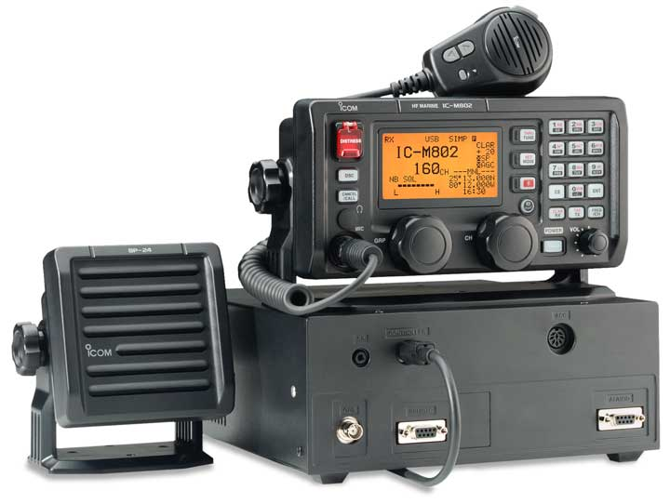
Agenda Item 1.4
“to consider possible new allocation to the amateur service on a secondary basis within the band 5 250-5 450 kHz in accordance with Resolution 649 (WRC‑12)”
ITU-R Responsible Group: WP 5A
ASMG Position:
  Some administrations support “Method B”, No additional allocation to to the amateur service on a secondary allocation in the band 5350 – 5450 KHz.
  Other administrations support “Method A-4”, An allocation to the amateur service at several specific channels, on a secondary basis, in the range 5 275 - 5 450 kHz.
21

Slide 22
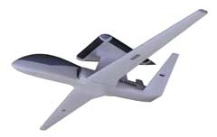
Agenda Item 1.5
“to consider the use of frequency bands allocated to the fixed-satellite service not subject to Appendices 30, 30A and 30B for the control and non-payload communications of unmanned aircraft systems (UAS) in non-segregated airspaces, in accordance with Resolution 153 (WRC‑12)”
ITU-R Responsible Group: WP 5B
ASMG Position:
  ASMG supports No change to RR “Method B”.
  ASMG in the view that there are considerable technical, operational and regulatory obstacles for the use of FSS for UAS CNPC links. Moreover, existing allocations for AMS(R)S as well as AMSS and MSS, under certain conditions could satisfy the requirements for UAS CNPC in the frequency bands of these services.
22

Slide 23

Agenda Item 1.6
“to consider possible additional primary allocations:
1.6.1 to the fixed-satellite service (Earth-to-space and space-to-Earth) of 250 MHz in the range between 10 GHz and 17 GHz in Region 1;
1.6.2 to the fixed-satellite service (Earth-to-space) of 250 MHz in Region 2 and 300 MHz in Region 3 within the range 13-17 GHz;
and review the regulatory provisions on the current allocations to the fixed-satellite service within each range, taking into account the results of ITU‑R studies, in accordance with Resolutions 151 (WRC‑12) and 152 (WRC‑12), respectively”
ITU-R Responsible Group: WP 4A
ASMG Position:
1.6.1: ensure the protection of the current services and avoiding any additional constrains in the proposed bands
Urge the Arab Administrations to state their view regarding the proposed bands based on the results of studies
1.6.2 : Ensure that the proposed allocations do not cause undue constrains to services allocated in these bands in Region 1
23

Slide 24
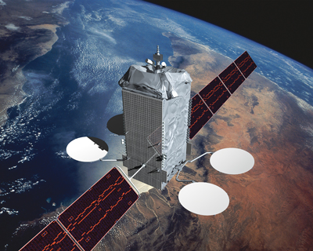
Agenda Item 1.7
“to review the use of the band 5 091-5 150 MHz by the fixed-satellite service (Earth-to-space) (limited to feeder links of the non-geostationary mobile-satellite systems in the mobile-satellite service) in accordance with Resolution 114 (Rev.WRC‑12)”
ITU-R Responsible Group: WP 4A
ASMG Position:
  Supports the removal of the time limitation in RR 5.444A to the primary allocation to the fixed-satellite service (Earth-to-space) in the band 5 091-5 150 MHz, limited to feeder links of non-geostationary satellite systems in the mobile-satellite service, based on the information received from ICAO that no new systems are planned in the band.
  Resolution 114 (Rev.WRC-12) after amendment shall continue to apply to this allocation in order to protect aeronautical services and encourage long-term sharing environment in the band.
24

Slide 25

Agenda Item 1.8
“review the provisions relating to earth stations located on board vessels (ESVs), based on studies conducted in accordance with Resolution 909 (WRC‑12)”
ITU-R Responsible Group: WP 4A
ASMG Position:
  Support NOC to the protection distances in Resolution 902 in order to protect terrestrial services.
  Does not support the use of PFD limits criteria to identify protection distances.
  Egypt Position: Support methods proposing the increment of the protection distances and follow up studies in the Study Groups.
25

Slide 26
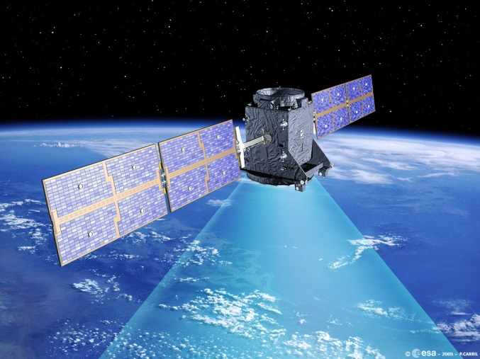
Agenda Item 1.9.1
“to consider , in accordance with Resolution 758 (WRC‑12)
1.9.1 possible new allocations to the fixed-satellite service in the frequency bands 7 150-7 250 MHz (space-to-Earth) and 8 400- 8 500 MHz (Earth-to-space), subject to appropriate sharing conditions ”
ITU-R Responsible Group: WP 4A
ASMG Position:
  Does not Support the new allocations to the fixed-satellite service in the frequency bands 7 150-7 250 MHz and the band 8400-8500 MHz because of the heavy use of Fixed Terrestrial Services in these two bands.
26

Slide 27

Agenda Item 1.9.2
“to consider , in accordance with Resolution 758 (WRC‑12)
1.9.2 the possibility of allocating the bands 7 375-7 750 MHz and 8 025-8 400 MHz to the maritime-mobile satellite service and additional regulatory measures, depending on the results of appropriate studies”
ITU-R Responsible Group: WP 4C
ASMG Position:
  Does not support the allocation to the maritime-mobile satellite service in the frequency bands 7 150-7 250 MHz and 8 025-8 400 MHz.
27

Slide 28
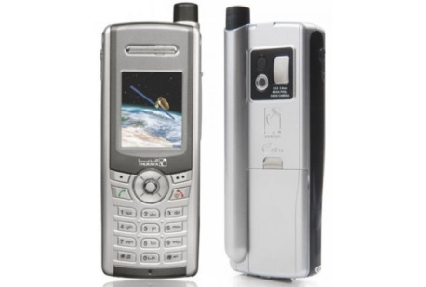
Agenda Item 1.10
“to consider spectrum requirements and possible additional spectrum allocations for the mobile-satellite service in the Earth-to-space and space-to-Earth directions, including the satellite component for broadband applications, including International Mobile Telecommunications (IMT), within the frequency range from 22 GHz to 26 GHz, in accordance with Resolution 234 (WRC‑12)”
ITU-R Responsible Group: WP 4C
ASMG Position:
  Does not support the allocations to the Mobile-Satellite service in the frequency range from 22 GHz to 26 GHz because most of the frequency bands in this range are allocated to terrestrial fixed and mobile services on primary basis, the frequencies of this range are heavily used by terrestrial services. Also, follow up the on-going studies
  UAE and Egypt position: follow up the on-going studies aiming to fulfill the spectrum requirements of the Mobile Satellite Service, and ensuring the protection of the existing services, in the following proposed bands:
  24.25 – 24.55 GHz (s-E) 22.65 – 22.95 GHz (s-E)
  24.25 – 24.55 GHz (E-s) 25.25 – 25.50 GHz (E-s)
28

Slide 29
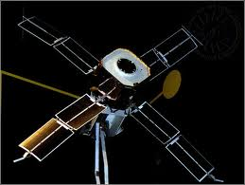
Agenda Item 1.11
“to consider a primary allocation for the Earth exploration-satellite service (Earth-to-space) in the 7-8 GHz range, in accordance with Resolution 650 (WRC‑12)”
ITU-R Responsible Group: WP 7B
ASMG Position:
  Some administrations support the primary allocation for EESS (Earth-to-space) with a new provision, because the studies shows that Fixed services are protected and current PFD limits are sufficient for protection.
  Other administrations support No Change, which means Not supporting a primary allocation for the Earth exploration-satellite service (Earth-to-space) in the 7-8 GHz range in order to protect the existing services because of heavy use of terrestrial fixed services in this band.
29

Slide 30
Agenda Item 1.12
“to consider an extension of the current worldwide allocation to the Earth exploration-satellite (active) service in the frequency band 9 300-9 900 MHz by up to 600 MHz within the frequency bands 8 700-9 300 MHz and/or 9 900-10 500 MHz, in accordance with Resolution 651 (WRC‑12)”
ITU-R Responsible Group: WP 7C
ASMG Position:
  Not supporting an extension of the current worldwide allocation to the Earth Exploration-Satellite Service (active) because of heavy use of terrestrial fixed services and for the protection of the RLS service.
  Adding the NOC method to the CPM text.
30

Slide 31
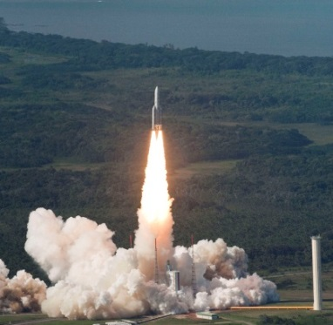
Agenda Item 1.13
“to review No. 5.268 with a view to examining the possibility for increasing the 5 km distance limitation and allowing space research service (space-to-space) use for proximity operations by space vehicles communicating with an orbiting manned space vehicle, in accordance with Resolution 652 (WRC‑12)”
ITU-R Responsible Group: WP 7B
ASMG Position:
  Support mitigating or removal of the 5 Km distance limitation (increase the distance), with maintaining the current PFD limits in 5.268 to ensure the protection of operational terrestrial stations in the fixed and mobile services
31

Slide 32

Agenda Item 1.14
“to consider the feasibility of achieving a continuous reference time-scale, whether by the modification of coordinated universal time (UTC) or some other method, and take appropriate action, in accordance with Resolution 653 (WRC‑12)”
ITU-R Responsible Group: WP 7A
ASMG Position:
  Support Method C2
  No change in definition of UTC as specified in Recommendation ITU R TF.460-6, which will remain the only time-scale which is broadcast in order to avoid any confusion.
32

Slide 33

Agenda Item 1.15
“to consider spectrum demands for on-board communication stations in the maritime mobile service in accordance with Resolution 358 (WRC‑12)”
ITU-R Responsible Group: WP 5B
ASMG Position:
  ASMG does not support the identification of additional spectrum for on-board communications in UHF.
  ASMG supports the identified method in CPM text.
33

Slide 34
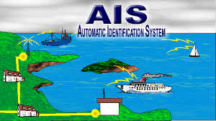
Agenda Item 1.16
“to consider regulatory provisions and spectrum allocations to enable possible new Automatic Identification System (AIS) technology applications and possible new applications to improve maritime radiocommunication in accordance with Resolution 360 (WRC‑12)”
ITU-R Responsible Group: WP 5B
ASMG Position:
    ASMG is of the view that more discussions are needed to handle and finalize the different issues related to this agenda item.
    Sub-working group is established to discuss the developed methods for each issue and to select the appropriate methods to meet the requirements of this agenda item in consultation with the concerned authorities for marine services of each Arab country in order to reach the unified ASMG position before the next ASMG meeting.
34

Slide 35

Agenda Item 1.17
“to consider possible spectrum requirements and regulatory actions, including appropriate aeronautical allocations, to support wireless avionics intra-communications (WAIC), in accordance with Resolution 423 (WRC‑12)”
ITU-R Responsible Group: WP 5B
ASMG Position:
  ASMG supports a primary AM(R)S allocation in the 4200 - 4400 MHz band exclusively reserved for WAIC systems inside the aircraft through a footnote or footnotes with a resolution to include the requirements of protection systems operating in accordance with the existing allocation. “Method B”
35

Slide 36

Agenda Item 1.18
“to consider a primary allocation to the radiolocation service for automotive applications in the 77.5-78.0 GHz frequency band in accordance with Resolution 654 (WRC‑12)”
ITU-R Responsible Group: WP 5B (invites 1& 2), WP 5A (Invites 1)
ASMG Position:
  ASMG supports a primary allocation to the RLS on a worldwide basis, limited to automotive applications, between 77.5 GHz and 78 GHz. “Method A”
36

Slide 37
Agenda Item 2
“to examine the revised ITU‑R Recommendations incorporated by reference in the Radio Regulations communicated by the Radiocommunication Assembly, in accordance with Resolution 28 (Rev.WRC‑03), and to decide whether or not to update the corresponding references in the Radio Regulations, in accordance with the principles contained in Annex 1 to Resolution 27 (Rev.WRC‑12)”
ITU-R Responsible Group: CPM15-2
ASMG Position:
  The position will be decided later upon the issuance of BR Director report during the second session of CPM-15
37

Slide 38
Agenda Item 4
“in accordance with Resolution 95 (Rev.WRC‑07), to review the resolutions and recommendations of previous conferences with a view to their possible revision, replacement or abrogation”
ITU-R Responsible Group: CPM15-2
ASMG Position:
  The position will be decided later upon the issuance of BR Director report during the second session of CPM-15
38

Slide 39
Agenda Item 7
“to consider possible changes, and other options, in response to Resolution 86 (Rev. Marrakesh, 2002) of the Plenipotentiary Conference, an advance publication, coordination, notification and recording procedures for frequency assignments pertaining to satellite networks, in accordance with Resolution 86 (Rev.WRC‑07) to facilitate rational, efficient, and economical use of radio frequencies and any associated orbits, including the geostationary‑satellite orbit”
ITU-R Responsible Group: WP 4A, Special Committee (SC)
39

Slide 40
Agenda Item 7 - Issue A: Informing the Bureau of a suspension under RR No. 11.49 beyond six months
ASMG Position:
  Option A of Method A2
Agenda Item 7 - Issue B: Publication of information on bringing into use of satellite networks at the ITU website
ASMG Position:
  Method B3
Agenda Item 7 - Issue C: Review or possible cancellation of the advance publication mechanism for satellite networks subject to coordination under section II of Article 9 of the Radio Regulations
ASMG Position:
  Some Administrations are supporting Method C3, and some other Administrations are supporting Method C5
40

Slide 41
Agenda Item 7 - Issue D: use of modern electronic means of communications in coordination and notification procedures
ASMG Position:
  Method D
Agenda Item 7 - Issue E: Failure of a satellite during the ninety-day bringing into use period
ASMG Position:
  Method E5
Agenda Item 7 - Issue F: Modifications to RR Appendix 30B in relation to the suspension of use of a frequency assignment recorded in the MIFR
ASMG Position:
  Method F1
41

Slide 42
Agenda Item 7 - Issue G: Clarification of bringing into use information provided under RR Nos. 11.44/11.44B
ASMG Position:
  Method G1
Agenda Item 7 - Issue H: Using one space station to bring frequency assignments at different orbital locations into use within a short period of time
ASMG Position:
  Method H1
Agenda Item 7 - Issue I: Possible method to mitigate excessive satellite network filings issue
ASMG Position:
  Consider the results of the upcoming CPM15-2 regarding this issue and decide on the position accordingly
  Work in collaboration with satellite operators to improve the current methods to satisfy this issue
42

Slide 43
Agenda Item 8
“To consider and take appropriate action on requests from administrations to delete their country footnotes or to have their country name deleted from footnotes, if no longer required, taking into account Resolution 26 (Rev.WRC‑07)”
ITU-R Responsible Group: CPM15-2
ASMG Position:
  Arab Administrations are encouraged to review their footnotes in Article V in the RR and provide their positions to the WRC-15 after coordination with neighboring countries.
43

Slide 44
Agenda Item 9.1.1
“to consider and approve the Report of the Director of the Radiocommunication Bureau, in accordance with Article 7 of the Convention:
9.1 on the activities of the Radiocommunication Sector since WRC‑12
9.1.1 – Res. 205 (Rev.WRC-12) Protection of the systems operating in the mobile-satellite service in the band 406-406.1 MHz”
ITU-R Responsible Group: WP 4C
ASMG Position:
  Support the revision of Resolution 205 (Rev. WRC-12) in order to protect the systems operating in the mobile-satellite service in the band 406-406.1 MHz, with consideration to other current and future services in the adjacent bands
44

Slide 45
Agenda Item 9.1.2
“to consider and approve the Report of the Director of the Radiocommunication Bureau, in accordance with Article 7 of the Convention:
9.1 on the activities of the Radiocommunication Sector since WRC‑12
9.1.2 – Resolution 756 (WRC-12) Studies on possible reduction of the coordination arc and technical criteria used in application of No. 9.41 in respect of coordination under No. 9.7”
ITU-R Responsible Group: WP 4A
ASMG Position:
  Consider the results of the upcoming CPM15-2 regarding this issue and decide on the position accordingly
  Establish a working group headed by the UAE to look into the optimum combination regarding possible reduction of the coordination arc and technical criteria used in application of No. 9.41 in respect of coordination under No. 9.7
45

Slide 46
Agenda Item 9.1.3
“to consider and approve the Report of the Director of the Radiocommunication Bureau, in accordance with Article 7 of the Convention:
9.1 on the activities of the Radiocommunication Sector since WRC‑12
9.1.3 – Resolution 11 (WRC-12) Use of satellite orbital positions and associated frequency spectrum to deliver international public telecommunication services in developing countries”
ITU-R Responsible Group: WP 4A (Technical and Regulatory aspects), SC (Regulatory and Procedural aspects)
ASMG Position:
  Support No Change to the Radio Regulations / option 1 of the current CPM text, and follow up the studies in case submitted to WRC-15
46

Slide 47

Agenda Item 9.1.4
“to consider and approve the Report of the Director of the Radiocommunication Bureau, in accordance with Article 7 of the Convention:
9.1 on the activities of the Radiocommunication Sector since WRC‑12
9.1.4 – Resolution 67 (WRC-12) Updating and rearrangement of the Radio Regulations”
ITU-R Responsible Group: WP 1B, SC (Regulatory and Procedural aspects)
ASMG Position:
Issue A: Modification of RR Article 2
Support modification of RR No. 2.1 in order to delete the unused abbreviations provided in the provision.
Issue B: Modification to the titles of some RR Articles for the purpose of better reflecting in the title the scope of these articles
Support the proposed modification of the title of the RR Articles 37, 39, 40, 42, 43, 44, 47, 49, 50, 52 and 53.
47

Slide 48
Agenda Item 9.1.5
“to consider and approve the Report of the Director of the Radiocommunication Bureau, in accordance with Article 7 of the Convention:
9.1 on the activities of the Radiocommunication Sector since WRC‑12
9.1.5 – Resolution 154 (WRC-12) Consideration of technical and regulatory actions in order to support existing and future operation of fixed‑satellite service earth stations within the band 3 400-4 200 MHz, as an aid to the safe operation of aircraft and reliable distribution of meteorological information in some countries in Region 1”
ITU-R Responsible Group: WP 4A (Technical and Regulatory aspects), SC (Regulatory and Procedural aspects)
ASMG Position:
  Resolution 154 (WRC-12) could be modified, calling for relevant administrations in Region 1 to use special care in the coordination, assignment, and management of frequencies taking into consideration the potential impact on the FSS earth stations used for satellite communications related to safe operation of aircraft and reliable distribution of meteorological information in the frequency band 3 400-4 200 MHz.
48

Slide 49
Agenda Item 9.1.6
“to consider and approve the Report of the Director of the Radiocommunication Bureau, in accordance with Article 7 of the Convention:
9.1 on the activities of the Radiocommunication Sector since WRC‑12
9.1.6 – Resolution 957 (WRC-12) Studies towards review of the definitions of fixed service, fixed station and mobile station”
ITU-R Responsible Group: WP 1B
ASMG Position:
  Support not to change the radio regulation and hence suppression of Resolution 957 (WRC-12).
49

Slide 50
Agenda Item 9.1.7
“to consider and approve the Report of the Director of the Radiocommunication Bureau, in accordance with Article 7 of the Convention:
9.1 on the activities of the Radiocommunication Sector since WRC‑12
9.1.7 – Resolution 647 (Rev. WRC-12) Spectrum management guidelines for emergency and disaster relief radiocommunication”
ITU-R Responsible Group: WP 1B
ASMG Position:
  Support modification of Resolution 647 (Rev. WRC-12) and consequential suppression of Resolution 644 (Rev. WRC-12)
50

Slide 51
Agenda Item 9.1.8
“to consider and approve the Report of the Director of the Radiocommunication Bureau, in accordance with Article 7 of the Convention:
9.1 on the activities of the Radiocommunication Sector since WRC‑12
9.1.8 – Resolution 757 (WRC‑12) Regulatory aspects for nano- and picosatellites”
ITU-R Responsible Group: WP 7B
ASMG Position:
  Support No Change to the Radio Regulations
  If WRC-15 approved further studies to this agenda item for the next conference, the position will be to support the studies while ensuring that any changes to the radio regulation to regulate the nano- and picosatellites, should not affect the current regulatory procedures related to the other satellite services.
51

Slide 52
Agenda Item 9.2
“to consider and approve the Report of the Director of the Radiocommunication Bureau, in accordance with Article 7 of the Convention:
9.2 on any difficulties or inconsistencies encountered in the application of the Radio Regulations; and
ITU-R Responsible Group: CPM15-2
ASMG Position:
  Follow up the current studies.
52

Slide 53
Agenda Item 9.3
“to consider and approve the Report of the Director of the Radiocommunication Bureau, in accordance with Article 7 of the Convention:
9.3 “on action in response to Resolution 80 (Rev.WRC‑07);
Due diligence in applying the principles embodied in the Constitution”
ITU-R Responsible Group:
ASMG Position:
  Supports the work of the BR in order to ensure equitable access to the GSO, and urges the BR to continue the work in this regards
  Supports the retention of Resolution 80 (Rev.WRC-07)
53

Slide 54
Agenda Item 10
“to recommend to the Council items for inclusion in the agenda for the next WRC, and to give its views on the preliminary agenda for the subsequent conference and on possible agenda items for future conferences, in accordance with Article 7 of the Convention”
ITU-R Responsible Group: CPM15-2
ASMG Position:
  Arab Administrations are requested to study the important matter by looking into the draft WRC-18 Agenda in the Resolution 808 (WRC-12) and provide their proposals to the next ASMG meeting.
54

Slide 55
ASMG Upcoming Meetings

Slide 56
ASMG Upcoming meetings
ASMG-19 Q1 2015
ASMG-20 July 2015
CPM15-2 16-27 Feb 2015
WRC-15
2-27 Nov
2015
Publication of draft CPM report December 2014
CPM15-2 23 March-2 April 2015
Publication of CPM report April-May 2015
56

Slide 57
THANK YOU!
Presented by
Mr. Tariq Al Awadhi
Chairman Arab Spectrum Management Group
Executive Director Spectrum and International Affairs
Telecommunications Regulatory Authority (TRA)
P. O. Box: 26662, Abu Dhabi, UAE
Tel: (+971) 2 611 8451
Fax: (+971) 2 611 8488
Email: tariq.alawadhi@tra.gov.ae
Web: www.tra.gov.ae
ASMG Website : www.asmg.ae
57

