Slide 1
RF interference hunting with drones – project update
Finland, 19.4.2018

Slide 2
Background
Centria University of Applied Sciences (www.centria.fi) has a specific project where different drone usage scenarios are investigated
A part of the project is to find out whether drones could be used for RF interference hunting
  The deadline of this part is by the end of May 2018
"The purpose of the project is to study if the RF interference measurements done with the drone in the air can give added value compared to interference measures done on ground level"
The project is still ongoing but here is a very brief update of the current situation

Slide 3
Why drones (1/2)
We have faced several RF interference hunting situations where the interference source is located in a problematic environment
Based on our statistics, the most common RF interference cases are related to mobile phone networks
  900 and 2100 MHz WCDMA
Example 1:
  Case: Interference source (illegal repeater) is located on a roof in city environment, hard to get access to the roof
    A drone could be used to easily verify whether the source of the interference really is on the roof
    A drone can be lifted higher than the mast of the measurement van (max 10 meters)

Slide 4
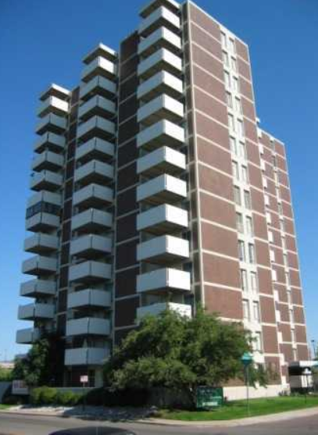
Why drones (2/2)
Example 2:
  Case: RF interference source is located inside an apartment in a large building.
    A malfunctioning DVB-T/T2 indoor antenna amplifier causes signal at 897 MHz that belongs to Operator's UMTS UL band
    Interference source located inside an apartment -> hard to verify the exact apartment from the staircase. Easier to use a drone to locate the exact window and then go to the staircase to find the corresponding apartment

Slide 5
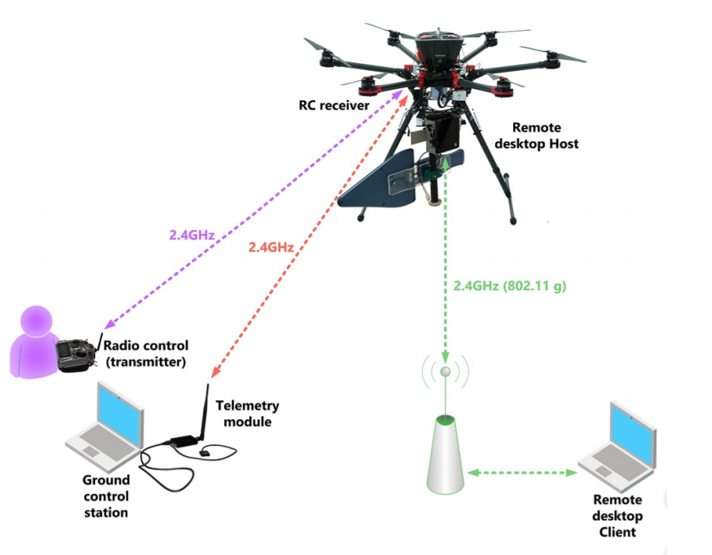
The Drone setup (1/2)
DJI S900
  Empty weight around 5 kg
  Total Height 730 mm
  Diagonal wheelbase 1300 mm
  Flight time ~ 18 min
Spectrum analyser: Aaronia HF-60105 + directional antenna
Mini-PC to control the Spectrum analyser, 2.4 GHz WLAN
Real time video

Slide 6
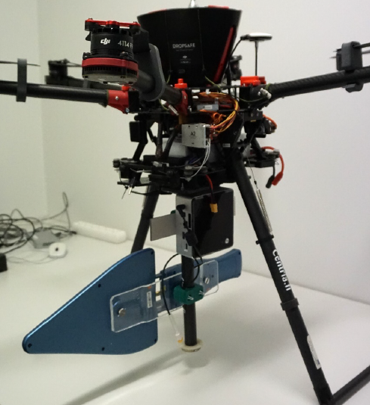
The Drone setup (2/2)
Enough fitting room for the RF-filter

Slide 7
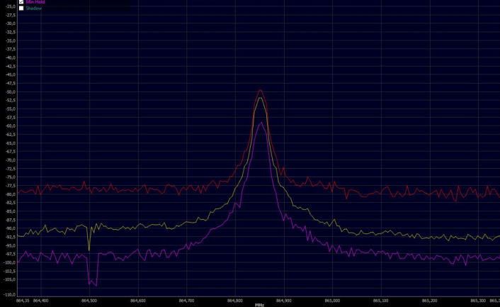
Test case
RF interference source: Wireless microphone
Located on top of the roof of a two-storey building
The aim is to verify how easily the interference source can be found with the drone
The target is to combine the telemetrydata, live video & Aaronia spectrum screen on the same computer window to make the operation easier

Slide 8
Issues (1/2)
Internal RF interferences from the drone
  Measurements in anechoic chamber have been done
    2.4 GHz RF-interferences cannot be investigated
    Below 300 MHz interferences are difficult due to drone's own EMC issues (electric motors)
Difficult to handle
  RF measurement drone should be easy enough to operate
  It is assumed that it needs two persons for the operation. One to fly, one to monitor/use the spectrum analyzer

Slide 9
Issues (2/2)
Flying restrictions
  Urban environment
  Wind/Rain/Temperature limitations
Size vs Lifting capacity
  RF filter must be placed on board to make RF interference hunting more reliable
    High signal levels in city environment
    Max total weight 8kg (flight regulations)
  Must be easy to transport inside a measurement van

Slide 10
Questions/Discussion?

Slide 11
Jukka.pihonen@ficora.fi

