Slide 1
Obstacle limitation surfaces at aerodromes and heliports/helidecks
17 December 2018

Slide 2
Purpose of the OLS
Historically the broad purpose of Annex 14 OLS has been to define the volume of airspace that should ideally be kept free from obstacles in order to minimize the dangers presented by obstacles to an aircraft.
The OLS have been always intended to be of a permanent nature and often enacted in the local zoning laws and ordinances or as part of the national planning consultation scheme.

Slide 3
References for aerodromes
ICAO Annex 14, Volume 1 Aerodromes - Chapter 4;
PANS-Aerodromes (Doc 9981);
PANS-OPS (Doc 8168);
Airport Service Manual (Doc 9137), Part 6 – Control of obstacles.

Slide 4
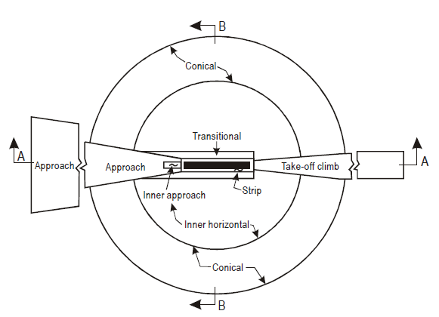
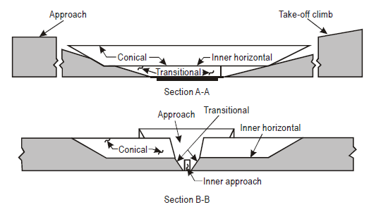
Set of Annex 14 OLS

Slide 5
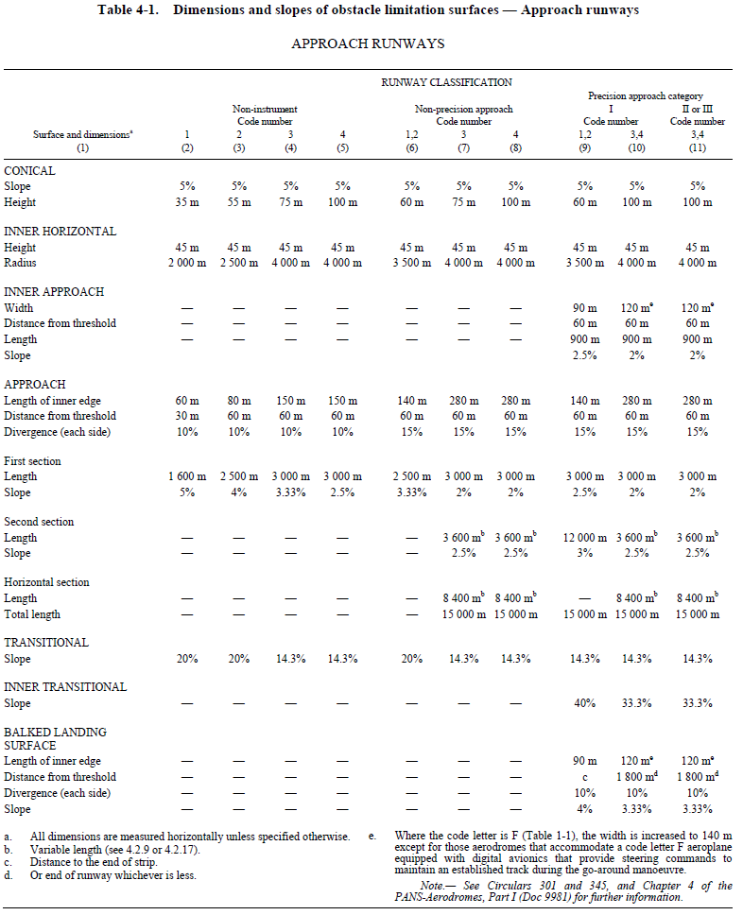
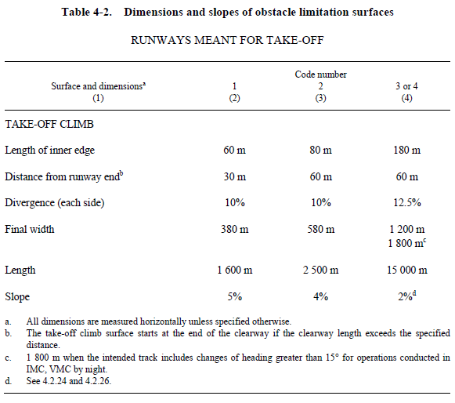
Set of Annex 14 OLS

Slide 6
Obstacle Free Zone
Contrary to the other Annex 14 surfaces, the Inner approach, Inner transitional and Balked landing surfaces must be kept free from obstacles
Requirement for CAT II and CAT III only
Frangible obstacles allowed
Some obstacles related to the flight operation are allowed

Slide 7
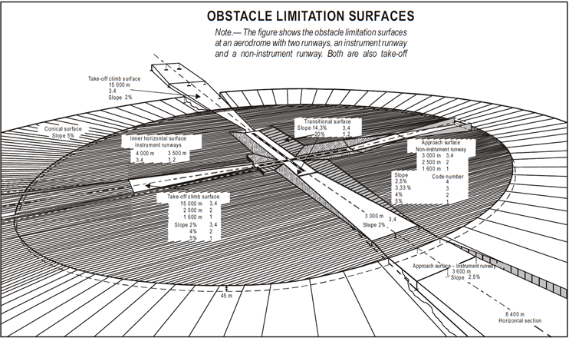
Overview

Slide 8
Modernizations of the OLS
The 12th Air Navigation Conference and the 38th ICAO Assembly called for a significant review of the Annex 14 OLS and for guidelines to be developed for conducting aeronautical studies to assess permissible penetrations;
Job card ADOP003 titled “Obstacle Limitation Surfaces at Aerodromes” was issued and the OLSTF was set up to undertake the review;
The task force reports to both ADOP and IFPP and work closely with the FLTOPS Panel;
Members include CAAs, aerodrome operators, regulators, aviation stakeholders (ACI, IFALPA) and industry experts;
Revised Job Card now specify 2022 as delivery date by the panel, and the provisions becoming effective 2024 and applicable 2026;
Due to scheduling of ADOP and IFPP panel meetings, the aim is to deliver by Q1 2021 latest.

Slide 9
Questions ?

