Slide 1
Positioning of elements in a simulation scenario
European Communications Office
Peter Faris
peter.faris@eco.cept.org
24-25 October 2017

Slide 2
Outline
Positioning overview
Positioning within a link
Relative positioning between links

Slide 3
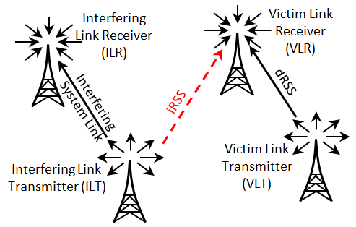
Positioning overview – generic systems
Once you have defined the parameters of the interfering and victim systems, you need to specify their positions
For each system you can specify the relative position of the transmitter and receiver within the link
You can then specify the relative position between the interfering and victim systems, according to the scenario to be modelled

Slide 4
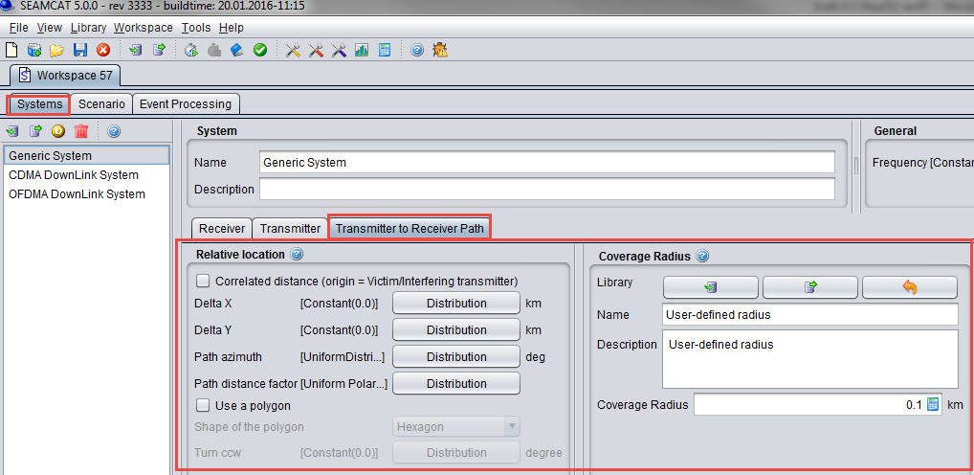
Positioning within a link – generic systems
The positioning of the transmitter and receiver within the link is specified under Transmitter to Receiver path in the Systems tab

Slide 5
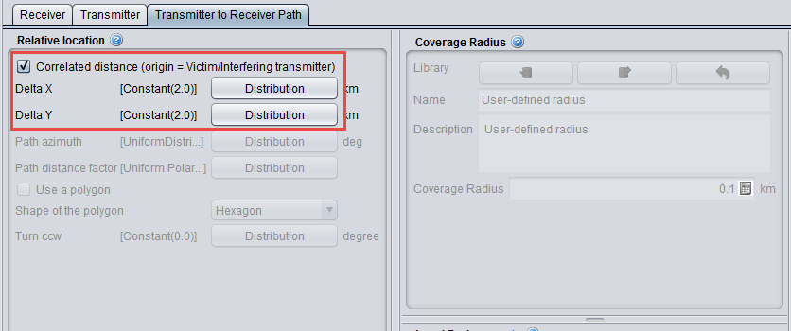
Positioning within a link – correlated distance
For fixed positioning between Tx and Rx use Correlated distance with constant values of Delta X and Delta Y
Delta X = 2 km
y
dRSS
(2 km,2 km)
Delta Y = 2 km
Victim
Receiver
(Vr)
Victim link
(0,0)
x
Other options are disabled if Correlated distance is selected
Wanted
Transmitter
(Wt)
You can also specify distributions instead of constant values of Delta X and Delta Y, in this case they specify the centre of the distribution

Slide 6
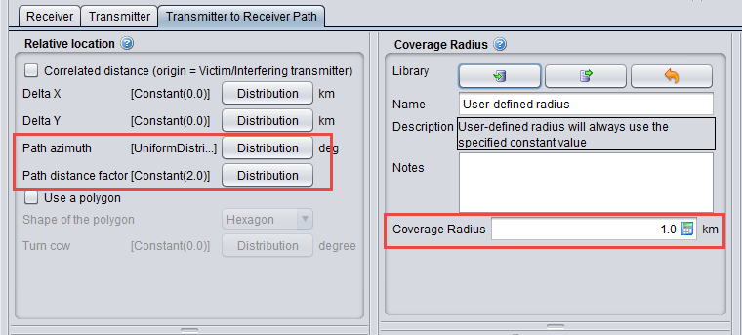
Positioning within a link – uncorrelated distance
For uncorrelated positioning between Tx and Rx the following parameters are used:
  Path azimuth: range of possible angles from Tx to Rx (constant or distribution)
  Path distance factor: scaling factor for the link distance (constant or distribution)
  Coverage radius: Parameter to determine the total link distance according to:
  link distance = path distance factor x coverage radius
  (user defined constant, or calculated according to a plug-in)
Delta X and Delta Y can also be used in conjunction with the above parameters. This determines an initial offset prior to the calculation above

Slide 7
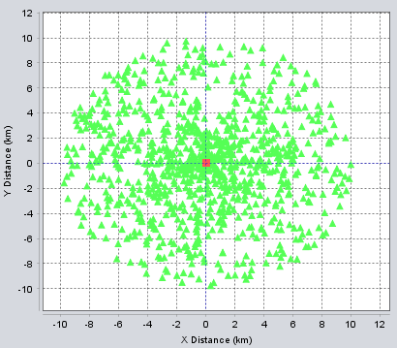

Positioning within a link - examples
Path azimuth:
Uniform 0 to 360 degrees
Path distance factor:
Uniform 0 to 1
Coverage radius:
10 km
Tx
Rx
Different Rx position at each snapshot according to random distributions
d_{max} = 10 km
Min. link distance:
d_{min} = 0 x 10 = 0 km
Max. Link distance:
d_{max} = 1 x 10 = 10 km

Slide 8
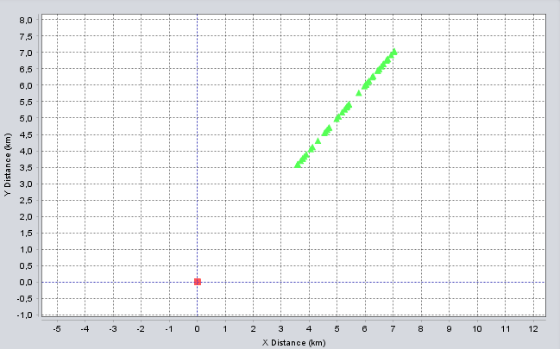
Positioning within a link - examples
Path azimuth:
Constant 45 degrees
Path distance factor:
Uniform 0.5 to 1
Coverage radius:
10 km
Tx
Rx
d_{max} = 10 km
Min. link distance:
d_{min} = 0.5 x 10 = 5 km
Max. Link distance:
d_{max} = 1 x 10 = 10 km
d_{min} = 5 km
45º

Slide 9
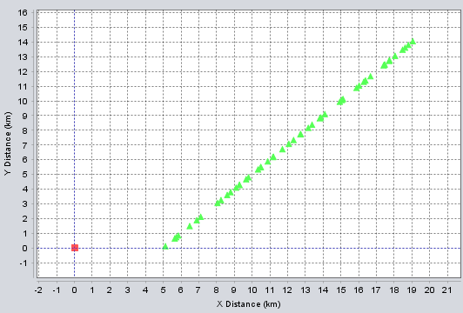

Positioning within a link - examples
Path azimuth:
Constant 45 degrees
Path distance factor:
Uniform 0 to 2
Coverage radius:
10 km
Delta X:
5 km
Tx
Rx
d_{max} = 23.8 km
Min. link distance:
d_{min} = 0 x 10 + 5 = 5 km
Max. Link distance:
d_{max} = 23.8km
d_{max} > Coverage radius!
d_{min} = ΔX= 5 km
45º
NB Path distance factor should be ≤ 1 and Delta X,Y = 0 to ensure link distance ≤ coverage radius

Slide 10
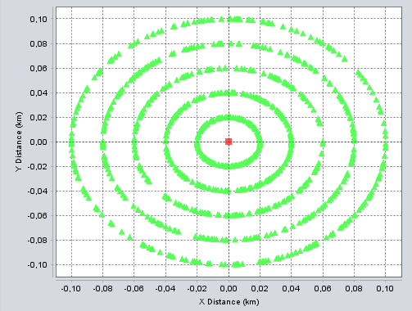
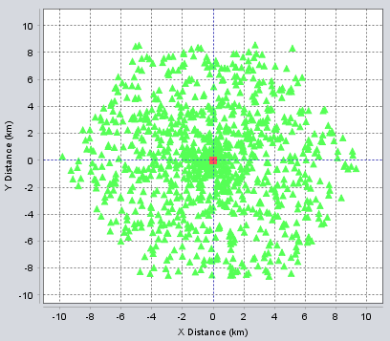
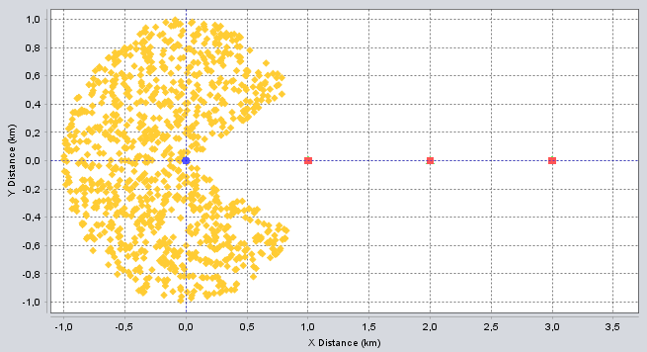
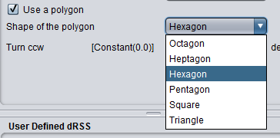
Positioning within a link – complex shapes
By using different combinations of parameters complex location distributions can be created:
Path distance factor:
Discrete Uniform 0.2 to 1, step = 0.2
Use a Polygon:
Enabled: Hexagon
Path azimuth:
Uniform 30 to 330 degrees

Slide 11
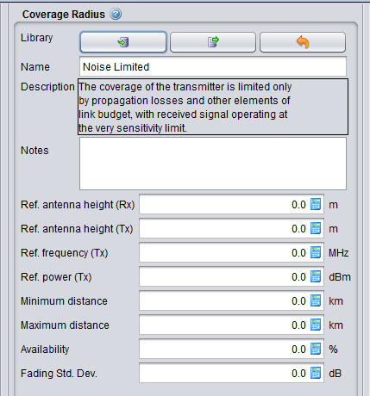
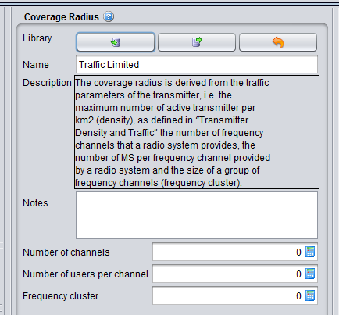
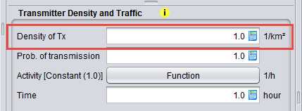
Positioning within a link – user-defined coverage radius
There are 3 options to set the coverage radius:
  User-defined: constant value set by the user
  Noise Limited: calculated according to a link budget, limited by receiver sensitivity
  Traffic Limited: derived from user-specified parameters for density of users, number of channels, max number of users and frequency re-use
The coverage radius is implemented as a plug-in, so it is also possible to define your own calculation
NB traffic limited mode also uses the Density of Tx parameter:
Noise limited:
Traffic limited:

Slide 12
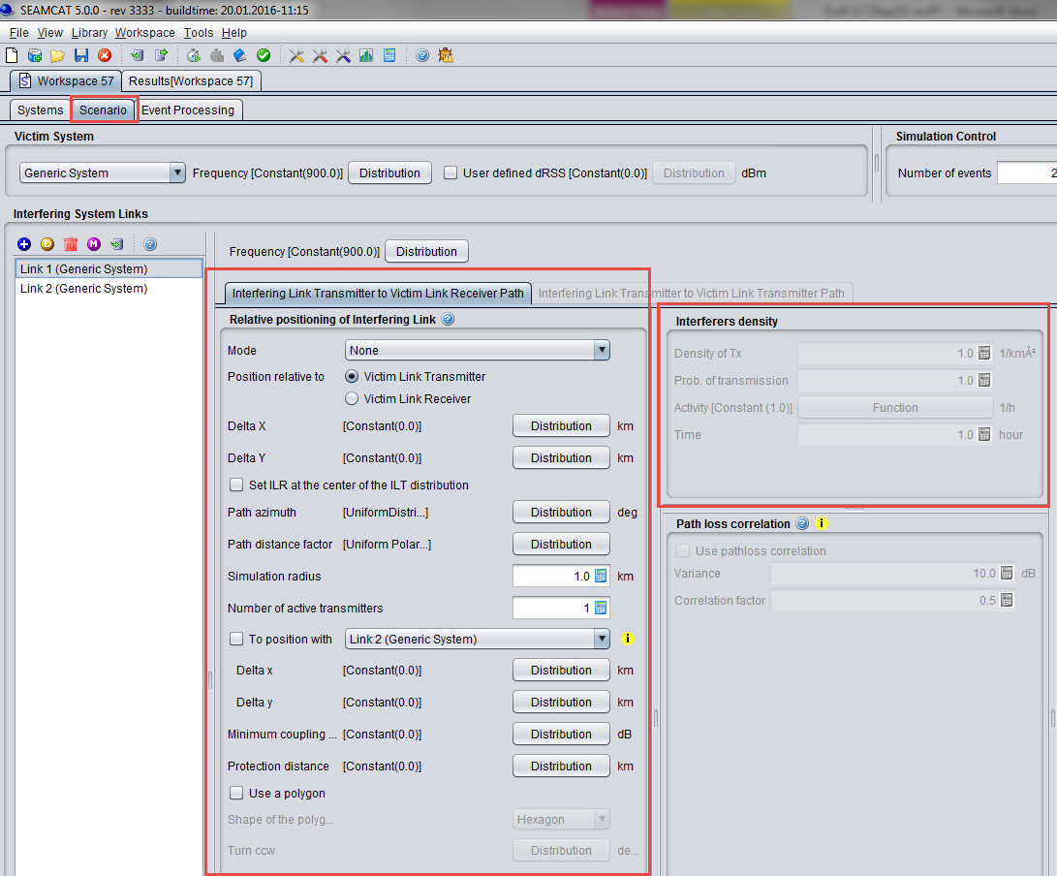
Relative positioning between links
The relative positioning between the interfering and victim system is specified in Interfering Link Transmitter to Victim Link Receiver Path under the Scenario tab

Slide 13
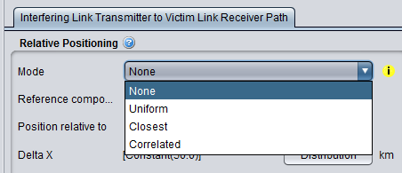
Relative positioning between links - Modes
Several options are available for Mode:
  None: positioning can be set similar to the parameters for within a system, with additional options to set minimum and maximum distances, and set positioning between interfering Tx or Rx with victim Tx or Rx
  Uniform density: generate multiple interferers with a specified density, considering duty cycle and activity factor
  Closest interferer: similar to Uniform density, but only 1 active interferer is considered
  Correlated: fixed correlated positioning between interfering Tx or Rx and Victim Tx or Rx (similar to ‘None’ but without option to set additional limitations)
Selection of Mode determines which positioning options are enabled
(some options are greyed out for certain modes)

Slide 14
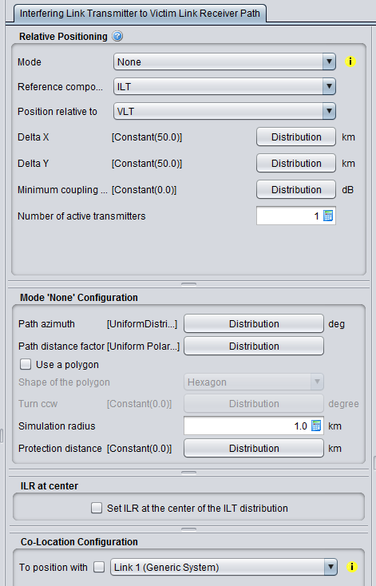
Relative positioning between links – ‘None’ mode
Reference component (IL_{ref}): interfering Tx (ILT) or Rx (ILR)
Relative component (VL_{ref}): victim Tx (VLT) or Rx (VLR)
Distance offset between IL_{ref} and VL_{ref} (X and Y)
Specify minimum coupling loss between ILT and VLR
Determines distance between IL_{ref} and VL_{ref} (before Delta X/Y is applied)
d_{ILref→VLref} = Simulation radius x path distance factor
(equivalent to Coverage radius within a link)
Set minimum distance between components
Overwrites settings in interfering System
Set positioning relative to another interfering link

Slide 15
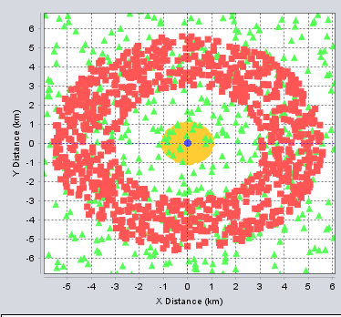
Relative positioning example – ‘None’ mode
Interfering system link
Path azimuth:
Uniform 0 to 360 degrees
Path distance factor:
Uniform polar distance, max 1
Coverage radius:
10 km
Relative positioning
Reference component :
ILT
Position relative to:
VLT
Path azimuth:
Uniform 0 to 360 degrees
Path distance factor:
Uniform polar distance, max 0.5
Simulation radius:
10 km
Protection distance:
3 km
Victim system link
Path azimuth:
Uniform 0 to 360 degrees
Path distance factor:
Uniform polar distance, max 1
Coverage radius:
1 km
ILT
VLT
The scenario outline plot is always centred on the VLT. All other components are shown relative to this.
ILR
VLR

Slide 16
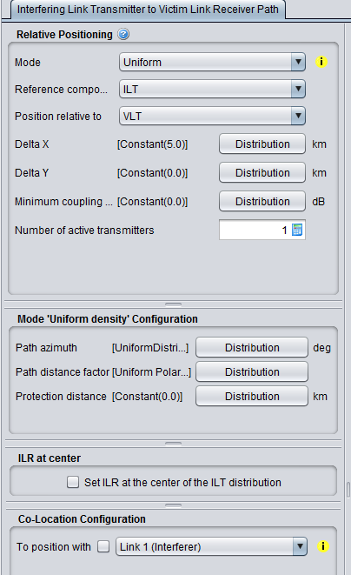
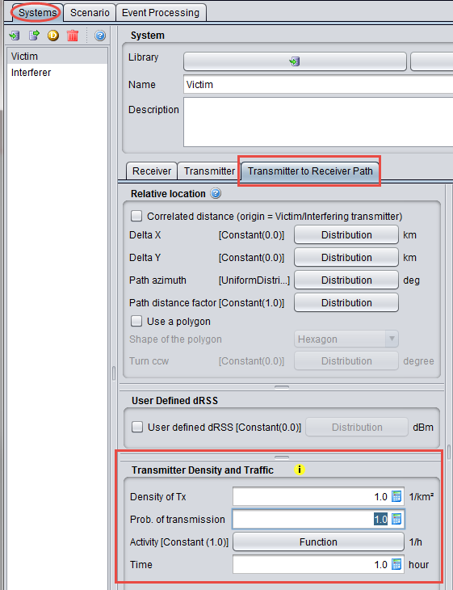
Relative positioning between links – ‘Uniform’ mode
Available options are similar to ‘None’ mode without simulation radius - in this case it is calculated
NB additional settings are required in the System tab:
Simulation radius:
d₀ is the protection distance
Density of active Tx:

Slide 17
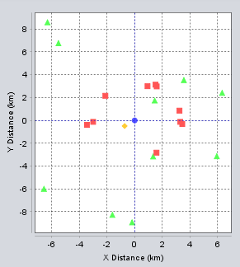
Relative positioning example – ‘Uniform’ mode
Relative positioning (Scenario tab)
Number of active transmitters: 10
ILT
Transmitter density and traffic (Interfering system transmitter tab)
Density of Tx: 1/km²
Probability of transmission: 1
Activity: Constant 1
ILR
VLT
VLR
Other parameters as in previous example
1 snapshot with 10 interferferers and 1 victim

Slide 18
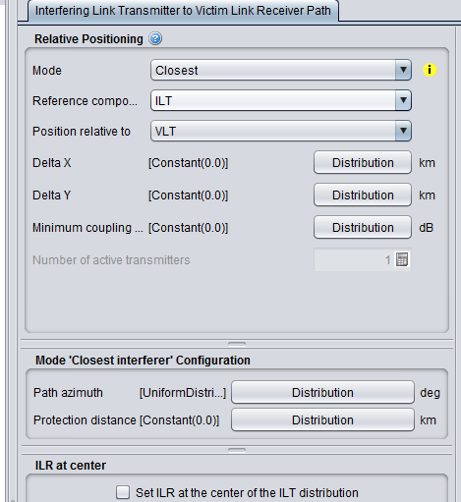
Relative positioning between links – ‘Closest’ mode
This is similar to the Uniform density mode but only 1 transmitter is simulated, and there is no option to set the path distance factor
The distance is randomly determined according to a Rayleigh distribution:
r is a random number
dens_{it}^{active} is calculated as for the uniform density mode

Slide 19
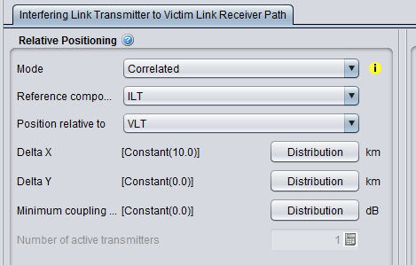
Relative positioning between links – ‘Correlated’ mode
This is the least flexible mode but simplest to implement
The only options are Delta X, Delta Y and Minimum coupling loss
Provides fixed offsets between components, or according to distributions

Slide 20

Thank you - Any Questions?

