Slide 1
Antennas
Patterns, Positioning and Gain
European Communications Office
Peter Faris
peter.faris@eco.cept.org
10-11 October 2018

Slide 2
Outline
Antennas in SEAMCAT
Equation based antenna patterns
Specifying antenna patterns – generic systems
Table based antenna patterns
Specifying antenna patterns – cellular systems
Antenna angle definitions

Slide 3
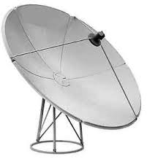

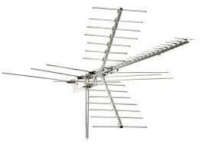
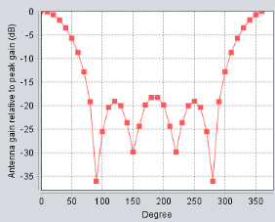
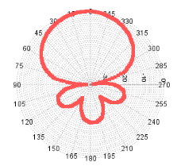
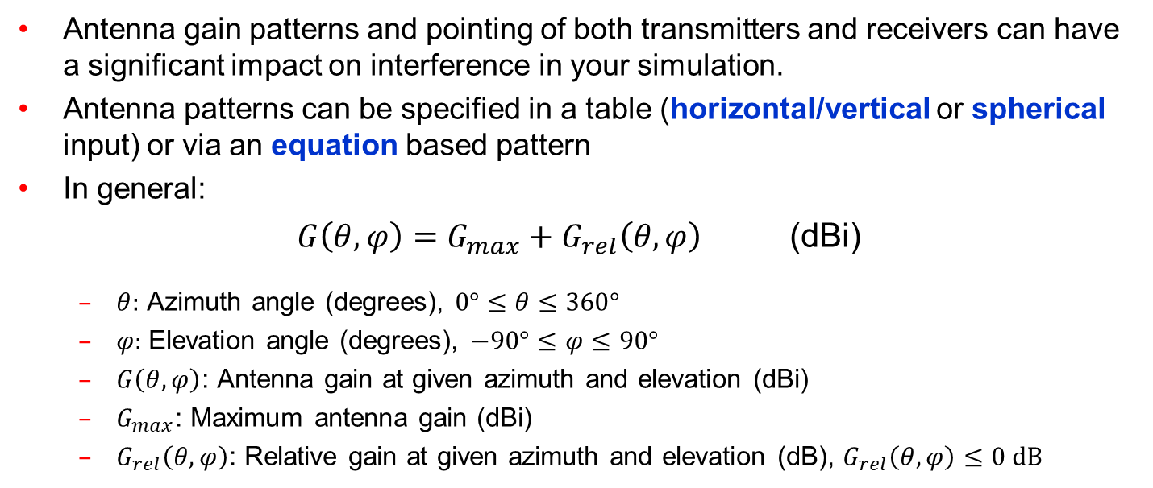
Antennas in SEAMCAT
Antenna gain patterns and pointing of both transmitters and receivers can have a significant impact on interference in your simulation.
Antenna patterns can be specified in a table (horizontal/vertical or spherical input) or via an equation based pattern
In general:
$G\left(θ,φ\right)=G_{max}+G_{rel}\left(θ,φ\right)$ (dBi)
  $θ:$ Azimuth angle (degrees), $0°≤θ≤360°$
  $φ:$ Elevation angle (degrees), $−90°≤φ≤90°$
  $G\left(θ,φ\right)$: Antenna gain at given azimuth and elevation (dBi)
  $G_{max}$: Maximum antenna gain (dBi)
  $G_{rel}\left(θ,φ\right)$: Relative gain at given azimuth and elevation (dB), $G_{rel}\left(θ,φ\right)≤0 dB$

Slide 4
Antenna angle definitions
The antenna pattern is specified relative to the antenna boresight (pointing direction)
It is necessary to map the antenna pattern to the pointing of the antenna which is defined in the “global” co-ordinate system of the scenario:
  Azimuth reference: 0 degrees towards “east”, angles increasing anticlockwise
  Elevation reference: 0 degrees towards horizontal plane, negative angles below antenna
The angle offset from the antenna towards the point of interest (e.g. towards the VLR) can then be used to calculate the gain
For downtilted antennas, e.g. cellular base stations, SEAMCAT applies
co-ordinate transformations

Slide 5
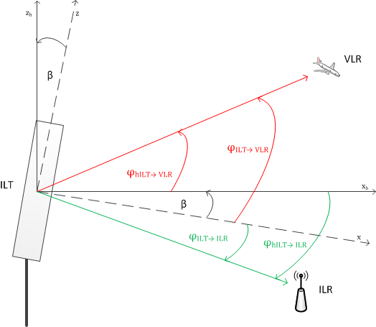
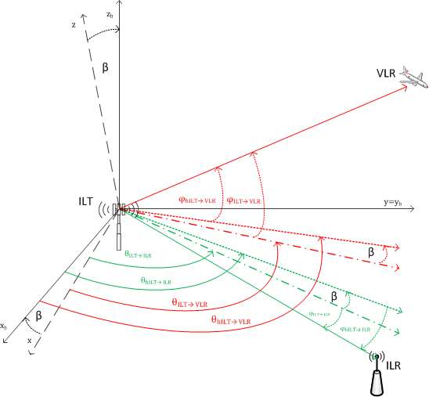
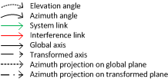
Antenna angle definitions
Elevation view
Spherical view

Slide 6
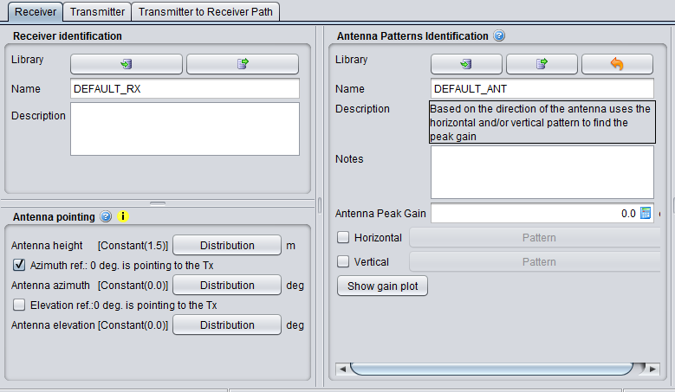
Specifying antenna patterns - generic systems
For generic systems antenna parameters are specified under the transmitter and receiver tab

Slide 7
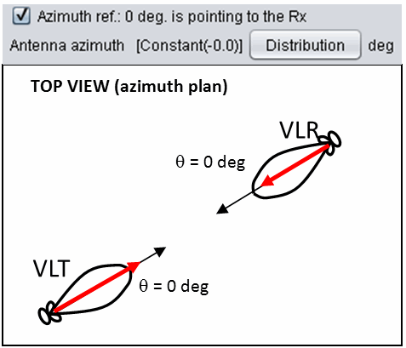
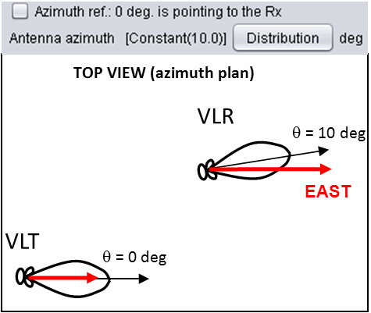
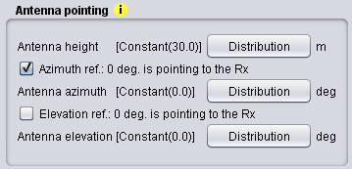
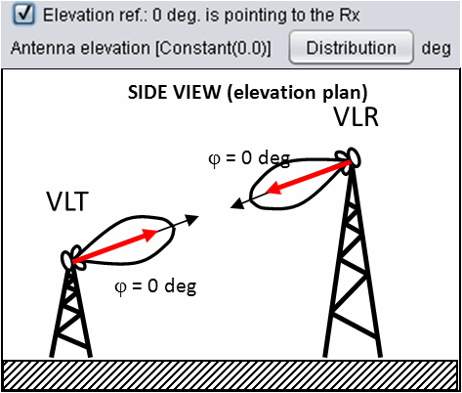
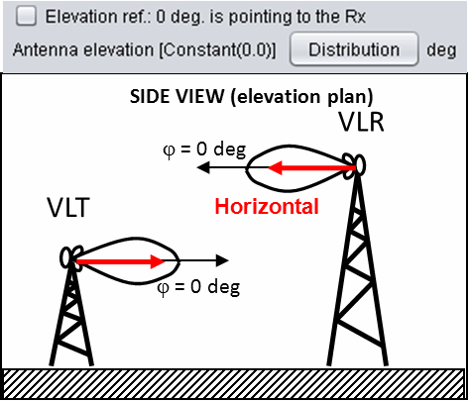
Antenna pointing in generic systems
By default the antenna pointing reference in generic systems is horizontal east
Option to set direct pointing on a link from Tx to Rx, e.g. for fixed links or aircraft/satellite tracking scenarios
This changes both the pointing and the angle references
Additional offsets are also possible

Slide 8
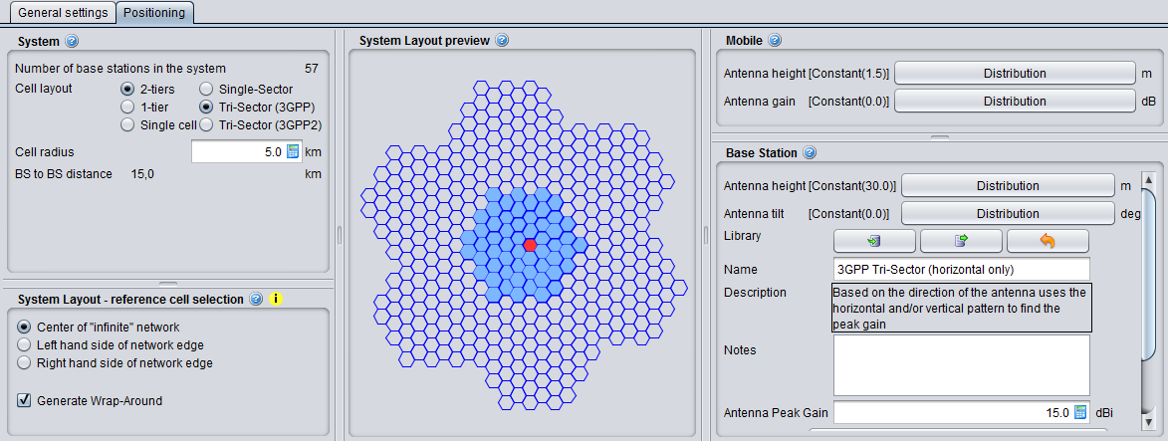
Specifying antenna patterns - cellular systems (CDMA/OFDMA)*
For cellular systems antennas are defined under the Positioning tab
For CDMA/OFDMA It is not currently possible to input a pattern for a mobile station – this is assumed to be omnidirectional by default.
Pointing of base stations is defined by the layout and is fixed
*IMT-2020 systems are addressed separately

Slide 9
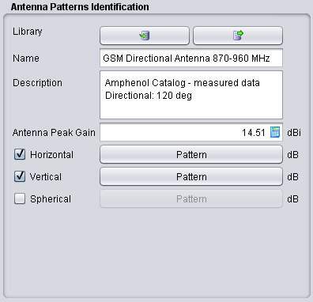
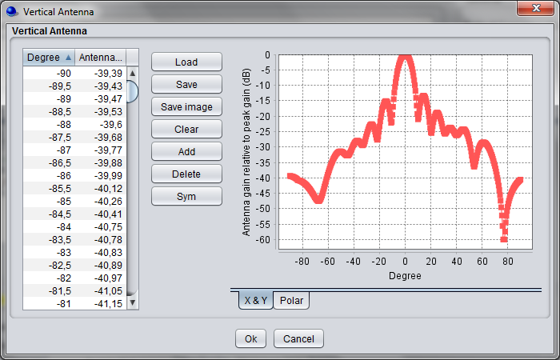
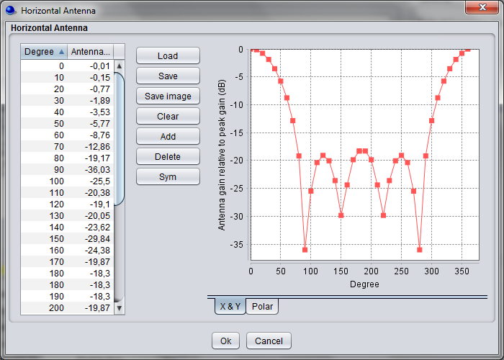
Table based antenna patterns
Table based antenna patterns can be defined separately in horizontal and/or vertical planes, or as a spherical pattern (0 to 180 degrees)
Antenna patterns can be saved and loaded from the library
Creating and editing antenna patterns is similar to editing masks

Slide 10
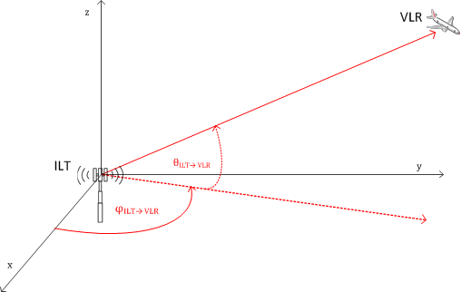
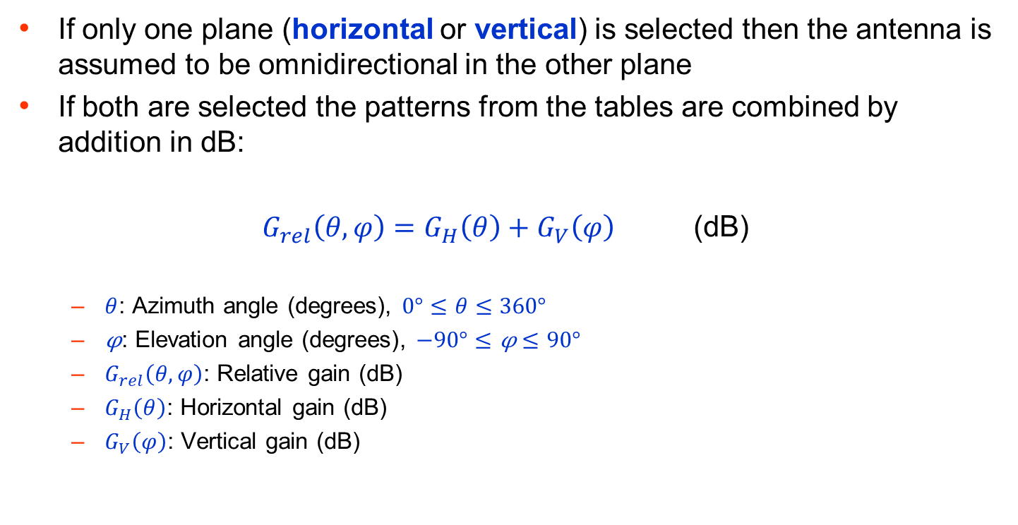
Horizontal/vertical patterns
If only one plane (horizontal or vertical) is selected then the antenna is assumed to be omnidirectional in the other plane
If both are selected the patterns from the tables are combined by addition in dB:
$G_{rel}\left(θ,φ\right)=G_{H}\left(θ\right)+G_{V}\left(φ\right)$ (dB)
  $θ$: Azimuth angle (degrees), $0°≤θ≤360°$
  $\text{φ}$: Elevation angle (degrees), $−90°≤\text{φ}≤90°$
  $G_{rel}\left(θ,φ\right)$: Relative gain (dB)
  $G_{H}\left(θ\right)$: Horizontal gain (dB)
  $G_{V}\left(φ\right)$: Vertical gain (dB)

Slide 11
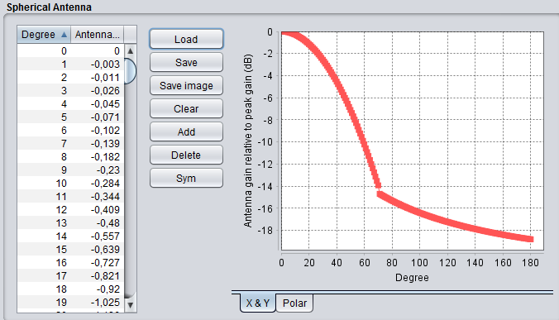
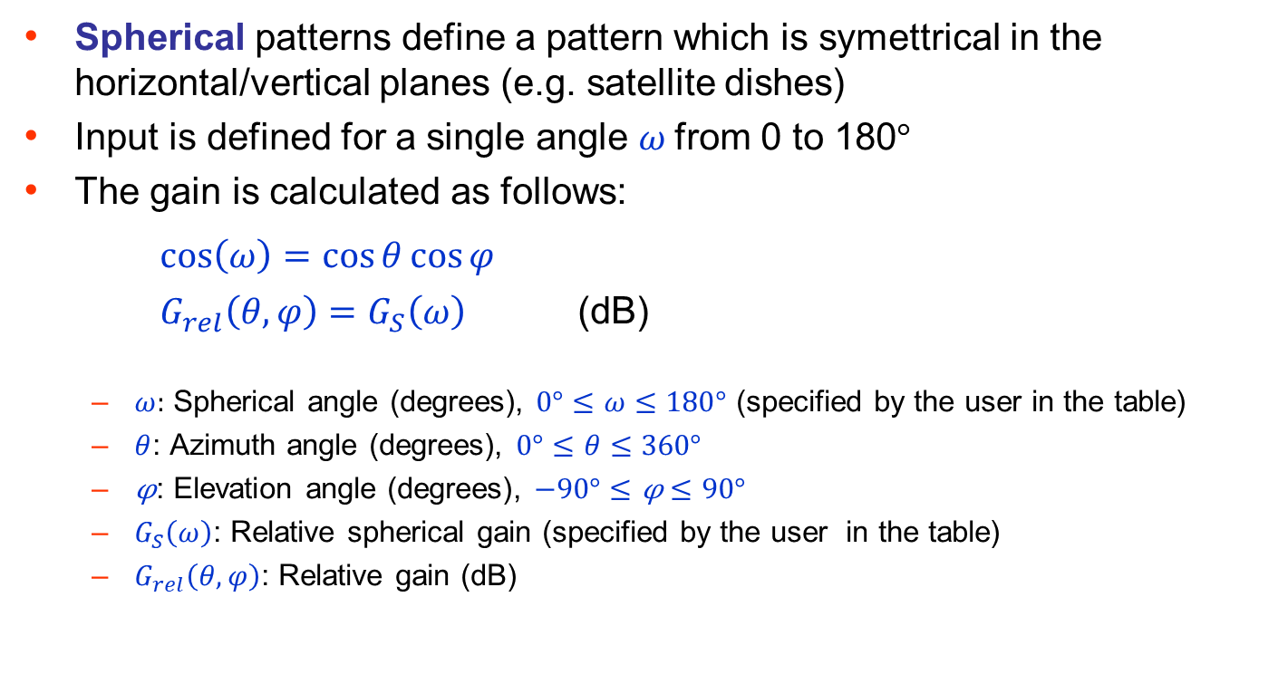
Spherical patterns
Spherical patterns define a pattern which is symettrical in the horizontal/vertical planes (e.g. satellite dishes)
Input is defined for a single angle $ω$from 0 to 180$°$
The gain is calculated as follows:
$cos\left(ω\right)=cos{θ}\cos{φ}$
$G_{rel}\left(θ,φ\right)=G_{S}\left(ω\right)$ (dB)
  $ω:$ Spherical angle (degrees), $0°≤ω≤180°$ (specified by the user in the table)
  $θ$: Azimuth angle (degrees), $0°≤θ≤360°$
  $\text{φ}$: Elevation angle (degrees), $−90°≤\text{φ}≤90°$
  $G_{S}\left(ω\right)$: Relative spherical gain (specified by the user in the table)
  $G_{rel}\left(θ,φ\right)$: Relative gain (dB)

Slide 12
Antenna patterns specified as equations
Antennas can also be specified with equations and defined as plugins - e.g. ITU-R Recommendations
With equation based plugins you only need to specify the peak gain and other defined parameters (e.g. sidelobe level, electrical tilt direction)
The pattern is calculated by SEAMCAT based on the user specified parameters
The following equation based plugins are available in the SEAMCAT library:
  ITU-R F.1336-4
  ITU-R F.699-7
  ITU-R F.1245-2
Beamforming antenna plugins for 5G systems are also now available

Slide 13
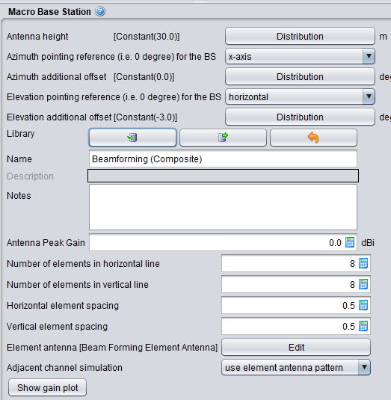
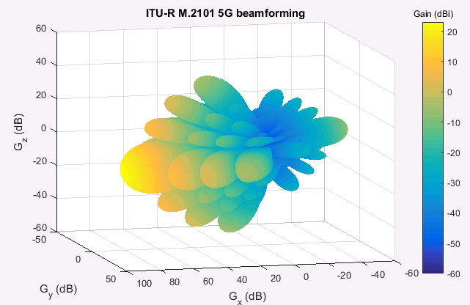
IMT-2020 beamforming antennas
In IMT-2020 (5G) systems it is possible to model multi-element active antenna systems which use dynamic beamforming (ITU-R M.2101/3GPP TS 37.840)
Beamforming antennas can be used for both base stations and mobiles
The single element pattern is defined separately as a normal antenna pattern from the library
Element antenna pattern defined independently
Option to configure correlation of beamforming in adjacent channel cases

Slide 14
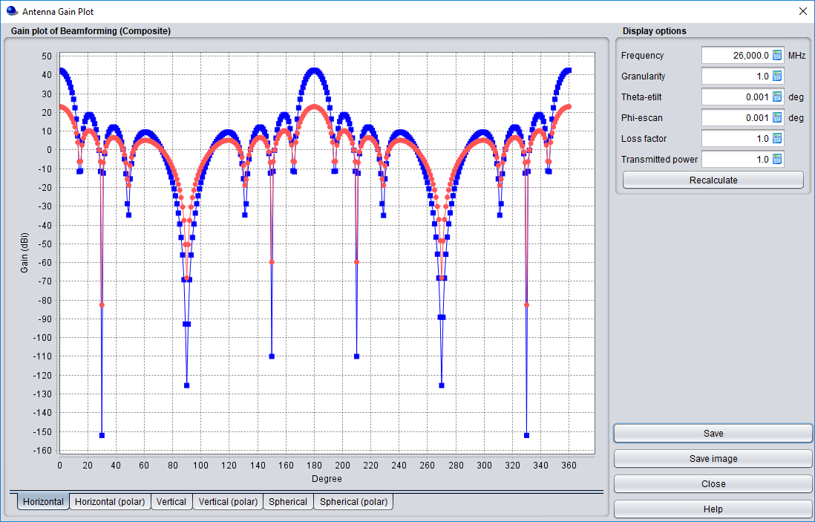
IMT-2020 beamforming antennas - plotting
User configurable angles and other parameters

Slide 15
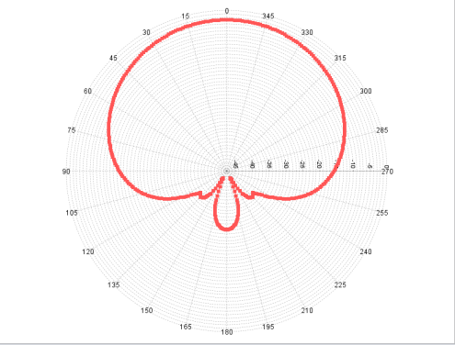
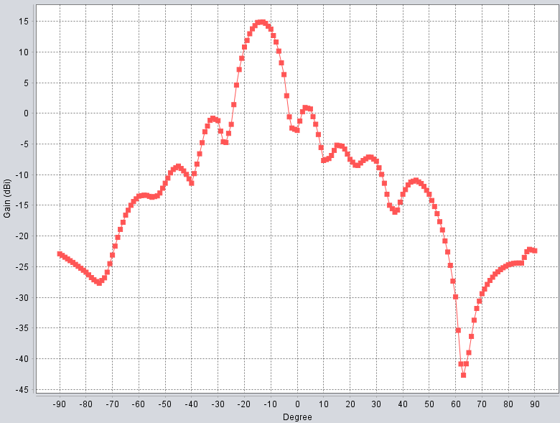
Exercise: Load a table based antenna pattern
Create a GSM 900 MHz base station antenna pattern
Use the information in the provided Excel file GSM900 BS antenna.xlsx
Ensure the pattern is converted into a format that can be read by SEAMCAT
Check that the full required range of angles are specified - assume the azimuth pattern is symmetrical
Explore the plotting and saving options
Compare your results with the existing GSM 900 MHz antenna available in the library

Slide 16
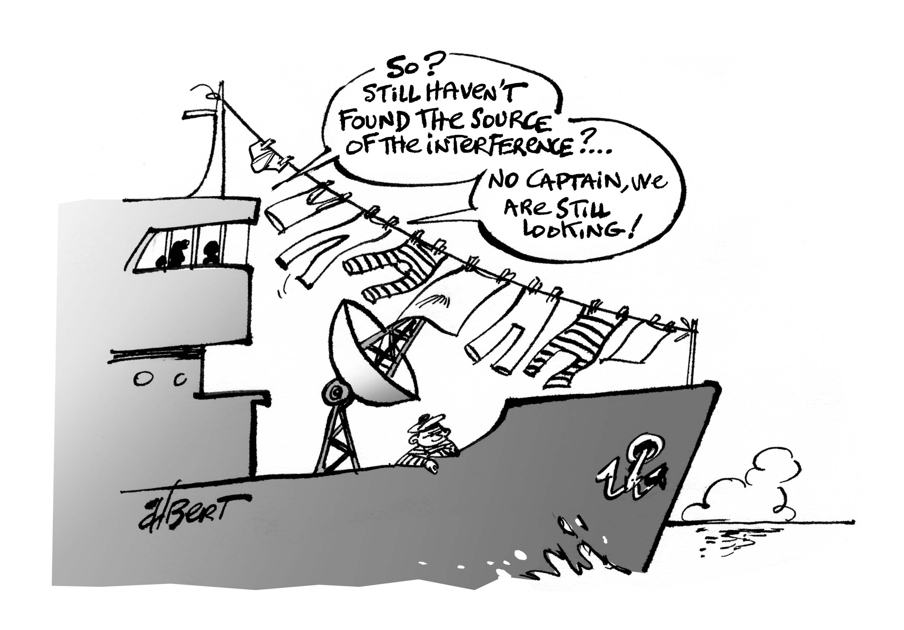
Thank you - Any Questions?

