Slide 1
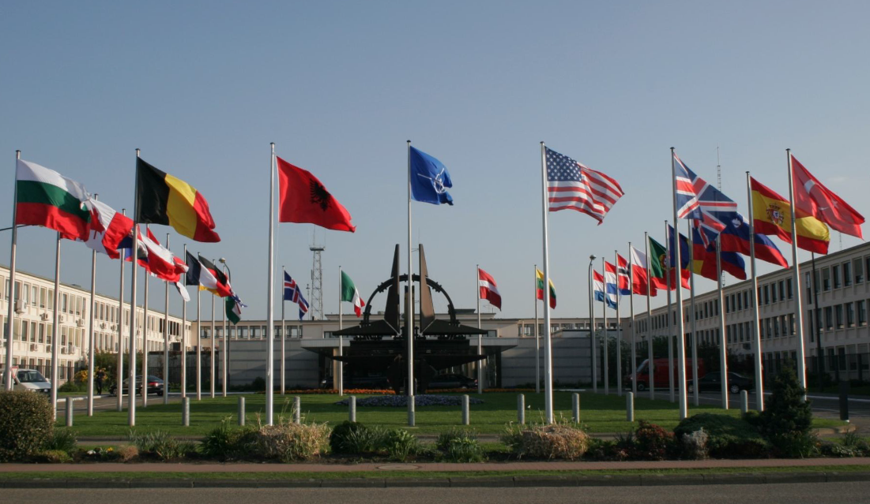

Slide 2
NATO Joint Civil/Military Frequency Agreement (NJFA) 2014
- Development, purpose and use -
Dietmar Poplawski
NATO HQ C3 Staff
Head Spectrum Policy
poplawski.dietmar@hq.nato.int

Slide 3

2 - Briefing Outline
NATO Spectrum Policy organisation
NJFA: purpose
NJFA: review and update
NJFA: use
Questions

Slide 4
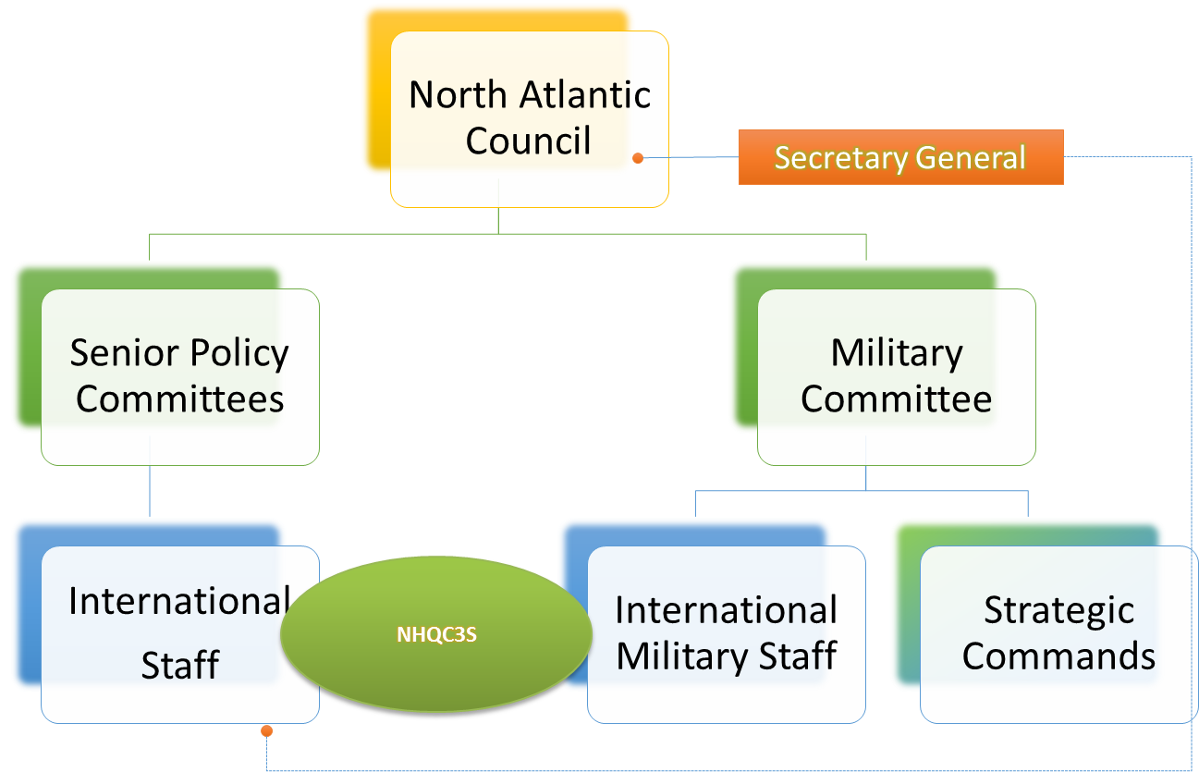
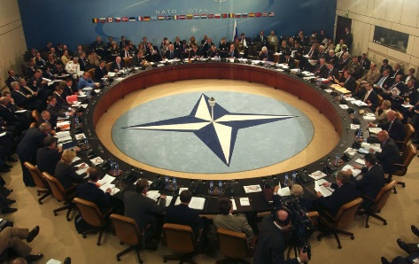
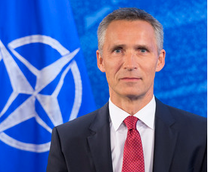
1 - NATO Structure

Slide 5
1 – C3 Committee / Staff
NATO HQ
North Atlantic Council (NAC)
support
IS
IMS
Consultation, Command
and Control Board (C3B)
support
NATO HQ C3 Staff
Capability Panel 1
(CaP1)
Comms & Info Systems
Capability Panel 2
(CaP2)
Navigation/
Identi-fication
Capability Panel 3
(CaP3)
Civ/Mil
Spectrum
Capability Panel 4
(CaP4)
Information Assurance &
Cyber Defense
Spectrum & C3 Infra Branch
(SC3IB)
CaT’s
CaT’s
CaT’s
CaT’s
support
CaT = Capability Team

Slide 6
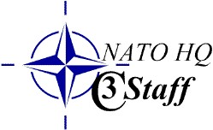
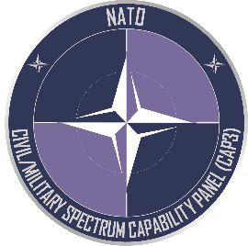
1 - NATO Spectrum Policy
Spectrum and C3 Infrastructure Branch
  Joint staff (international staff / international military staff)
  Supports MC- and NAC-structure (staff hierarchy)
  Supports Civil/Military Spectrum Capability Panel (CaP 3)
  (committee hierarchy)
Civil/Military Spectrum Capability Panel
  Delegated C3 Board decision making authority
  Sole competent source for advice and decision
  on spectrum management/policy in and for NATO
  Reports to C3 Board, Military Committee, North Atlantic Council
  WRCs, NJFA, NATO UHF Band 225-400 MHz, policies, positions
Unanimous decisions as NATO principle

Slide 7
2 – NJFA: Purpose
NATO Joint Civil/Military Frequency Agreement
      The joint agreement between the civil and military authorities of the NATO nations
      On the current and future use of the radio frequency (RF) spectrum for military purposes
      Required for NATO forces or in support of NATO
  First agreed in 1982, previous version Dec 2002
  Need for supplement for states of emergency and times of crisis or war under evaluation

Slide 8
2 – NJFA: Purpose
Sets out major common NATO military spectrum requirements
Defines harmonised NATO bands
Improves common use for military operations (interoperability)
Simplifies border-coordination
To protect major NATO military spectrum requirements

Slide 9
3 - NJFA Review and Update
NJFA first agreed in 1982, revised 1995 & 2002
Civ/mil CaP 3 update started in 2011 with
      Quantitative analysis by questionnaire
      Qualitative valuation
      Supporting NCIA* study
Civ/mil CaP 3 approved 2014; NAC approved 2015
To be reviewed after each WRC
* NATO Communications and Information Agency

Slide 10
3 – NJFA: Update
What does it look like?
Text part with scope and principles
Followed by tables on current and future military utilisation
Example of the table:
Table of Class X and X frequency bands
(a) Frequency Range (ECA table) | (b) Allocation used by Military | (c) Class | (d) Justification for the Military Requirement
225 - 399.9 MHz | MOBILE MOBILE-SATELLITE | A | The range 225-399.9 MHz is essential to NATO and is in military use for XX, XX…. This NATO UHF band 225-400 MHz is the only harmonised and commonly available resource managed by the NHQC3S/SC3IB Staff on behalf of CaP 3 on a daily basis. It is recognized that 380-385 MHz and 390-395 MHz are currently shared with narrowband Public Protection and Disaster Relief (PPDR) applications.

Slide 11
4 – NJFA: Use
To be applied by NATO-nations to the maximum extent possible
Recommended to be applied by Partner-nations
Implemented in the national frequency allocation tables
Reflected in the European Table of Frequency Allocations and Utilisations (ECA, ERC Report 25)
Public Version of the NJFA 2014 on request of the ECC - to be published soon -

Slide 12
4 – NJFA: Use
NJFA a tool for spectrum planning
To be used by administrations for/in:
The preparation of/at WRCs
The development of CEPT/EU regulations
The drafting of harmonisation measures for commercial services in Europe (ECC / EC)
The development of standards
The common funded & national procurement
…..

Slide 13
4 – NJFA: Use
  Reduces national and common costs
  Reduces coordination needs
  Improves management and organisation
  Improves efficiency and effectiveness
  Strengthens NATO capabilities
  Strengthens NATO

Slide 14

Question Time

