Slide 1

eCall – remaining issues & PSAP-DIR Update
16thG NaN Reykjavík, Iceland
29-31 May 2018

Slide 2
eCall – Remaining Issues
EENA Conference (Ljubljana, 25-27 April 2018)
Dedicated session on eCall Remaining Issues
Presentations on:
  Presentation on eCall experience - Spain
  Sharing MSD across the rescue chain – Beta 80 Group
  eCall Implementation and Open Issues – Portugal
Presentations mainly from PSAP perspective on important issues such as transferring MSD from PSAP to responders. Issues with TPSPs.
Some conclusions and recommendations on above.

Slide 3
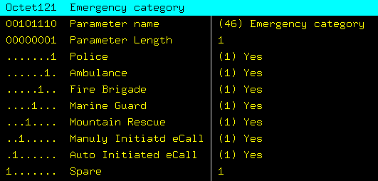
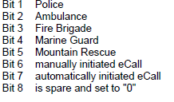
NaN-related issues #1 – Ghost Calls
Incorrect configuration of some handsets causing ghost calls.
According to ETSI 3GPP TS 24.008, a mobile station initiating an eCall shall set either bit 6 or 7 to 1.
Trace example from Portugal

Slide 4
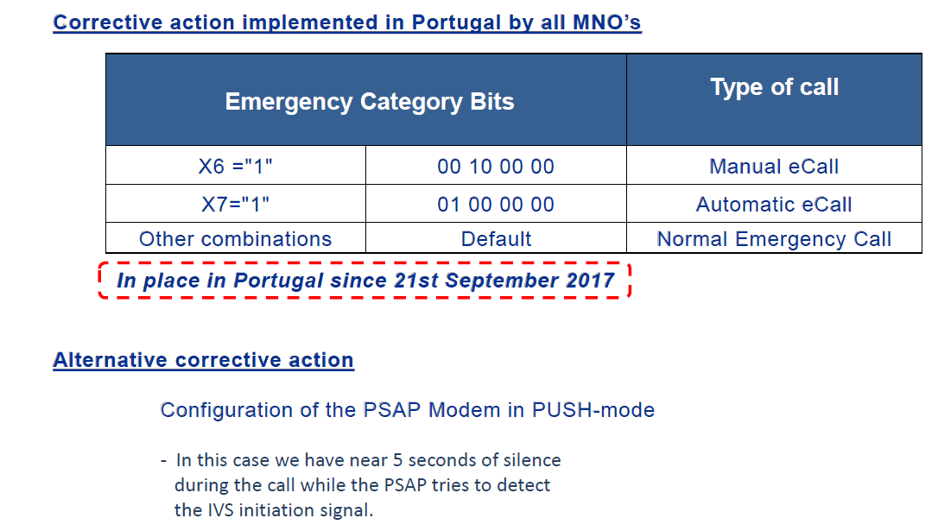
Numbering-related issues #1 – Ghost Calls

Slide 5
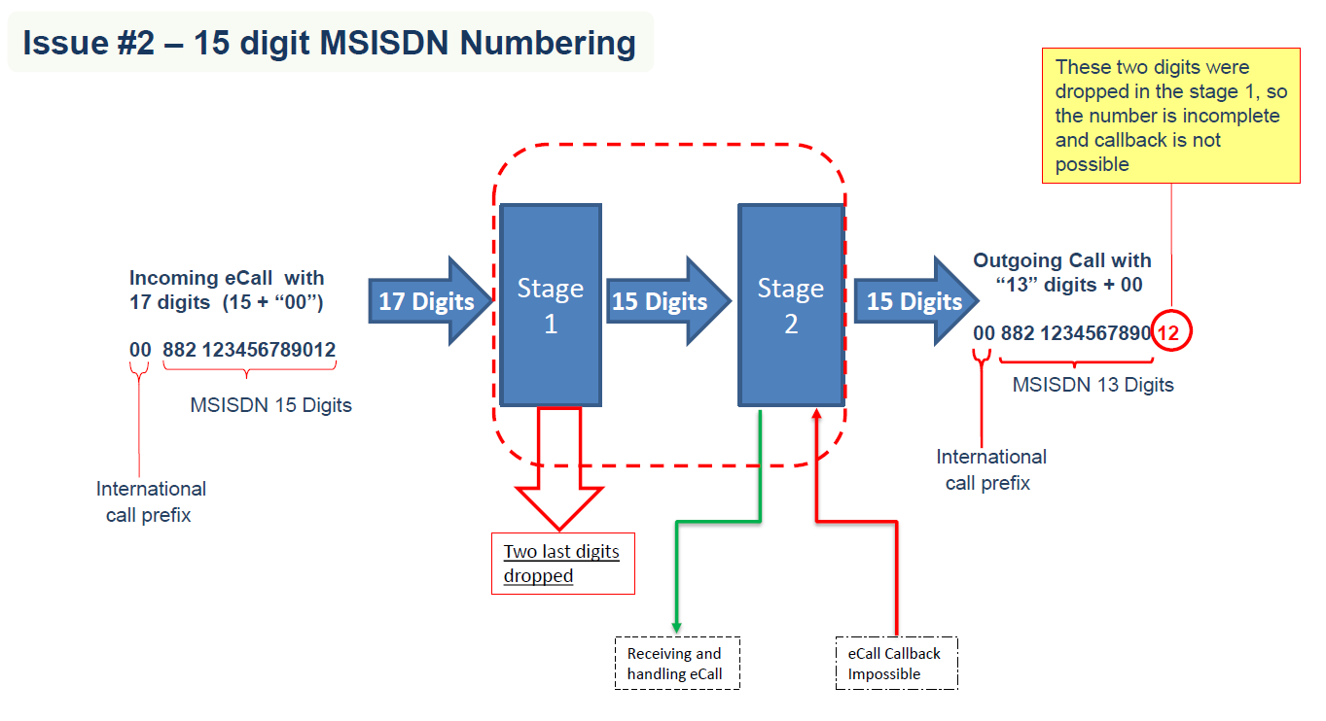
NaN-related issues #2 – 15-digit numbering

Slide 6
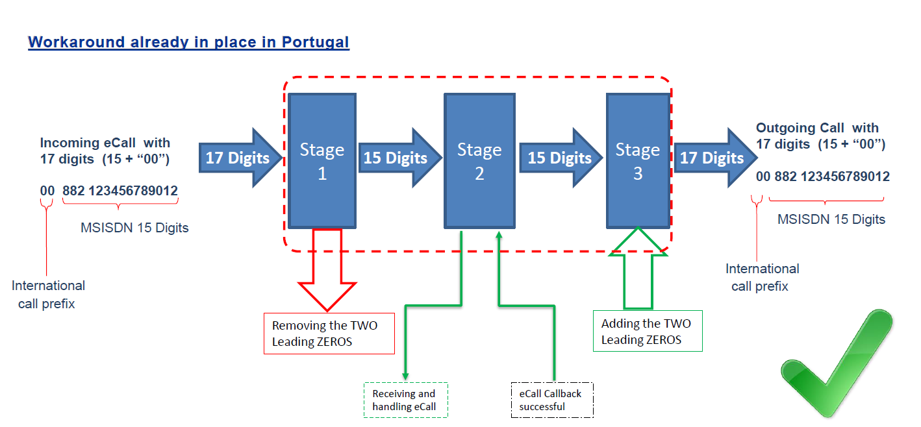
NaN-related issues #2 – 15-digit numbering

Slide 7
Statement from Vodafone Group
See Document NaN(2018-05)032
Issues re 15 digit numbering in Portugal, Slovenia,Netherlands & Denmark (DK issue relates to 12-digit limitation on fixed operator IT systems)
+88239 – further digit analysis to distinguish from satellite ranges
Incomplete CLI – no callback possible (as per Portuguese example)
Numbers need to be provisioned on fixed networks
Vodafone calls for:
  Call for assistance from national administrations
  EU database of numbers used for eCall to be published
Reasonable pricing on international numbering ranges

Slide 8
Draft contribution to ITU-SG2 from Orange
See Document NaN(2018-05)039
Proposal for statement in operational bulletin
To open access to +882 and +883 across all networks

Slide 9
eCall Remaining Issues
Discussion

Slide 10

PSAP-DIR - update
“an ECO-hosted directory to facilitate inter-PSAP communications in Europe”

Slide 11
Background
EENA Database for transnational emergency calls
    Contact details for 24 PSAPs in 19 European Countries
EENA letter to ECC - April 2015
    Encourage greater participation by European PSAPs by putting the directory “on a more formal footing with an appropriate public European body with the experience and expertise to manage it”
ECC Report 264 – Feasibility Study adopted in May 2017
    Why is there a need for PSAP-DIR?
    Is it an appropriate activity for the ECC?
    Are their risks for the ECO?
    Legal and cost considerations
ECC decided to proceed in June 2017
ECO Council, following consideration of financial and legal aspects, agreed to commit resources to the project in December 2017.

Slide 12
PSAP-DIR features
Participation is voluntary and free of charge for PSAPs
Secure portal. Unique watermarked and password protected .pdf can be downloaded by authorised PSAP representatives and used locally.
New entries/updates communicated to participating PSAPs immediately
PSAPs take ownership of their contact information in the directory
Contains the following information:
  PSAP Name, Country, Telephone Number, Non-Personal email address, PSAP type (primary, backup, police, fire, ambulance etc.)

Slide 13
Project Plan (1)
Project Kick-Off (13 February 2018 – web meeting with stakeholders)
Parallel running of administrative and technical work (February 2018 – September 2018)
  Administrative tasks –
    Notification to current EENA transnational DB members to obtain letter from relevant national authority and sign participation agreement with ECO (notification sent 19 February 2018)
    Notification to all other PSAPs at EENA conference (25-27 April 2018)
  Technical tasks – Software development and testing – in progress.
ECO will be technically ready by August 2018
EENA to discontinue transnational database from 01 December 2018

Slide 14
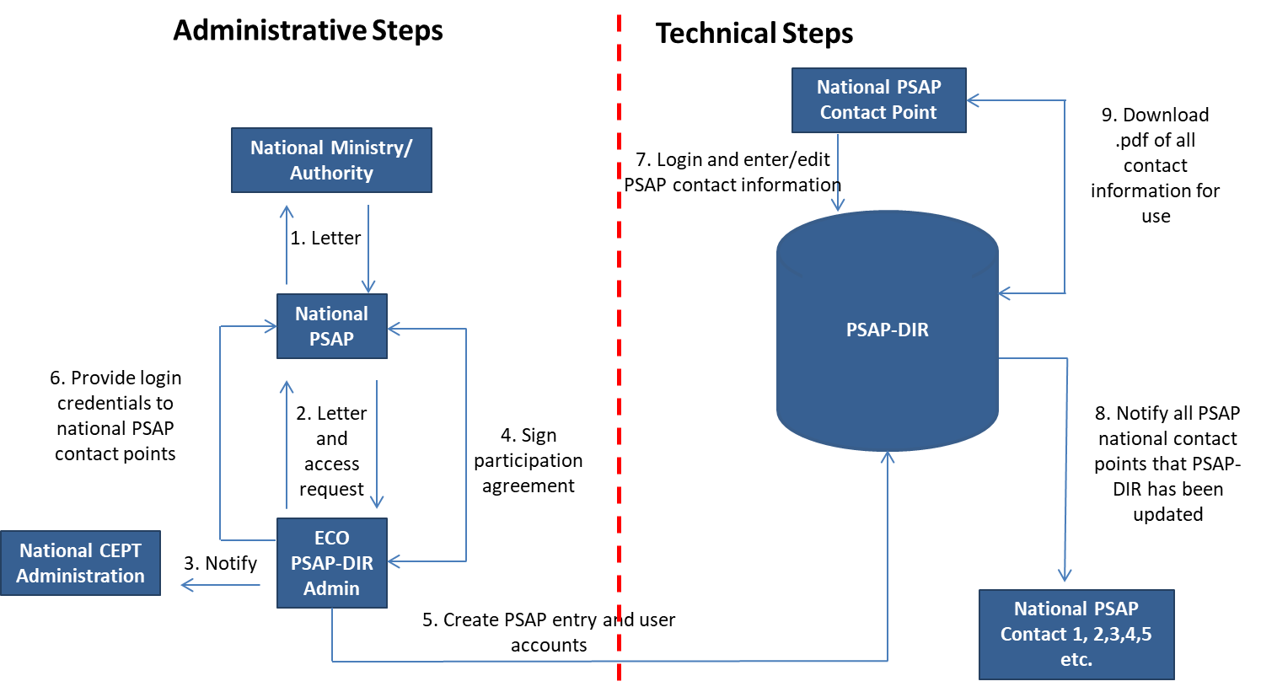
Project Plan (2)

Slide 15
PSAPs signed up so far
Letters received from 10 countries so far (Ireland, Finland, Slovak Republic, Georgia, Poland, The Netherlands, Croatia, Romania, Czech Republic and Latvia)
Letters expected soon from Estonia, Lithuania, UK, Sweden and others
The Netherlands is the first to sign a participation agreement with the ECO.
“If you want to participate or have any questions then please contact me!”

Slide 16

Any questions?
Contact:
  Freddie McBride BBS MSc DipRegGov
  freddie.mcbride@eco.cept.org
  +45 33 89 63 22
European Communications Office:
  www.cept.org/eco
  Follow us on Twitter – @CEPT_ECC

