Slide 1
Executive summary from the
EENA Conference & Exhibition 2023
WG NaN – 26th Meeting
Hybrid meeting, 20-22 June 2023
Budapest, Hungary
Vassil Krastev, European Communications Office

Slide 2
EENA Conference 2023
19-21 April, Ljubljana, Slovenia
European Emergency Number Association (EENA)
  500+ emergency services representatives from over 80 countries worldwide
  100+ solution providers
  100+ researchers
  200+ Members of the European Parliament
Annual commercial conference with an exhibitors’ area
Discussion platform for emergency services, public authorities, decision makers, researchers, associations and solution providers
EENA Conference 2023
  800+ participants
  100+ speakers
  35+ exhibitors
  50+ countries

Slide 3
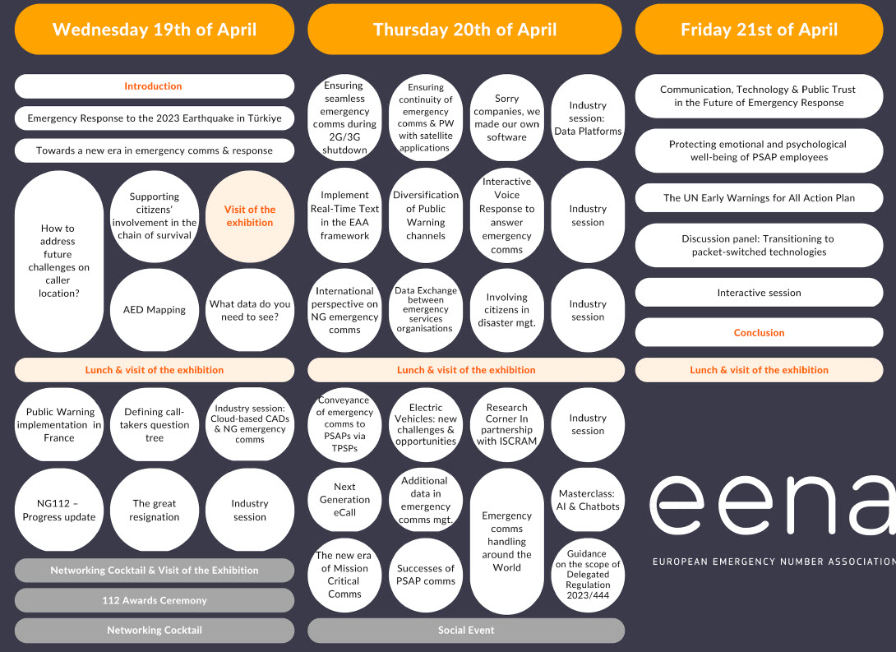
Programme overview

Slide 4
Focus areas of interest to WG NaN
Caller location (AML)
Public Warning Systems (PWS)
2G/3G shutdown
Next Generation 112 (NG112) emergency communications
Real-Time Text in the EAA framework
Next Generation eCall
Guidance on the scope of the Delegated Regulation 2023/44
Transition to packet-switched technologies.
PSAP Directory

Slide 5
Focus areas of interest to WG NaN
Public Warning implementation in France
  PWS will rely on both cell broadcast and location-based SMS
  technical and operational aspects of the implementation
2G and 3G shutdown
  incorrect interpretation/implementation of technical standards for VoLTE
  varying degrees of capabilities of chipsets installed in handsets
  interoperability issues between networks and handsets for support of IPv4/IPv6
  limited implementation of VoLTE roaming agreements between MNOs
  2G/3G unavailability on visited network and no CS fallback.

Slide 6
Focus areas of interest to WG NaN
NG112 projects/deployments
  Portugal, Switzerland, and North Macedonia shared their insights and experiences on their respective NG112 projects/deployments.
  Highlighted challenges
    definition and understanding of the exact PSAP requirements
    common interfaces for voice service providers (VSPs), PSAPs, and their suppliers
    defining use and test cases
    end-to-end design that allows VSPs and PSAPs to migrate to NG112 in parallel and independently

Slide 7
Focus areas of interest to WG NaN
Implementing Real-Time Text (RTT) in the framework of the European Accessibility Act (EAA)
  access to emergency services for end-users with disabilities to be “functionally equivalent” to a regular call to 112
  requirement for the implementation of RTT by June 2027
  RTT implementation plans and projects were presented and what a functionally equivalent RTT service looks like
Next Generation eCall
  evolution of eCall to its Next Generation based on IP and how to implement NG eCall

Slide 8
Focus areas of interest to WG NaN
Delegated Regulation (EU) 2023/444)
  entered into force on 5 March 2023
  supplements the requirements of Article 109 of the EECC with regard to the establishment and provision of caller location information, equivalent access to emergency services, through emergency communications for end-users with disabilities and the routing of emergency communications to the most appropriate PSAP.
  imposes reporting deadlines for various matters related to location, equivalent access and PSAP upgrades.
  objectives of the regulation and guidance to EU Member States’ competent authorities to implement its requirements.

Slide 9
Focus areas of interest to WG NaN
Transitioning to packet-switched technologies
  upgrade PSAP infrastructure to efficiently receive and process all types of emergency communications and contextual data.
  technical and regulatory drivers for change
  EU Member States must submit roadmaps for the transitioning of their PSAPs to packet-switched technologies to the European Commission by 5 December 2023.
  challenges and strategies for transitioning to packet-switched technologies, including the need for reliable and resilient handsets and networks, cybersecurity concerns, and training requirements for call takers.

Slide 10
Focus areas of interest to WG NaN
PSAP Directory
  ECO signed the PSAP Directory participation agreement with the Czech Republic.
  ECO held discussions with representatives from
    Switzerland
    Italy
    Latvia
    Norway
    France
    Germany
    on joining the PSAP Directory and how to facilitate the process.

Slide 11
More information and next event
EENA Conference 2023 presentations
  Public presentations (Dropbox)
EENA CONFERENCE & EXHIBITION 2024
  24-26 April 2024, Valencia, Spain

Slide 12


Thank you for your attention!

