Slide 1
Techniques for Mitigating Fraud (USA): DNO and Traceback
ECC Workshop on Combating Fraudulent Communications
July 2024
Somos, Somos and Design, 4 Quarters Design, RouteLink, , SMS/800 TFNRegistry Design, TSSRegistry Design, TFNIdentity Design, SomosID Design and RealNumber Design are trademarks of Somos.
Copyright 2024 Somos, Inc. All rights reserved.

Slide 2

Somos U.S. Number Administration Responsibilities
FCC
North American Numbering Plan Administrator
(NANPA)
Toll Free Number Administrator
(TFNA)
Reassigned Numbers Database Administrator (RNDA)
Provisioning and assignment of 10-digit, geographic numbers
Provisioning and Porting of Toll-Free numbers
Subscription-based querying service for all disconnected TNs in the U.S.

Slide 3



What is the Problem?
Sources:

Slide 4




DNO as a Solution
Unassigned / Unallocated / Invalid
Inbound Contact Centers
Billing & Stationary Numbers
IoT Numbers

Slide 5
How can DNO Support Fraud Mitigation Efforts?
Numbers that have been assigned to a provider w/active or pending service
NPA and NXX ranges that are invalid and cannot be utilized (ex. In the U.S. 0 [zero] and 1 [one] are invalid in A and D location of the numbering plan)
Numbers in-service but either Do Not Originate or are IoT/data only (can include enterprise, inbound only numbers)
NPAs that are either unassigned or not available for assignment (ex. NPAs w/N11, 555, 950 or 988)
Number ranges where the NPAs are assigned and number ranges are pending allocation
NANP Numbering Format: NXX-NXX-XXXX / N=2-9 and X=0-9 Digit location = ABC-DEF-GHIJ
*Denotes assumption, based on frequency of numbering application requests

Slide 6

DNO Results
Leading Wireless Provider
90%
Reduction in Reported Robocalls
Tier 1 Carrier
3%
Hit Rate Upon Implementation
1B
Calls per Day Screened Against
DNO
Gateway Provider
17%
Hit Rate Upon Implementation
2023
10%
Of ITG Tracebacks were on RealNumber® DNO List
This is results from our commercial DNO product.

Slide 7
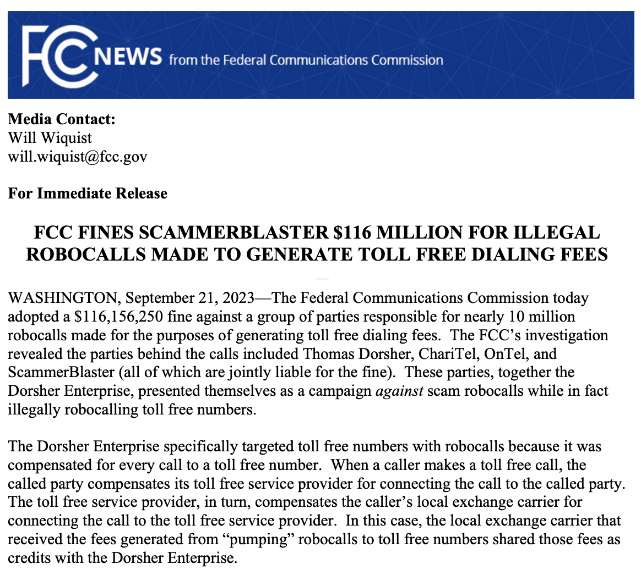
Traceback and Enforcement

Slide 8
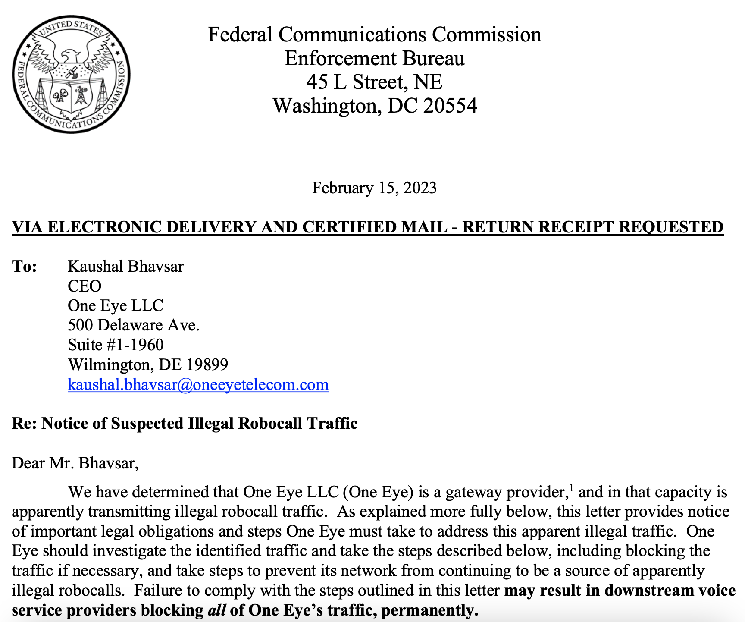
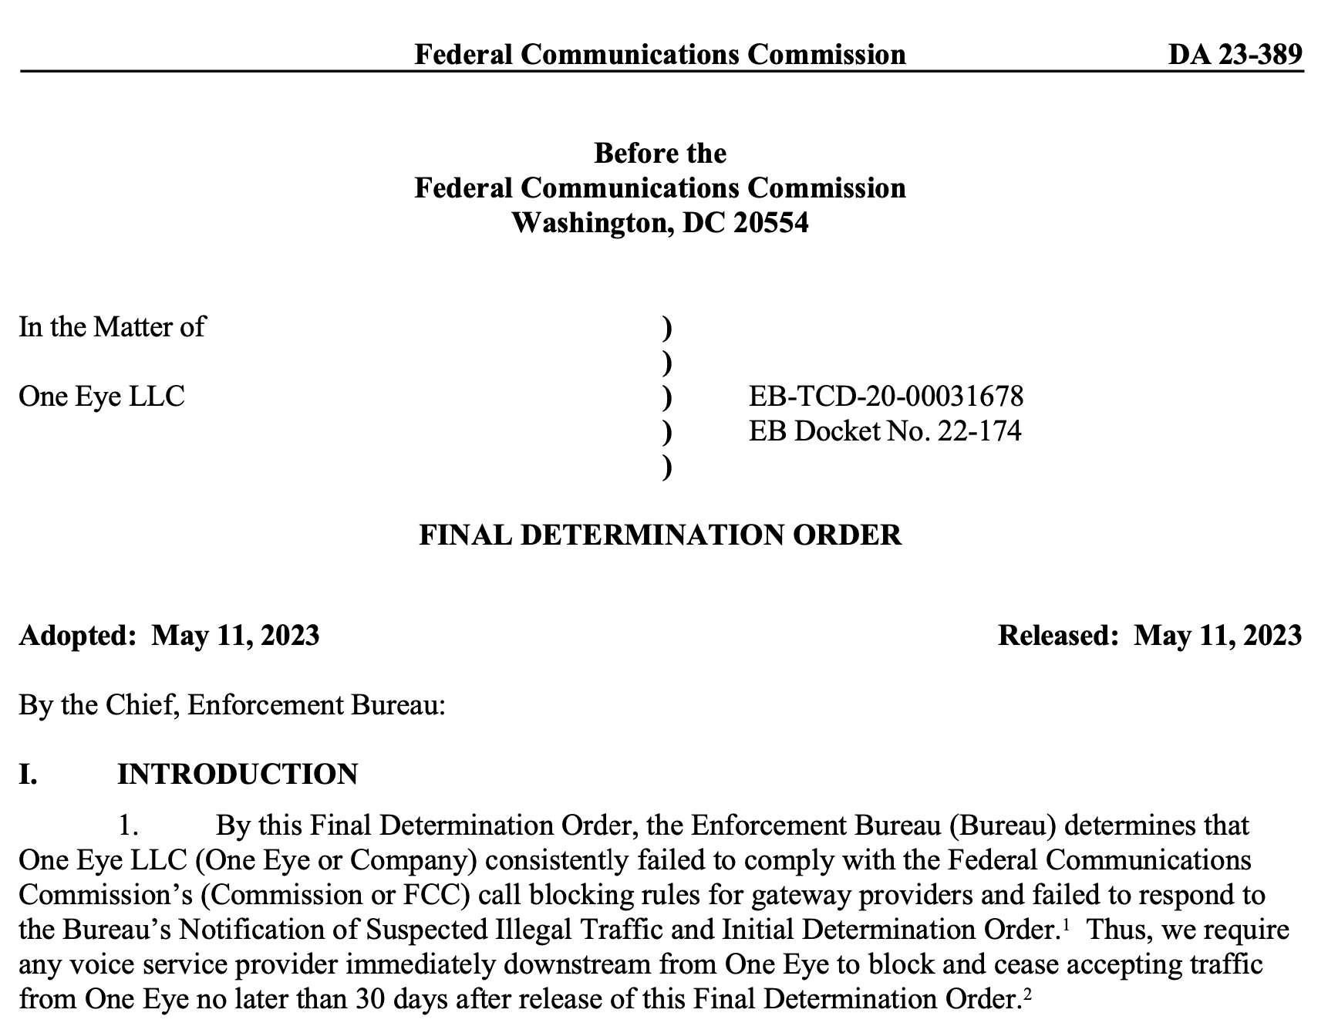
Robocall Mitigation Database and Enforcement

Slide 9
Collective Fraud Mitigation Impact
Robocalls
BILLIONS
Robotexts
BILLIONS
Sources:

Slide 10
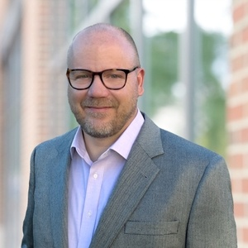
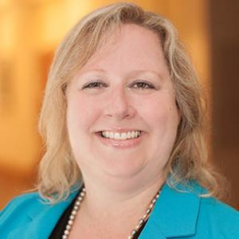
Contact
Justen Davis
Senior Director, Industry Relations and Public Policy
Call or Text | 844-HEY-JUSTEN or 844-439-5878
Email | jdavis@somos.com
Web | www.somos.com
Ann Berkowitz
SVP & CAO, Strategic Public Policy & Number Administration
Call or Text | 844-800-HI-ANN or 844-800-4424
Email | aberkowitz@somos.com
Web | www.somos.com

